Slide 1
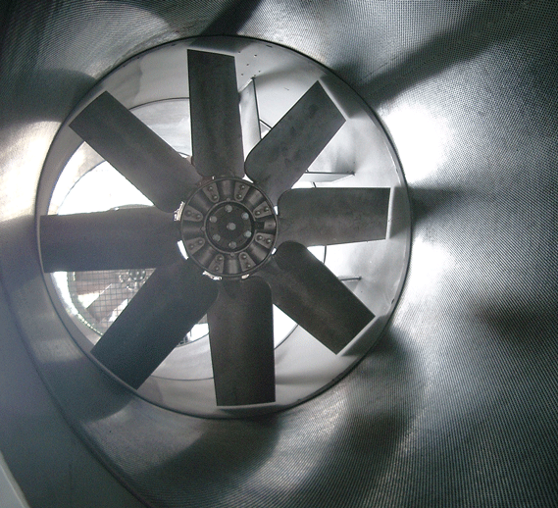
Automatic Control
LET085 Project
Andreas Johansson
John Croft

Slide 2
Outline
Overview
Implementations
Results

Slide 3
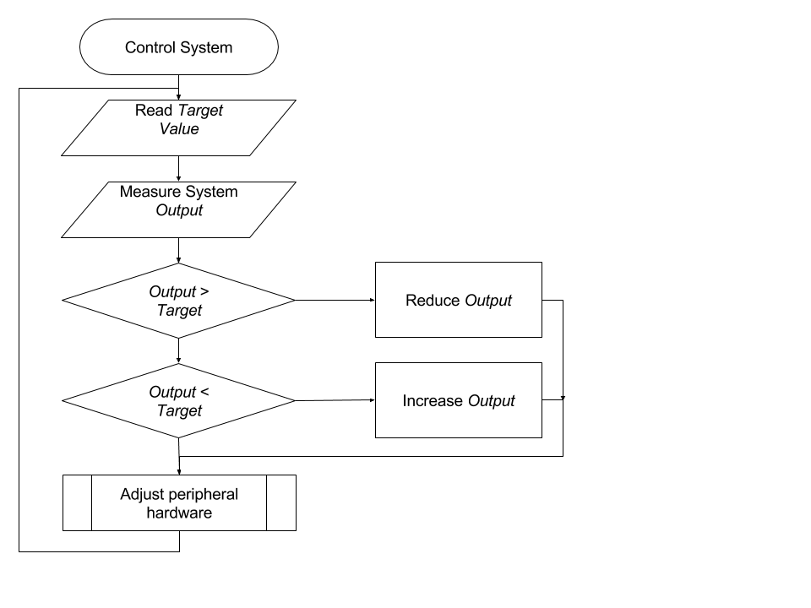
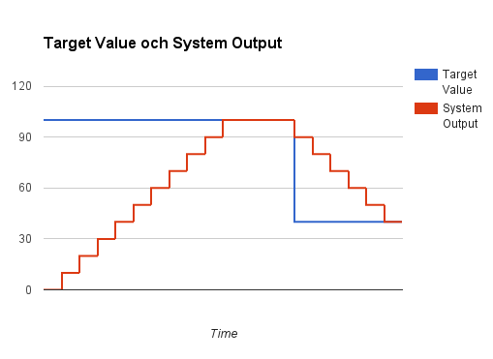
General Overview

Slide 4
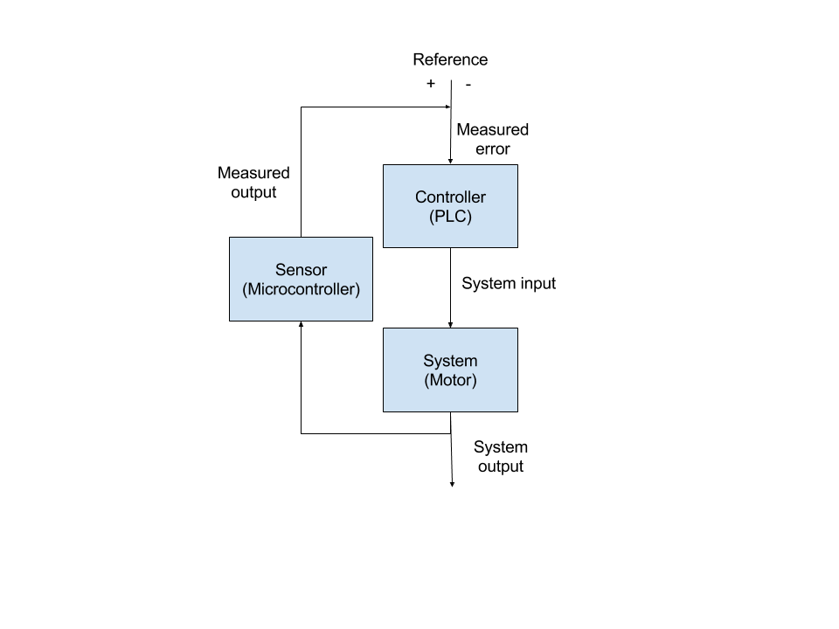
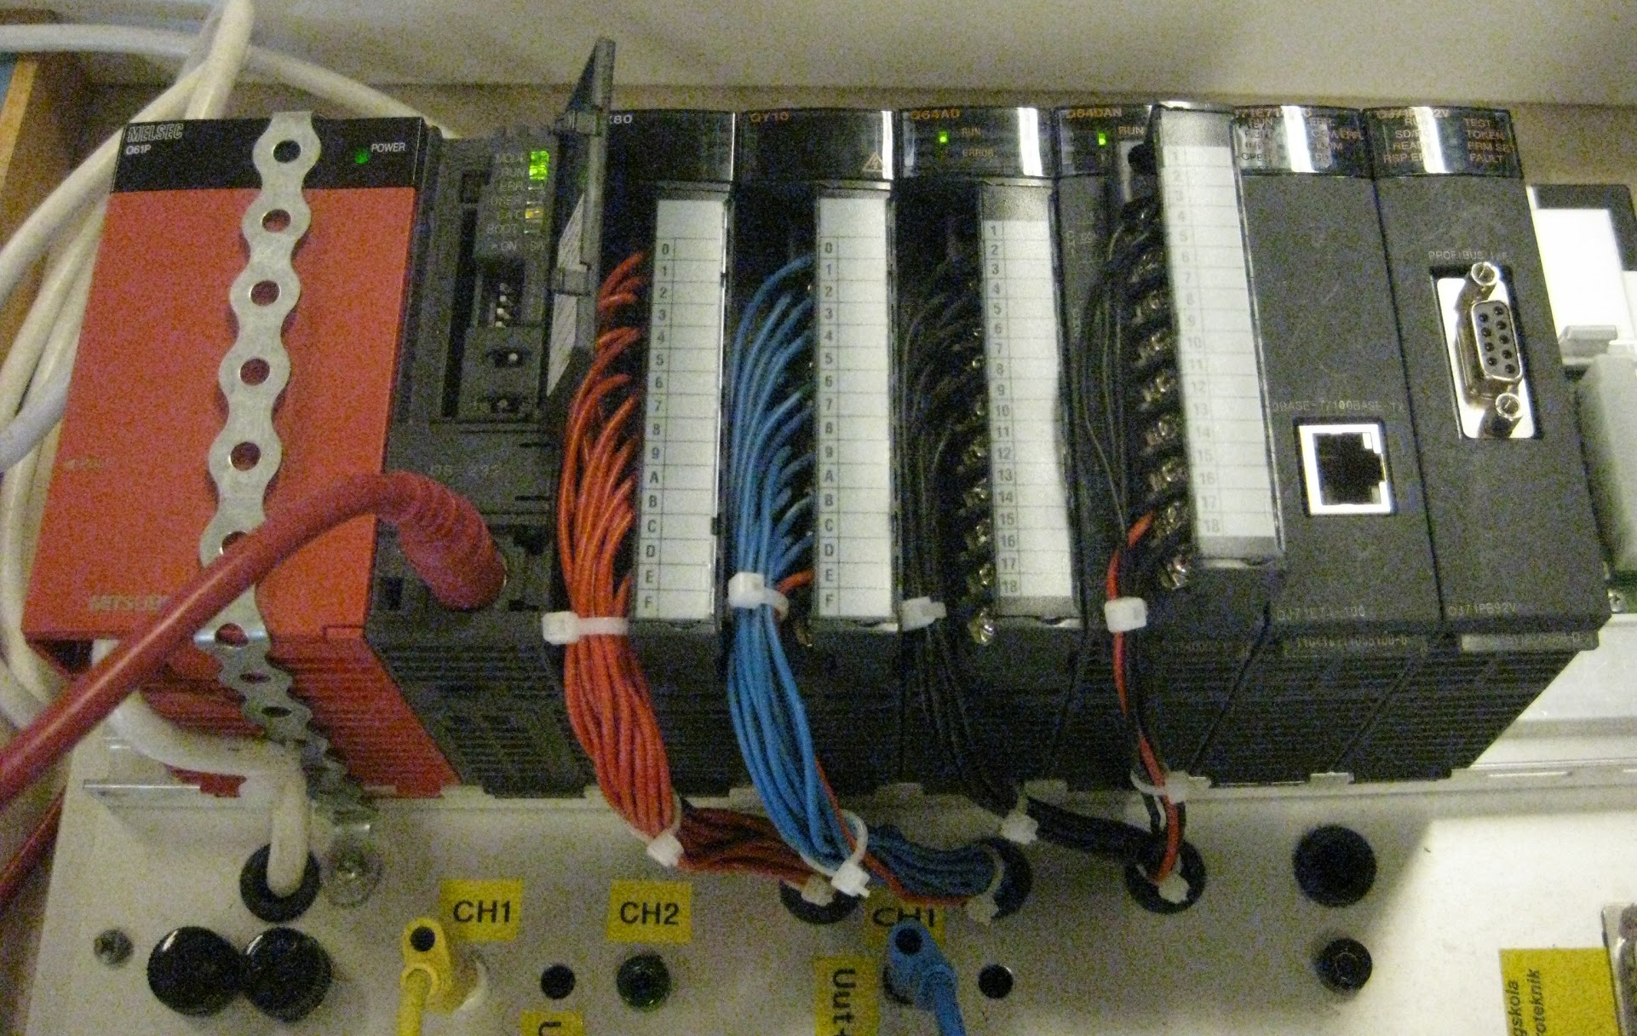
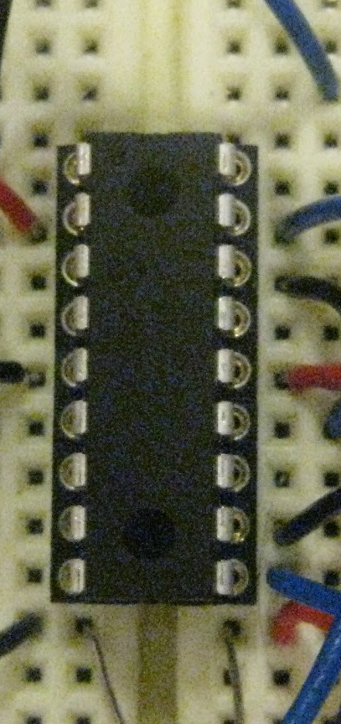
Implementation
Programmable Logic Controller
Common in heavy industry
Electrically & physically robust
Uses specialized programming
languages
PIC16F1827 microcontroller
Mass produced
Electrically vulnerable
Compatible with common programming languages

Slide 5
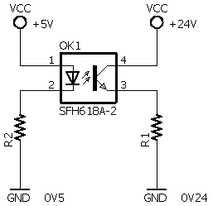
Obstacles
LED
Phototransistor
Galvanic Isolation

Slide 6
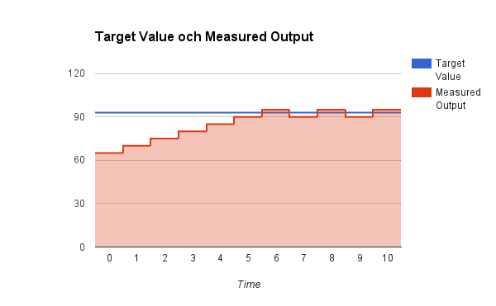
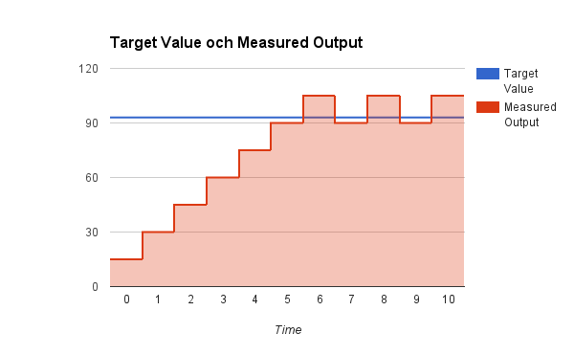
Problems Encountered
Accurate but slow
Fast but innaccurate
Large oscillation around target

Slide 7
Results
Responsiveness vs. accuracy
Loose specifications = unclear requirements

Slide 8
Fin
Questions?

