Slide 1

Thesis Presentation -
Mobile Electroencephalography
(EEG)
John Croft (EI)
Christoffer Olsson (DAI)
Notes:
(45 sec)
Welcome audience.
Introduce ourselves.
Today we’re going to talk about our thesis project ...

Slide 2
Agenda
What an EEG is and how it’s used (Background) .
The project objective.
Potential problems & possible solutions.
Conclusion.
Notes:
Speaker: Christoffer
So, to dive right in…
First we’ll talk a little about…
Then we’ll move on to the main objectives of the project…
After that we’ll present a few challenging aspects of the project as well as a few solutions…
Lastly, we’ll round off with a

Slide 3
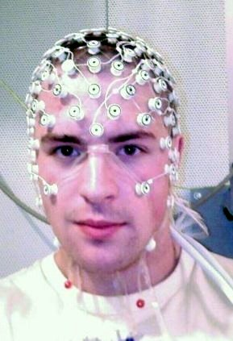
Background
Notes:
(3 min)
So, a bit of background...

Slide 4
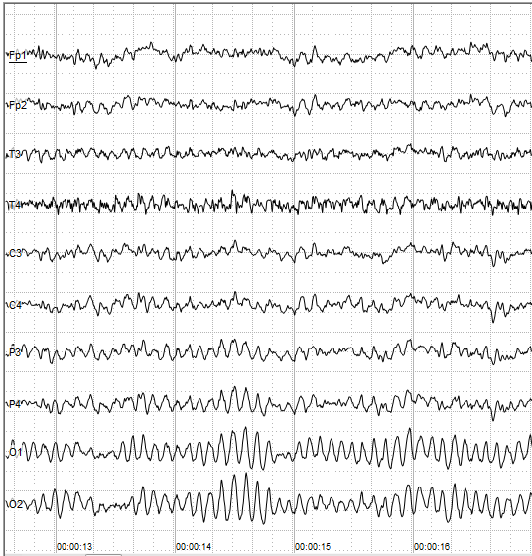
What is EEG?
A method of measuring electrical activity (biopotentials) in the brain via sensors (electrodes), and presenting the data in visual form.
Not unlike an oscilloscope!
Though with many more signals that are measured in parallel.
No clear ground/reference point (more on this later...).
Notes:
Speaker: Christoffer
Just what is electroencephalography?
To put it simply, it is a method of measuring electrical activity in the brain and displaying it in visual form, such as in a graph.
This may remoind you of an oscilloscope, though there are a few key differences
Far more measurements are taken in parallel
These measurements are essentially “floating”, the human body doesn’t really have a common ground, making measurements tricky (more on this later).

Slide 5
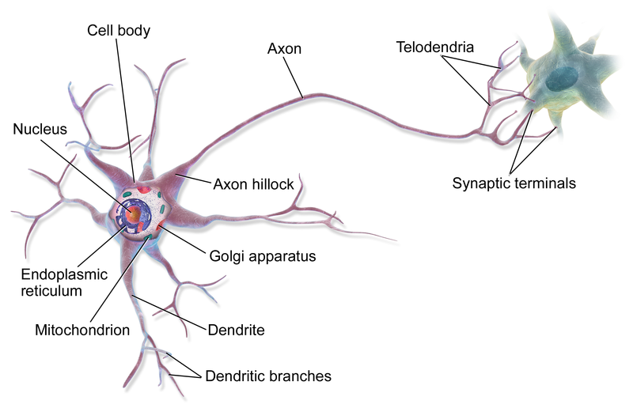
How does it work?
Neurons (specialised nerves in the brain and spinal cord) are in constant communication via electrochemical signaling.
Each signal generates a slight biopotential (voltage).
One neuron “firing” has little effect, but a large group generates a measurable voltage (1-100µV) on the surface of the skin.
Notes:
Speaker: John
So how does this work?
The brain consists of specialised nerve cells that are in constant communication via electrochemical signaling
Inidividual cells make no measureable impact.
Large groups “firing” at once, however, generates a measureable voltage on the surface of the scalp.
Typically on the order of 10s of microvolts.

Slide 6
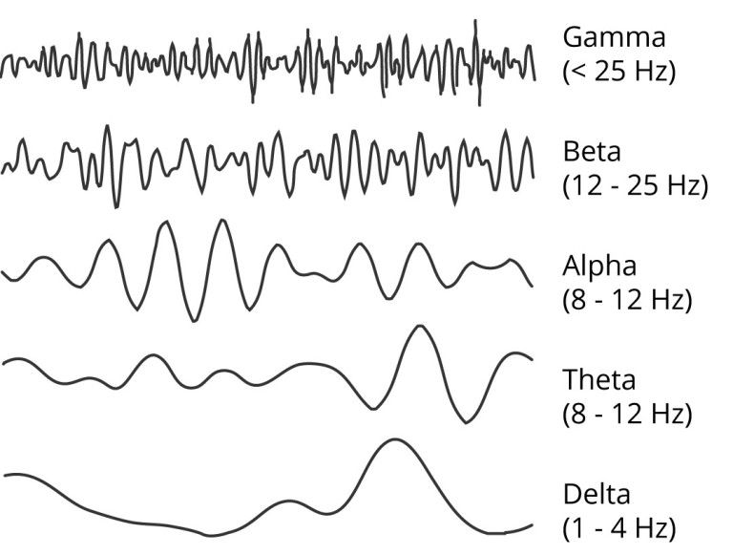
Neural Oscillations
Sinusoidal.
Frequency and amplitude are defining characteristics.
Notes:
Speaker: John
What we’re interested in seeing are particular patterns in the measured signals.
Sinusoids categorized by frequency and amplitude.

Slide 7
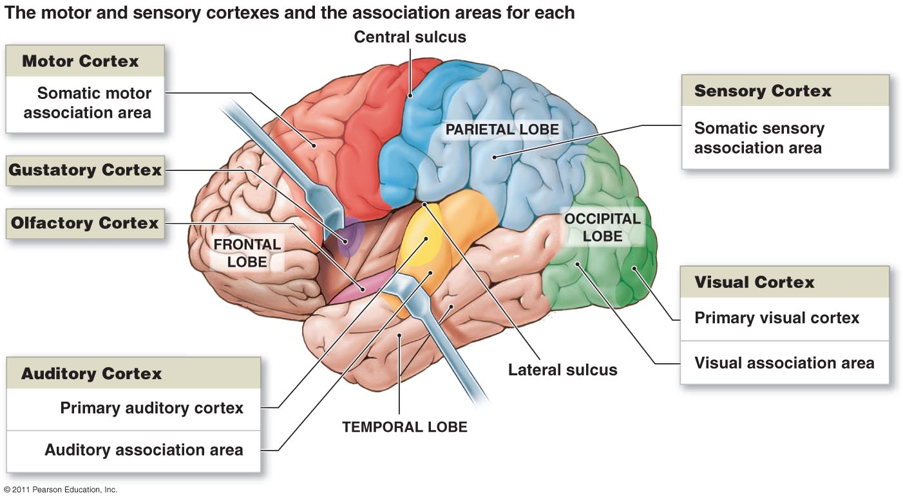
Neural Oscillations
Different parts of the brain produce different electrical activity.
Measured signals are highly dependent on location!
Notes:
Speaker: John
The measured signal will depend on what part of the brain is being measured
As you can see the brain is divided by function into “lobes”.
The frontal lobe, for instance, might produce beta waves during a high level of mental engagement.

Slide 8
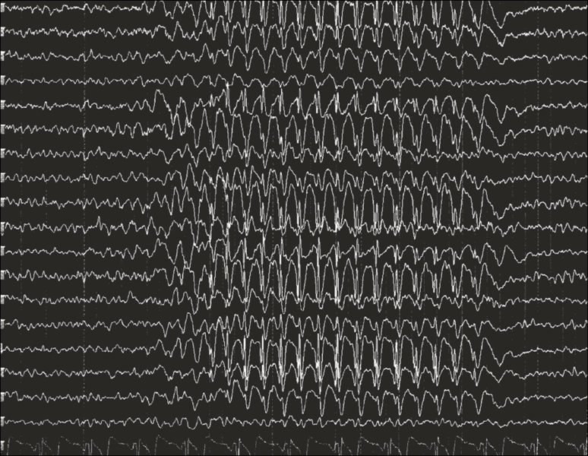
Uses of EEG
Record patterns in brain activity during various states of consciousness.
Help diagnose epilepsy, sleep disorders, coma severity and brain death, to name a few.
To the right is an example of an epileptic seizure.
Notes:
Speaker: Christoffer

Slide 9
The Objective
Notes:
(1-2 min)

Slide 10
Making it Mobile
Broaden the range of locations and activities where it may be used.
Same functionality as a regular EEG
Potentially shorten time to apply device to patient.
Simultaneously record
Stimuli: video and audio.
Response: neural activity and eye-movement.
Notes:
Speaker: Christoffer
Locations: Ambulande, at home, private use

Slide 11
Potential Problems
& Solutions
Notes:
(4-5 min)

Slide 12
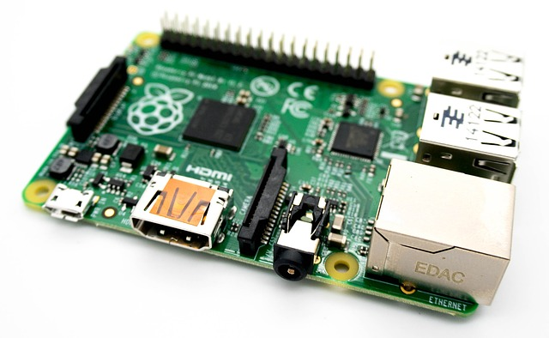
Mobility
The entire system must be:
stand-alone.
powered from a single battery.
lightweight & efficient.
Relatively fast & powerful
Still have enough processing power handle large volumes of data.
Solution: an SBC (single board computer) fulfills these criteria. In this case a Raspberry Pi.
Notes:
Speaker: Christoffer
The mobility itself….
As you can see, the system must fulfil certain criteria in order to be feasable in practice.

Slide 13
Synchronisation
Data from multiple external sensors (electrodes, camera & microphone) must be read in parallel and timestamped.
This requires:
fast processing
near-parallel signal acquisition
Solution: Offloading signal sampling to dedicated subsystems, such as purpose-built ASICs then using software to sort and log data to a database.
Notes:
Speaker: John
Multiple sensors need read in parallel, to preserve the context, and then logged in a database with associated timestamps

Slide 14
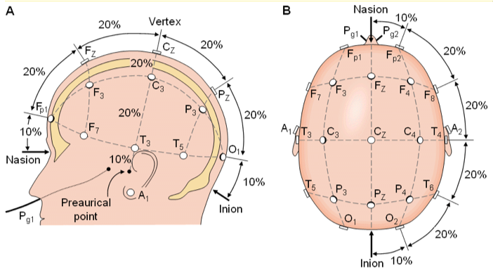
Signal Sampling
Measuring the human body is non-trivial.
How should the electrodes be positioned?
10-20 system.
What should voltage measurements be referenced to?
What is the “ground” in this scenario?
Analog-to-digital conversion (ADC)
Which method should be used for optimal results?
Noise, speed and accuracy must be considered.
Notes:
Speaker: John

Slide 15
Data accuracy while moving
Motor-neurons generate stronger electrical signals than those of non-motor neurons (by orders of magnitude!).
This often leads to unacceptably noisy measurements.
This greatly impacts the usage of a mobile EEG.
Notes:
Speaker: John
Not as important, may skip.

Slide 16
Next steps...
Create platform for synchronous data acquisition.
Construct working signal amplifier, capable of detecting neural oscillations in the occipital lobe.
Distinctive activity.
Useful for calibration.
Notes:
Speaker: JOHN??
Not as important, may skip.

Slide 17
In conclusion
EEG measures and displays electrical activity in the brain.
Benefits presented by a mobile solution.
Designing an EEG system to be mobile presents many significant engineering challenges.
Mobility
Synchronization
Sampling
Notes:
(1 min)

Slide 18
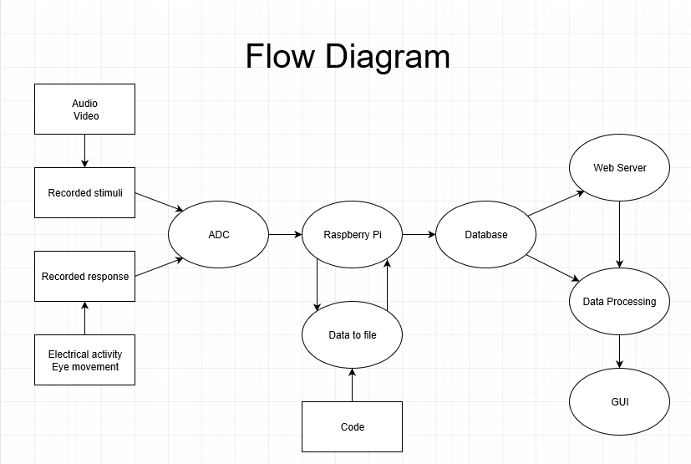
Questions?

