Slide 1
EDA for signal and power integrity solutions
John Croft & Alfred Kulldorff

Slide 2
Problem description
Power supply integrity
  Challenging due to the complexity of determining the dynamic current drawn by the IC (SSO)
  Inductance of power distribution network (PDN)
  Dynamic power consumption → Jitter → Slower clock
Signal integrity
  Layout of connections
Notes:
simultaneous switching output (SSO)
Ideal load? Resistiv

Slide 3
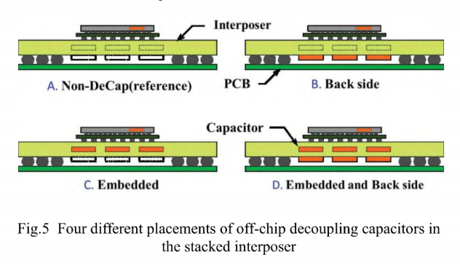
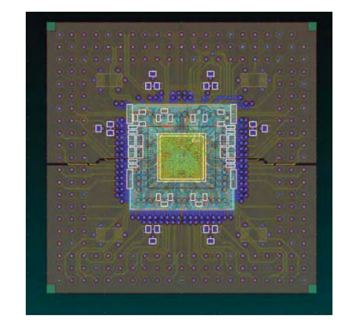
Decoupling Solution
Introduce capacitance to both in and outside of system-in-package (SIP)
  2D field solver (SIwave, Ansys Corp.)
Notes:
is there 3D? aswell

Slide 4
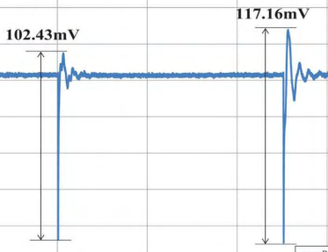
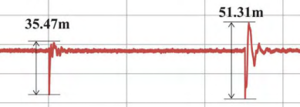
Result
  Example: 0.13um cmos chip

Slide 5
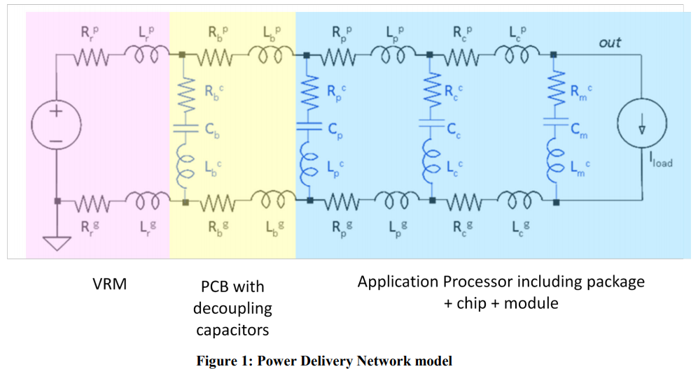
Prediction of Noise From Activity in an FPGA
Determination of parameters R,L,C
Dynamic power by Clk, Test vector, delay and logic

Slide 6
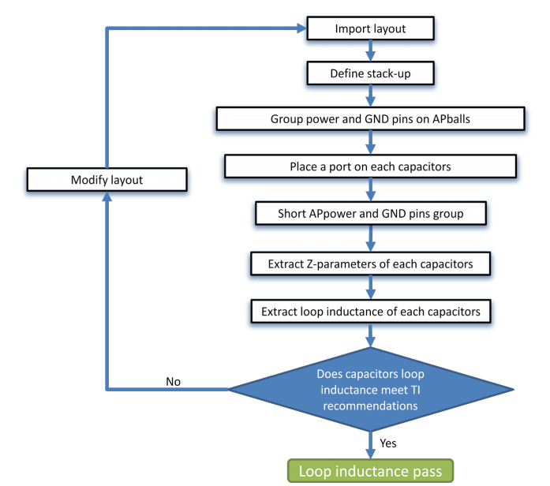
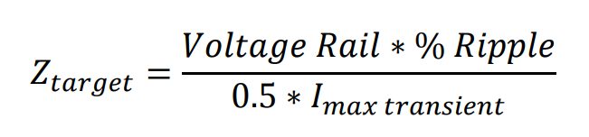
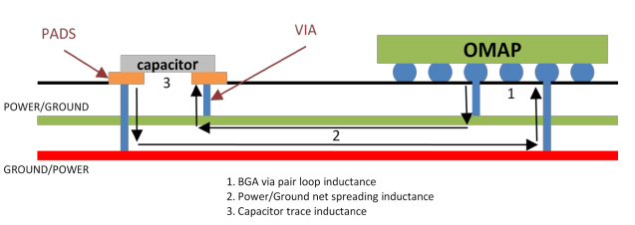

Slide 7
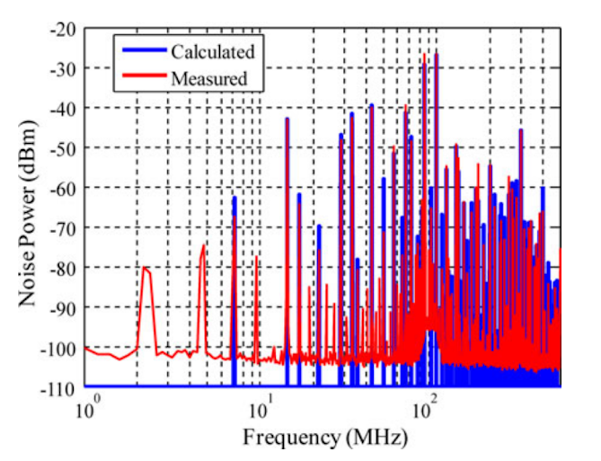
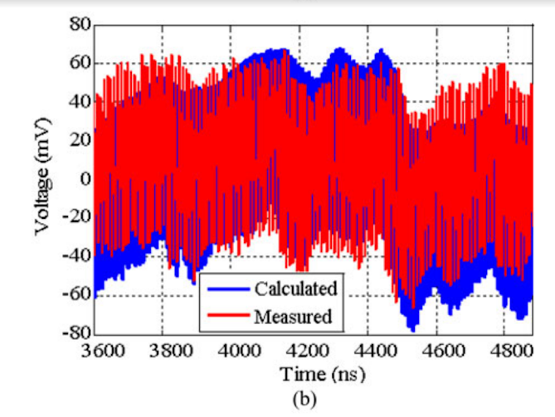
Result
With the gray code counter design

Slide 8
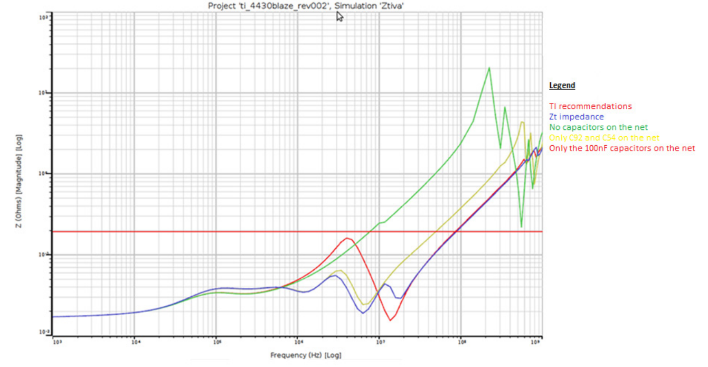
Result
Notes:
Where Zt is the recomendation

Slide 9
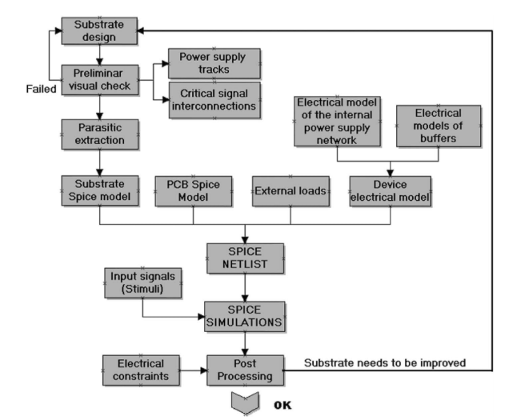
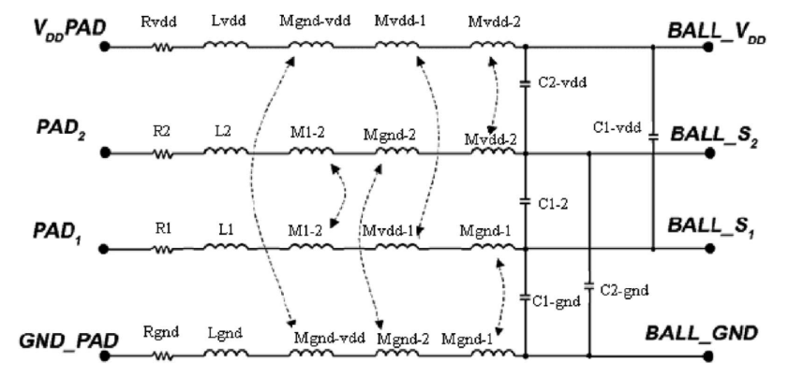
Solve it from the beginning
Signal Integrity

Slide 10
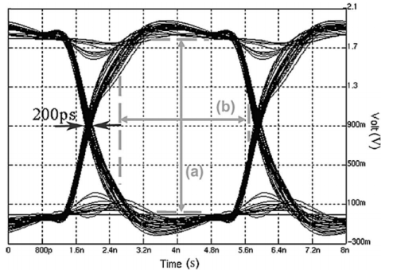
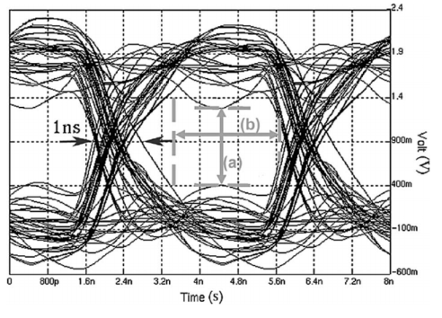
Result

Slide 11
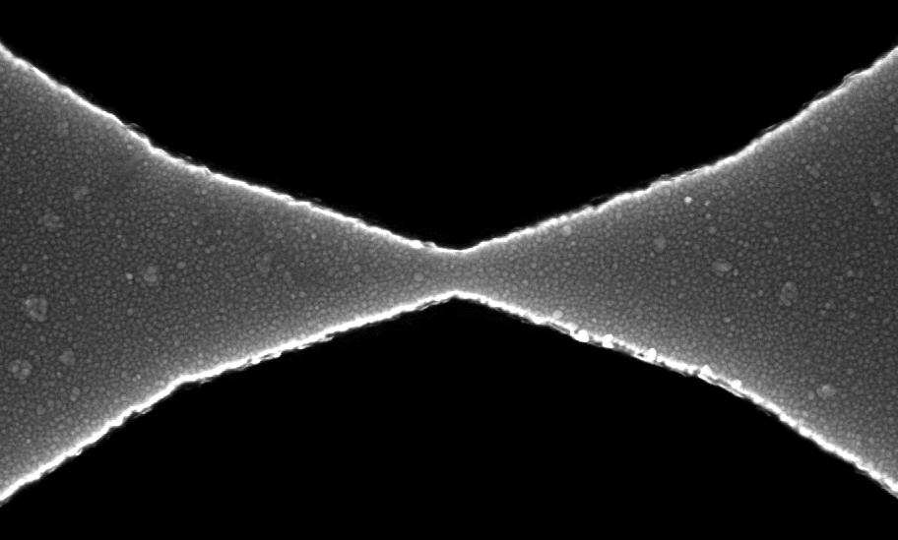
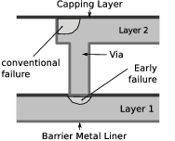
Electromigration

Slide 12
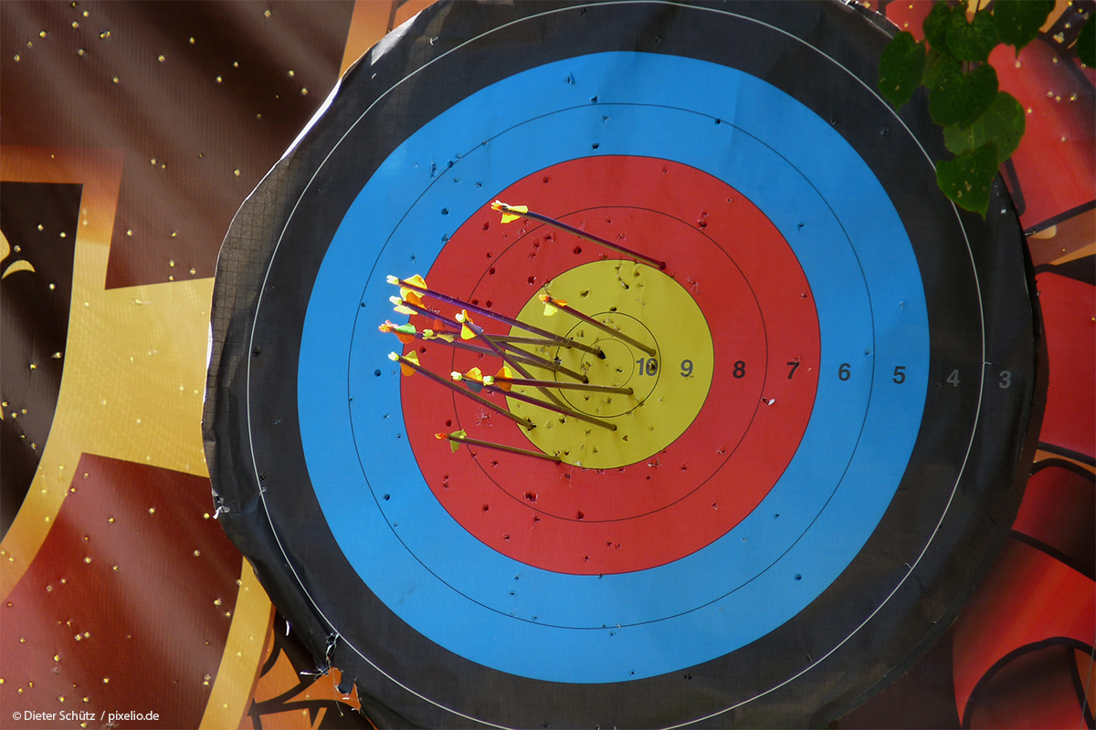

Slide 13


Slide 14


Slide 15
Thanks to

Slide 16
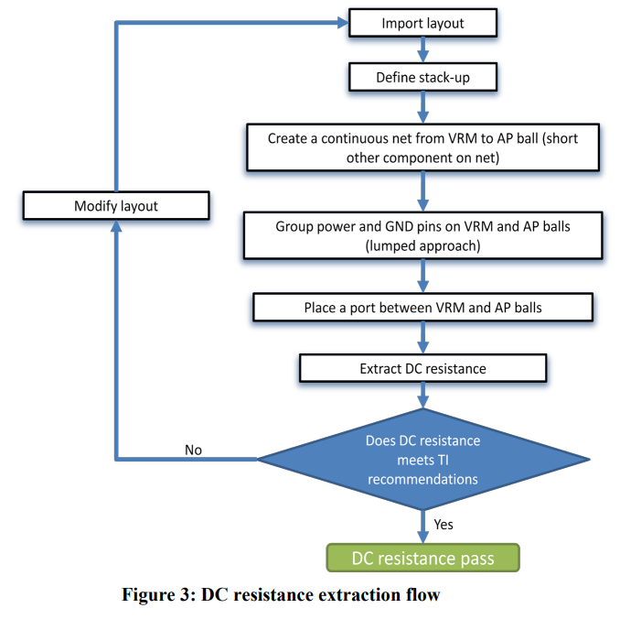
Determination of parameters
R
L
C

Slide 17
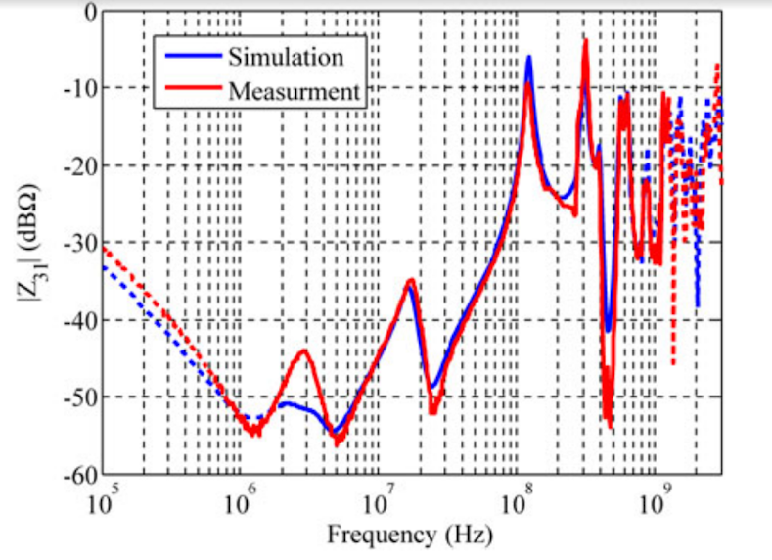
Prediction of Noise - Results

Slide 18
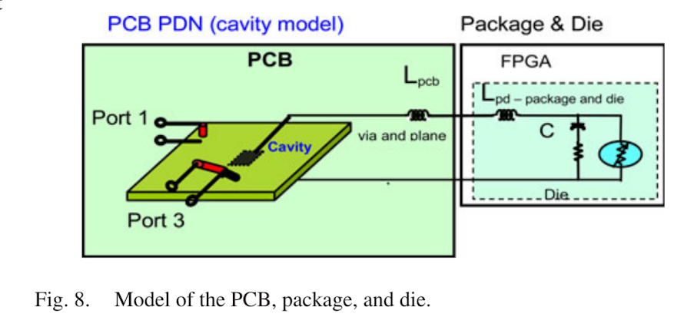
The Power Delivery Network (PDN)
Notes:
https://drive.google.com/file/d/1k78GLabsrkRjyW4vTQYc2HOolHnxayRH/view

Slide 19
Rapport
https://www.overleaf.com/project/5be252cd6e0aeb75ecbda247

Slide 20
Skit
https://pingpong.chalmers.se/courseId/10227/node.do?id=5009591&ts=1542376334907&u=-1339079809
https://pingpong.chalmers.se/courseId/10227/node.do?id=4970743&ts=1540899520772&u=-1339079809
http://www.ti.com/lit/an/swpa222a/swpa222a.pdf
https://drive.google.com/drive/folders/1ZN7fSYf81wvvFUleEfTdxmigrxHZEEGf

