Slide 1
Adder design
going further . . .
exploring new design approaches

Slide 2
Outline
Apply our CMOS circuit design skills for designing adders
A step-by-step process for improving performance wrt timing constraints
Interactive lecture where we play around designing adders in Microsoft Excel
Why Excel?
  Cell based like standard-cell design
  Excel logic functions can be used to validate adder functionality
  Unit delay model can be used to illustrate propagation delay
Types of adders
  Ripple-carry adder
  Carry generate and propagate prefix setup logic to improve speed
  Carry-skip adders
  Carry-lookahead adders
  Prefix tree adders, like Sklansky adders, Ladner-Fischer, Brent-Kung adders

Slide 3
Datapath adder word slice
Adder word slice
Bitslice 6
Bitslice 5
Bitslice 4
Bitslice 3
Bitslice 2
Bitslice 1
Notes:
This slide shows the datapath layout. We can see that the datapath is designed by 8 more or less identical bit slices, one for each bit. Each bit slice contains different functionalities, at the datapath level we can talk about functionality slices.
This is a design style that we are going to use in this course in some design examples concerning adder design. The use of bit slices to form functional arrays is sometimes referred to as iterative logic arrays, if all bit slices in the array are identical. This is a very efficient way of designing, since we only need to design one bit-slice cell to build a complete multi-bit array.
As I said, we shall apply this design style to the design of a full adder in a series of exercises later in the course.

Slide 4
Iterative logic arrays: FULL ADDER
Design adder by using 8 instances of bit adder cell
Adder word slice
a₀
b₀
CLK cycle time T
c_{out}
FA
c_{in}
Sum₀
a₇
b₇
a₆
b₆
a₅
b₅
a₄
b₄
a₃
b₃
a₂
b₂
a₁
b₁
a₀
b₀
FF
FF
FF
FF
FF
FF
FF
FF
FF
FF
FF
FF
FF
FF
FF
FF
CLK
c_{out}
FF
FA
FA
FA
FA
FA
FA
FA
FA
FF
c_{in}
Sum₇
Sum₆
Sum₅
Sum₃
Sum₃
Sum₂
Sum₂
Sum₁
Sum₇
Sum₆
Sum₅
Sum₄
Sum₁
Sum₀
Sum₄
Sum₀
c_{out}
Notes:
One of the main themes of this course is the design of n-bit adders. For starters, we will do that by designing the adder as an iterative logic array. For this, we need to design one Full Adder cell as the one shown here. We will use the methods discussed in this lecture to design the cell with MOSFETs from the Boolean truth table.
Then we will build an iterative logic array from many instances of this cell.
The two numbers to be added are enetered at the top. The carry-in is entered to the LSB (least significant bit) to the right. As the carry ripples from cell to cell, from right to left, the sums pop out at the bottom.

Slide 5
Boolean truth table
You can check your Boolean expression by inserting it to the Boolean truth table first!
SUM expression already inserted as a hint on how to write logic in Excel!
SUM=OR(AND(A;B;CIN);AND(NOT(COUT);OR(A;B;CIN)))*1
(A, B, CIN, COUT to be replaced by work sheet cell coordinates)

Slide 6
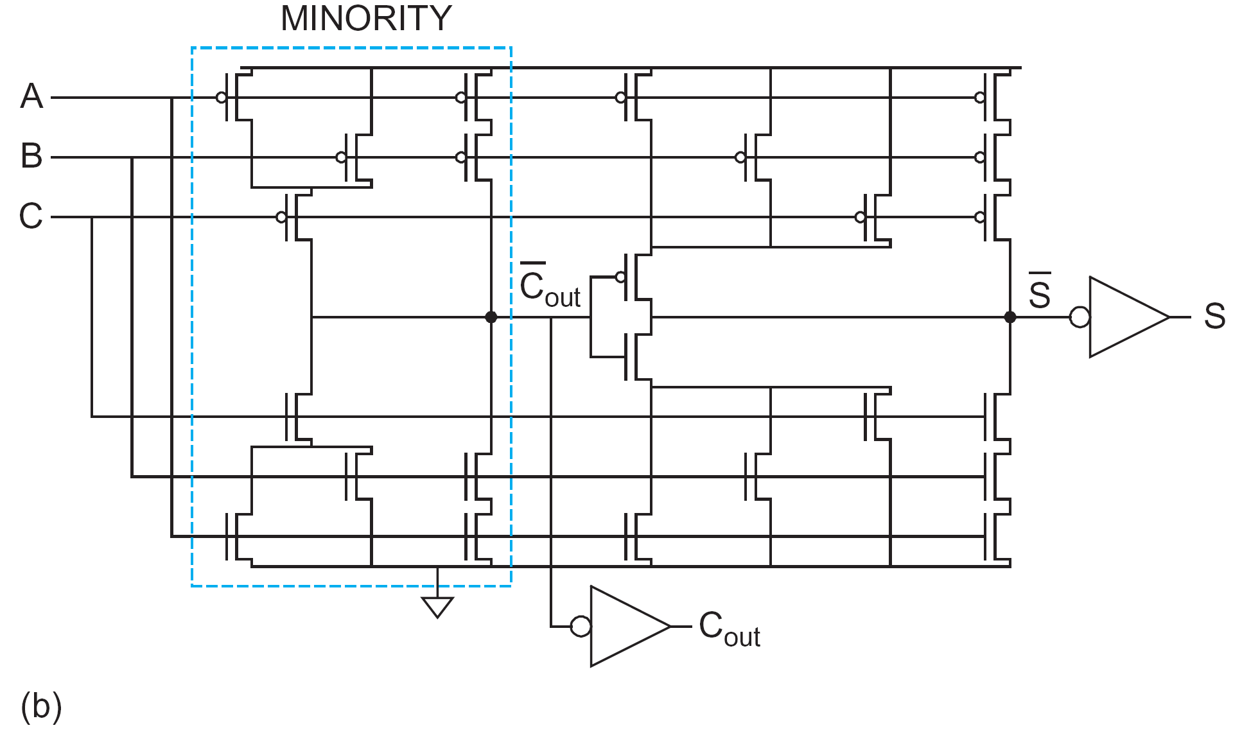
Ripple-carry adder design in Excel
This is a geometrical representation of a ripple-carry adder.
Each row in in Excel work sheet corresponds to 2.6 μm in ST 65 nm CMOS cell library.
Next task: implement your carry cell using the adder template where the SUM cell logic has already been implemented.
YOUR TASK IS
1) TO WRITE CARRY LOGIC EXPRESSION
INTO LSB CARRY CELL USING EXCEL AND/OR/NOT LOGIC FORMULA,
AND
2) CLICK-AND-DRAG TO GET 8 INSTANCES OF CARRY CELL
CARRY LOGIC ”=(LOGIC EXPRESSION)*1”
Text book full adder block solution
SUM LOGIC ”=OR(AND(A;B;C);AND(IN;OR(A;B;C)))*1”
carry cell
SUM cell

Slide 7
Ripple-carry adder design in Excel
Next task: Validate your design by checking its functionality!
Does it work also for subtraction?

Slide 8
Ripple-carry adder design in Excel
Teacher demo: illustrating the carry-ripple delay by introducing a timing axis, and by letting each cell row height represent a unit delay. CUT-AND-PASTE exercise.
Each row in Excel is a timing representation using unit-delay model.
TIME AXIS

Slide 9
Ripple-carry adder design in Excel
Teacher demo: illustrating the carry-ripple delay by introducing a timing axis, and by letting each cell row height represent a unit delay. CUT-AND-PASTE exercise.
Each row in Excel is a timing representation using unit-delay model.
TIME AXIS

Slide 10
Ripple-carry delay calculations
Full textbook solution as proposed in chapter 10 on adders
A
B
carry cell
SUM cell
CIN
SUM
COUT

Slide 11
Ripple-carry delay calculations
Full textbook solution as proposed in chapter 10 on adders
A
B
SUM
CIN
SUM cell
carry cell
COUT

Slide 12
Ripple-carry delay calculations
Redraw for identifying the critical timing path
A
B
COUT
CIN
carry cell
A
B
CIN
SUM
SUM cell

Slide 13
Ripple-carry delay calculations
Redraw for identifying the critical timing path
A
A
B
B
COUT
CIN
COUT
CIN
carry cell
carry cell
A
A
B
B
CIN
CIN
SUM
SUM
SUM cell
SUM cell

Slide 14
Ripple-carry delay calculations
Identifying the critical timing path
2
4
A
A
2
4
B
B
4
X2
X
X2
COUT
CIN
COUT
CIN
2
1
2
1
2
carry cell
X2
X1
carry cell
2
2
A
A
2
2
B
B
2
2
CIN
CIN
2
2
SUM
1
SUM
1
1
1
1
1
1
1
SUM cell
SUM cell

Slide 15
Ripple-carry delay calculations
Critical timing path
A
A
B
carry cell
g_{CIN}=2, p=4
B
X2
X
X2
COUT
CIN
COUT
CIN
carry cell delay
d=4+2*(x+1)/2+1+4/x
carry cell
X2
X1
carry cell
A
A
B
B
CIN
CIN
SUM
SUM
SUM cell
SUM cell

Slide 16
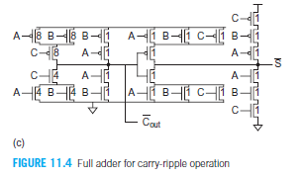
Ripple-carry delay calculations
In the textbook there is a discussion on full adder cell MOSFET sizing!
Rather extreme sizing!

Slide 17
Ripple-carry delay calculations
Critical timing path
2
8
A
A
2
8
B
carry cell
g_{CIN}=2, p=4
B
8
X4
X
X4
COUT
CIN
COUT
CIN
4
carry cell delay
d=4+2*(x+1)/2+1+4/x
1
4
1
4
carry cell
X2
X1
carry cell
A
A
B
B
CIN
CIN
SUM
SUM
SUM cell
SUM cell

Slide 18
Improving the design
Finding faster carry cells!
Less complicated cell with smaller number of MOSFETs!
We are going to accomplish this by preparing the carry cell input signals!
As an example: SUM=XOR(A;B;CIN),
here P=XOR(A;B) can be prefixed while we are waiting for the carry!

Slide 19
Go back to Boolean truth table
Design adder by using 8 instances of bit adder cell
NOTE: COUT=Generate+Propagate*CIN
a₀
b₀
c_{out}
FA
c_{in}
Sum₀
Divide and conquer: Divide full adder cell into carry and SUM cells!
G=AND(A;B)
P=XOR(A;B)
G P
c_{out}
AO21
c_{in}
SUM=XOR(P;CIN)
SUM XOR
SUM

Slide 20
Using P and G half adder setup cells
a₈
b₈
a₇
b₇
a₆
b₆
a₅
b₅
a₄
b₄
a₃
b₃
a₂
b₂
a₁
b₁
HA
HA
HA
HA
HA
HA
HA
HA
g₈
p₈
g₇
p₇
g₆
p₆
g₅
p₅
g₄
p₄
g₃
p₃
g₂
p₂
g₁
p₁
c_{out}
Carry cell
Carry cell
Carry cell
Carry cell
Carry cell
Carry cell
Carry cell
Carry cell
c_{in}
SUM XOR
SUM XOR
SUM XOR
SUM XOR
SUM XOR
SUM XOR
SUM
XOR
SUM
XOR
Sum₈
Sum₇
Sum₆
Sum₅
Sum₄
Sum₃
Sum₂
Sum₁

Slide 21
Using P and G half adder setup cells
a₈
b₈
a₇
b₇
a₆
b₆
a₅
b₅
a₄
b₄
a₃
b₃
a₂
b₂
a₁
b₁
HA
HA
HA
HA
HA
HA
HA
HA
g₈
p₈
g₇
p₇
g₆
p₆
g₅
p₅
g₄
p₄
g₃
p₃
g₂
p₂
g₁
p₁
c_{out}
AO21
AO21
AO21
AO21
AO21
AO21
AO21
AO21
c_{in}
SUM XOR
SUM XOR
SUM XOR
SUM XOR
SUM XOR
SUM XOR
SUM
XOR
SUM
XOR
Sum₈
Sum₇
Sum₆
Sum₅
Sum₄
Sum₃
Sum₂
Sum₁

Slide 22
Using P and G half adder setup cells
Fourth task: Enter G and P logic, enter carry AO21 logic and replace SUM cell logic with XOR logical function!
Empty row of cells, to be left blank until the next task
Note: P and G is never =1 at the same time! It is either propagate or generate, never both!
Therefore the AO logic expression in the C1:0 cells can be written very simple like =G1+P1*CIN!

Slide 23
Using P and G half adder setup cells
Fifth task: Let the combined propagate signal ripple through the adder array along with the carry signal
Note: P and G is never =1 at the same time! It is either propagate or generate, never both!
Therefore the AO logic expression in the C1:0 cells can be written very simple like =G1+P1*CIN!
Next improvement is letting the combined propagate signal ripple along with the carry signal to the array output.
Why: The carry-skip adder!

Slide 24
Carry-Skip Adder
Carry-ripple is slow through all N stages
Carry-skip allows carry to skip over groups of n bits
  Decision based on n-bit propagate signal
N-bit adder
n-bit blocks
k=N/n number of n-bit blocks
Verify the delay model given in eq. 10.13:

Slide 25
Carry-Skip Adder
Carry-ripple is slow through all N stages
Carry-skip allows carry to skip over groups of n bits
  Decision based on n-bit propagate signal
N-bit adder
n-bit blocks
k=N/n number of n-bit blocks
For 32-bit adder we had 31*t_{AO}; Now only t_{PG}+14t_{AO} + 3t_{MUX}
Delay is cut in half!

Slide 26
Analyzing the AOI21 cell
Let us make a non-inverting AO21 cell as a module and determine its g and p values
AOI21 cell
NORMALIZED DELAY C_{IN} INPUT:
4
4
PROPAGATE
R
CIN=
6C
AOI21 cell
g=2, p=8/3
G
4
X
3xC
F
2
R
R/x
CONCLUSION:
Non-inverting X4 AO21 cell has
internal parasitic delay p=7.7≈8
and logical effort g=0.5
2
GENERATE
P
2
X2

Slide 27
Using P and G half adder setup cells
Once we realize that the carry arriving at the adder block output is actually a block generate signal, we are ready for the next improvement step!
THE CARRY-LOOKAHEAD ADDER
Why is that so? Because if G_{8:1}=1, a carry has been generated within the block!

Slide 28
Carry-Lookahead Adder
Carry generate allows us to replace MUX with another AO21 gate.
N-bit adder
n-bit blocks
a_{7:0}
”MUX”
k=N/n groups of n-bit blocks
Verify the delay model given in eq. 10.14:

Slide 29
Propagate binary tree
Two ways of designing an 8-bit AND gate!
Which solution is the fastest?
In one solution the delay increases linearly with the number of inputs N,
in the other the delay increases as log₂N,
P1
P2
P3
P4
P5
P6
P7
P8
&
&
&
&
P2:1
P4:3
P6:5
P8:7
&
&
P4:1
P8:6
&
P8:1
P1
P2
P3
P4
P5
P6
P7
P8
&
&
&
&
&
&
&
P8:1
P2:1
P3:1
P4:1
P5:1
P6:1
P7:1

Slide 30
Carry-Lookahead Adder
So if we design the block-PROPAGATE AND-gate as a binary tree,
will the adder be any faster?
Yes or no?

Slide 31
Propagate binary tree
No, it will not.
We still have to wait for BLOCK-GENERATE!
Unless it also can be designed as binary tree!

Slide 32
G, P binary prefix-tree
G(8)
G(6:5)
G(8:5)
G(8:1)
The “dot operator” logic
P(8)
P(6:5)
P(8:5)
P(8:1)
G(i:j)
G(i:k)=G(i:j)+P(i:j)G(j:k)
G(7)
P(i:j)
P(i:k)=P(i:j)P(j:k)
P(7)
G(j:k)
G(6)
G(6:5)
P(j:k)
P(6)
P(6:5)
Use the “dot operator” to show that the output carry from the binary prefix-tree tree is equal to the carry output from a ripple-carry array! Expression shown at top!
G(5)
P(5)
G(4)
G(2:1)
G(4:1)
P(4)
P(2:1)
P(4:1)
G(3)
The “dot operator”
P(3)
G(2:1)
G(i:k)=G(i:j)+P(i:j)G(j:k)
G(2)
P(2:1)
P(i:k)=P(i:j)P(j:k)
P(2)
G(1)
P(1)

Slide 33
Summary
We have
introduced Microsoft Excel as a tool for studying adder designs
introduced Excel timing graphs
identified the generate/propagate behaviour of the addition
built a new G and P based adder using AO21 cells for the carry
built a 32-bit carry-skip adder with reduced propagation delay compared with the ripple-carry solution
introduced the carry–lookahead concept using block G and P
used a binary tree design to form the block P and G outputs
Next week: a close look at our G/P cell design name it the ”dot operator” and, see how it can be used to build pre-fix tree adders

Slide 34
To think about until next Tuesday
Task 1: Try to appreciate the Excel adder design approach ☺
Task 2: Verify the carry-skip propagation delay formula given in textbook equation 10.13.
Task 3: Verify the carry-lookahead propagation delay formula given in textbook equation 10.14.
Task 4: Use the “dot operator” to show that the binary prefix-tree carry output is equal to the carry output from a ripple-carry array!

Slide 35
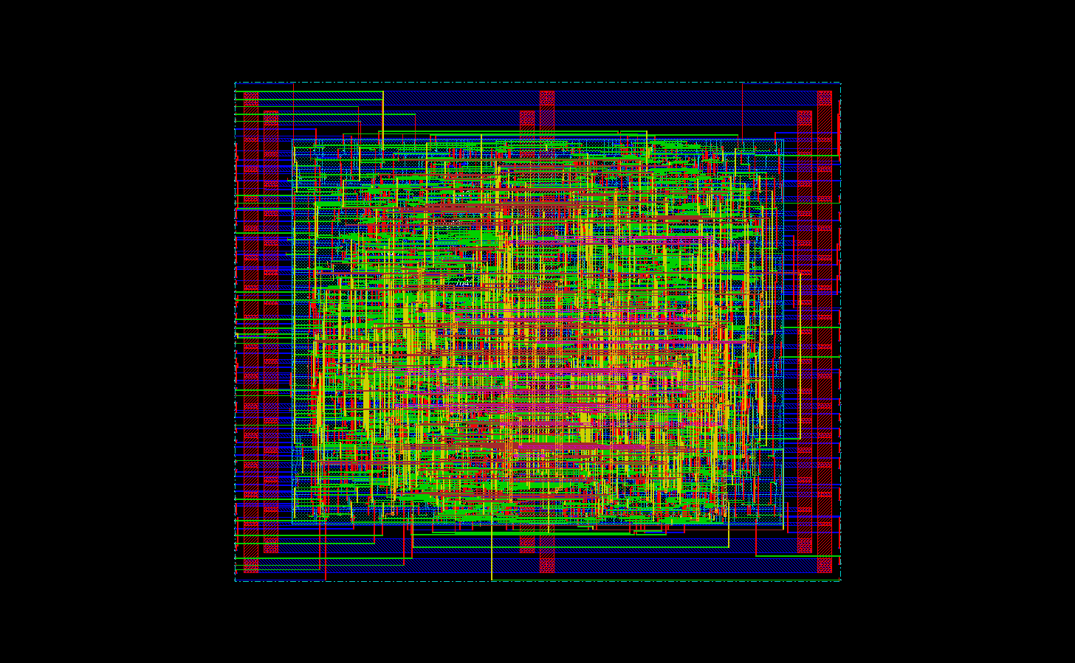
Example: synthesized 32-bit ALU/adder layout

