Slide 1
Sequential circuit design with metastability
Lecture 11
October 3, 2017
Preliminary version

Slide 2
Sequential Logic
Combinational logic
  output depends on current inputs
Sequential logic
  output depends on current and previous inputs
  Requires separating previous, current, future
  Called state or tokens
  Examples: Finite state machine (FSM), pipeline
Combinatorial logic
in
out
clk
clk
Combinatorial logic
in
out
Figure 1.67 from W&H

Slide 3
Sequencing
If tokens move through pipeline at constant speed, no sequencing elements are necessary
Ex: fiber-optic cable
  Light pulses (tokens) are sent down cable
  Next pulse sent before first reaches end of cable
  No need for hardware to separate pulses
  But dispersion sets min time between pulses
This is called wave pipelining in circuits
In most circuits, dispersion is high
  Solution: delay fast tokens so they don’t catch up on slow ones.

Slide 4
Sequencing overhead
Solution: Use flip-flops to delay fast tokens so they move through exactly one stage each cycle.
Drawback: Adds some delay also to the slow tokens
Thus, circuit is slower than just logic propagation delay
  Added delay is called sequencing overhead
Some people call this clocking overhead
  But it applies to asynchronous circuits too
  Inevitable side effect of maintaining sequence

Slide 5
This lecture
Compute sequencing overhead with flip-flops
  Compute maximum clock frequency
  Also with clock skew
Understand causes of delays in flip-flops and abit about their design tradeoffs
  But not design them
Synchronization of asynchronous signals
  Metastability

Slide 6
Return to adder example
Figure 1.67 from W&H

Slide 7
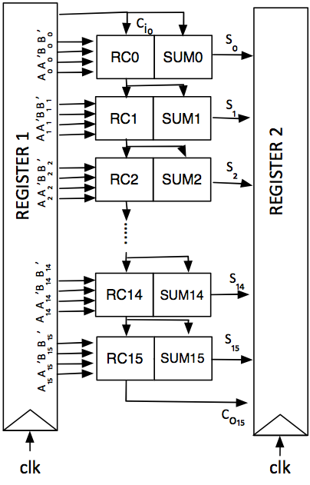
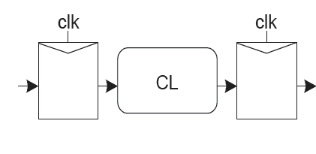
Ripple-carry adder (from postlab 2)
A way of drawing
the same thing with less detail for
the combinational logic (CL)

Slide 8
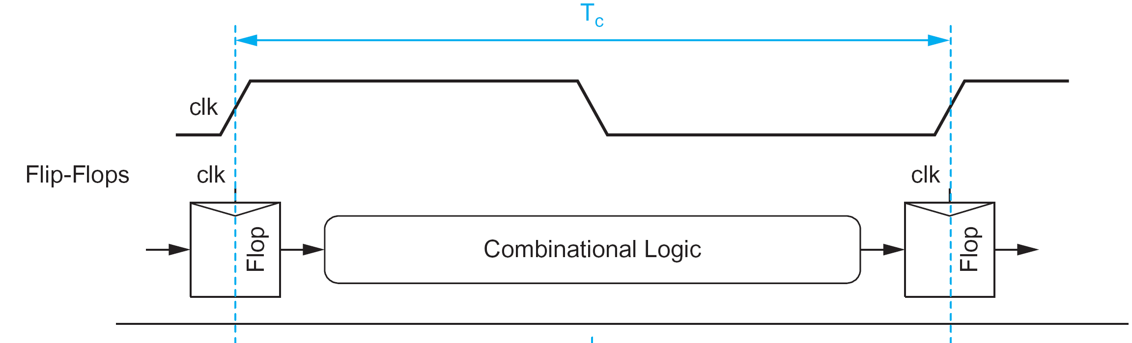
Sequencing with flip-flops
Fllip-flop: Edge-triggered (positive edge) holds data until next edge
Goals today:
Given a certain CL determine the minimum possible T_{c} with and without clock skew.
Given certain f_{c}, clock skew and flip-flops determine timing requirements on CL.
Part of Figure 10.2 from W&H
Notes:
You can also sequence with latches but we leave that out.

Slide 9
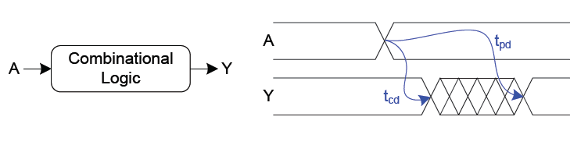
Characterizing combinational logic
Propagation delay, t_{pd}:
  Maximum time until output finally reaches V_{DD}/2.
  Output is guaranteed not to change after t_{pd.}
Contamination delay, t_{cd:}
  Minimum time until output initially reaches V_{DD}/2.
  Output is guaranteed not to change before t_{cd.}
Figure 10.4 (a) from W&H
Notes:
Contamination delay is important because we do not wamt tokens to catch up with each other!

Slide 10
Contamination delay
When is delay shorter than t_{pd}?
3-input NAND gate, Example 4.2 from W&H, Figure 4.7

Slide 11
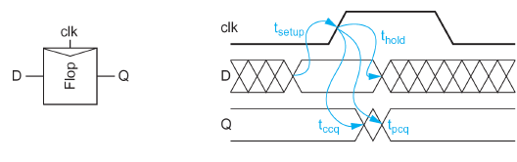
Flip-flop operation and delays
Edge-triggered (positive edge) holds data until next positive clock edge.
Input is called D output is called Q.
Input D has to be ready before clock edge happens, so that correct data is read.
Input D has to be stable long enough after clock edge happened to be correctly locked by flip-flop.
From clock edge happening it takes some time until output Q is available, there is a maximum and a minimum delay.
Figure 10.4 (b) from W&H

Slide 12
Flip-flop operation and delays
sampling window, aperture
Abbreviation | Flip-flop delay
t_{pcq} | Clk-to-Q propagation delay
t_{ccq} | Clk-to-Q contamination delay
t_{setup} | Setup time
t_{hold} | Hold time
Setup time is always
positive.
Hold time can be
positive, zero or
negative.
Figure 10.4 (b) from W&H

Slide 13
What is minimum T_{c}?
t_{pd}, t_{cd}
Abbreviation | Flip-flop delay
t_{pcq} | Clk-to-Q propagation delay
t_{ccq} | Clk-to-Q contamination delay
t_{setup} | Setup time
t_{hold} | Hold time
Notes:
You can also sequence with latches but we leave that out.

Slide 14
What is minimum T_{c}?
t_{pd}, t_{cd}
Make sure result from CL is always there when next clock edge happens:
Otherwise there is a setup violation.
Notes:
You can also sequence with latches but we leave that out.

Slide 15
Maximum propagation delay
Figure 10.5 from W&H

Slide 16
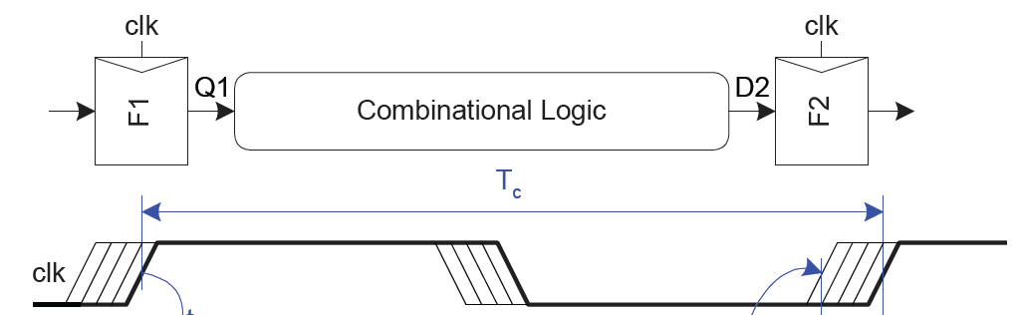
What is minimum T_{c} with clock skew?
t_{pd}, t_{cd}
Clock skew = difference in delay (arrival time) for clock signals.
We do not know which way the difference will go.
Make sure result from CL is always there anyways when next clock
edge happens
Figure 10.15 (a) from W&H
Notes:
You can also sequence with latches but we leave that out.

Slide 17
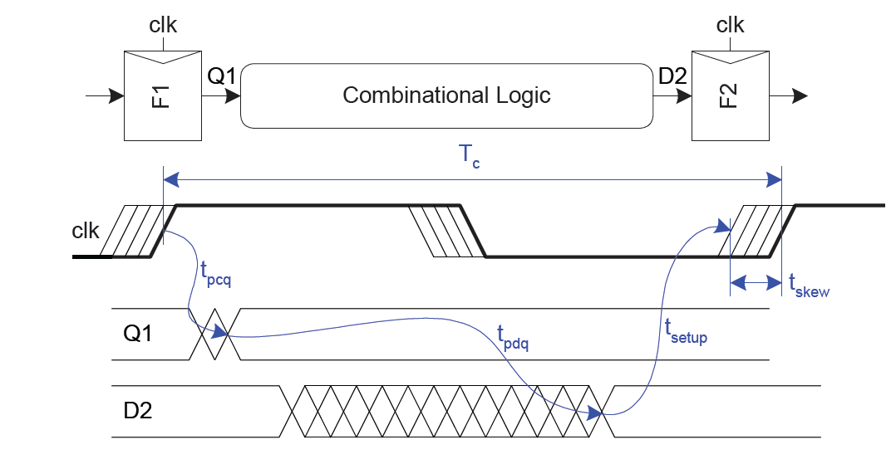
Maximum propagation delay with clock skew
  Decreases maximum propagation delay

Slide 18
Another potential problem
t_{pd}, t_{cd}
What if result from CL changes before the previous result has been read?
Then tokens are merged and data is lost.
Notes:
You can also sequence with latches but we leave that out.

Slide 19
Minimum contamination celay
Figure 10.9 from W&H

Slide 20
Hold violation with clock skew?
t_{pd}, t_{cd}
What if result from CL changes before the previous result has been read
and we have clock skew?
Then tokens are merged and data is lost.
Notes:
You can also sequence with latches but we leave that out.

Slide 21
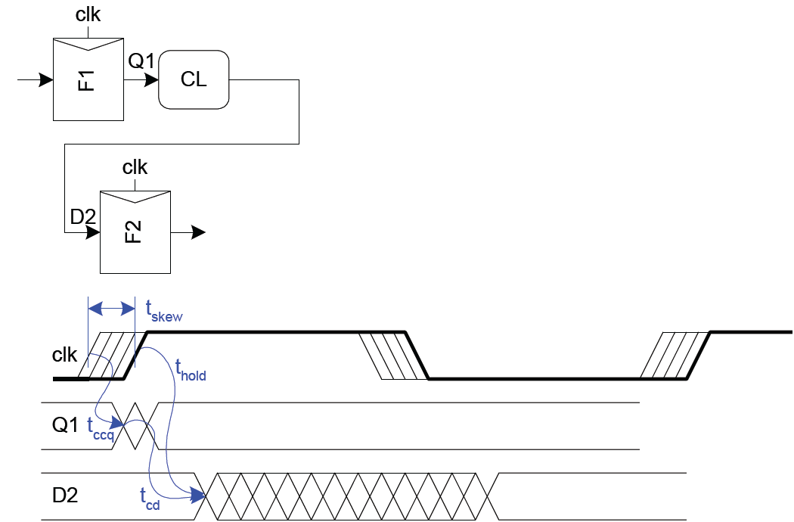
Minimum contamination delay with clock skew
  Increases minimum contamination delay
Figure 10.15 (b) from W&H

Slide 22
Is setup or hold violations worse?

Slide 23
System balancing
A well-designed system is balanced
No need to overdesign one part if another part limits system performance.
Tradeoff between:
  CL: delays, area, power
  Flip-flop design: delays, area, power, metastability
  Clock generation and distribution: delay clock skew, area, power

Slide 24
How design a flip-flop?
Important requirements:
  Data is always maintained and restored
  Short delays
  Low capacitive load on clocks signals
  Small
  Enable
  Reset/set (synchronous or asynchronous)
  Scan chain

Slide 25
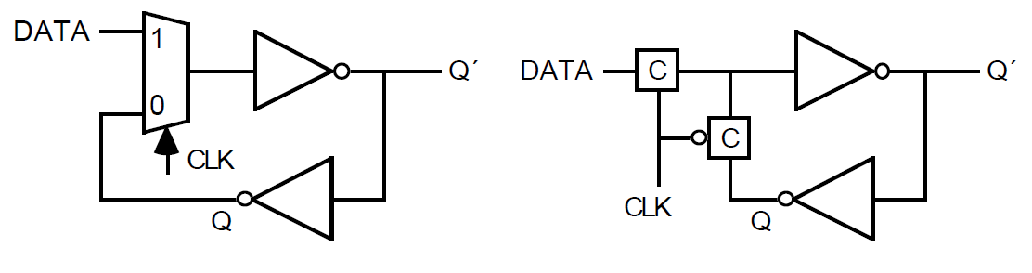
D-Latch Example
A MUX on the input allows us to either load new data or keep old data
Two C-switches make a simple MUX

Slide 26
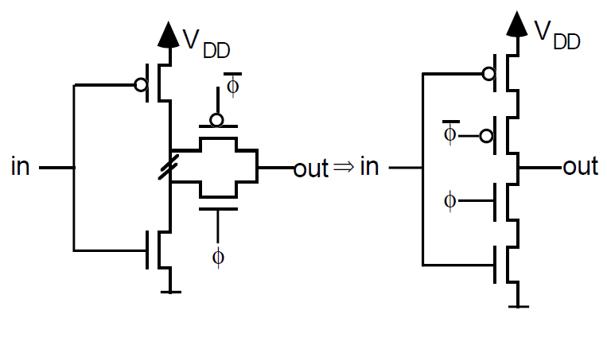
Using tri-state inverters
However, an inverter and a C-switch can be replaced by tri-state inverter
_
φ
_
φ
φ
φ

Slide 27
D-Latch Design
Tristate feedback
  + Static
  Backdriving risk
Static latches are essential so that data
does not disappear because of leakage
φ
X
_
Q
D
_
φ
φ
_
φ

Slide 28
D-Latch Design
Buffered input
  + Fixes diffusion input
  + Makes latch noninverting
φ
X
D
Q
_
φ
φ
_
φ

Slide 29
D-Latch Design
Q
Buffered output
  + No backdriving
Widely used in standard cells
  + Very robust (most important)
  Rather large
  Rather slow (1.5 – 2 FO4 delays)
  High clock loading
φ
X
D
Q
_
φ
φ
_
φ

Slide 30
D-type Flip-Flop Design
Flip-flop is built as pair of back-to-back latches
_
Q
φ
X
φ
X
D
Q
_
φ
_
φ
φ
φ
_
φ
_
φ

Slide 31
D-type Flip-Flop Design
Data is transferred from master to slave when CLK=1
data
Q´
Q
φ=1
data
Q´
Q
φ=0
_
φ
_
φ
φ
φ
New data is received by master when CLK=0, while slave stores previous data

Slide 32
Enable
Enable: ignore clock when en = 0
  Mux: increase latch D-Q delay
  Clock Gating: increase en setup time, skew

Slide 33
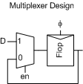
Enable circuit implementation
0
1
C
C
Q
DATA
C
C
CLK
CLK
ENABLE
Q’

Slide 34
Reset
Force output low when reset asserted
Synchronous vs. asynchronous

Slide 35
Set/Reset
Set forces output high when enabled
Flip-flop with asynchronous set and reset

Slide 36
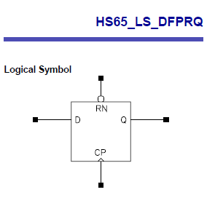
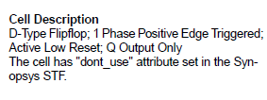
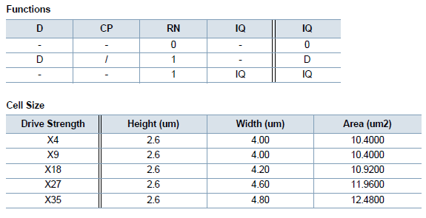
HS65_LS_DFPRQ

Slide 37
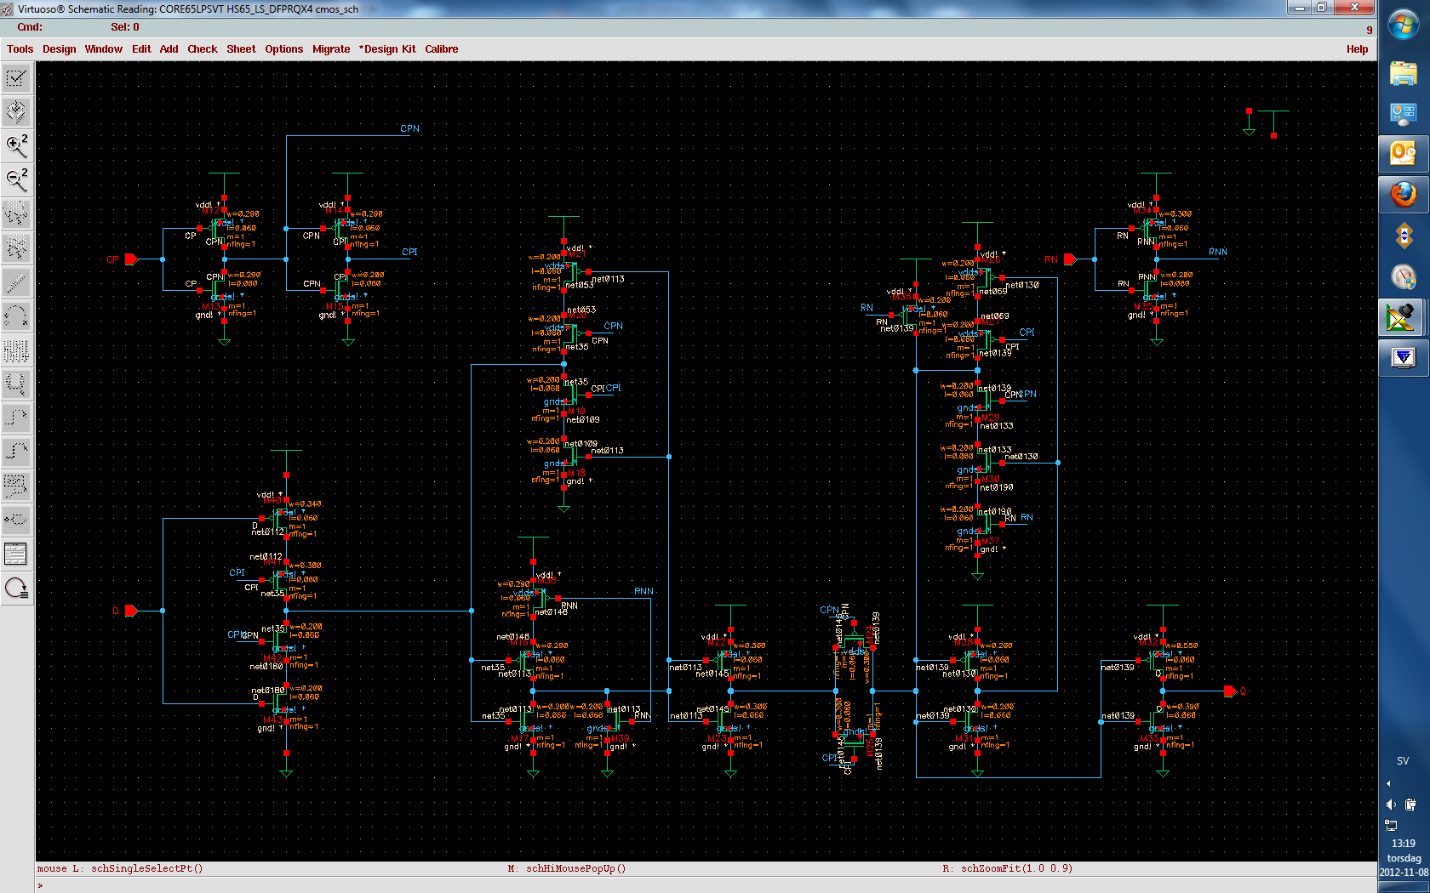
Clock generation
Master latch
with NOR2
Slave latch
with tristate NAND

Slide 38
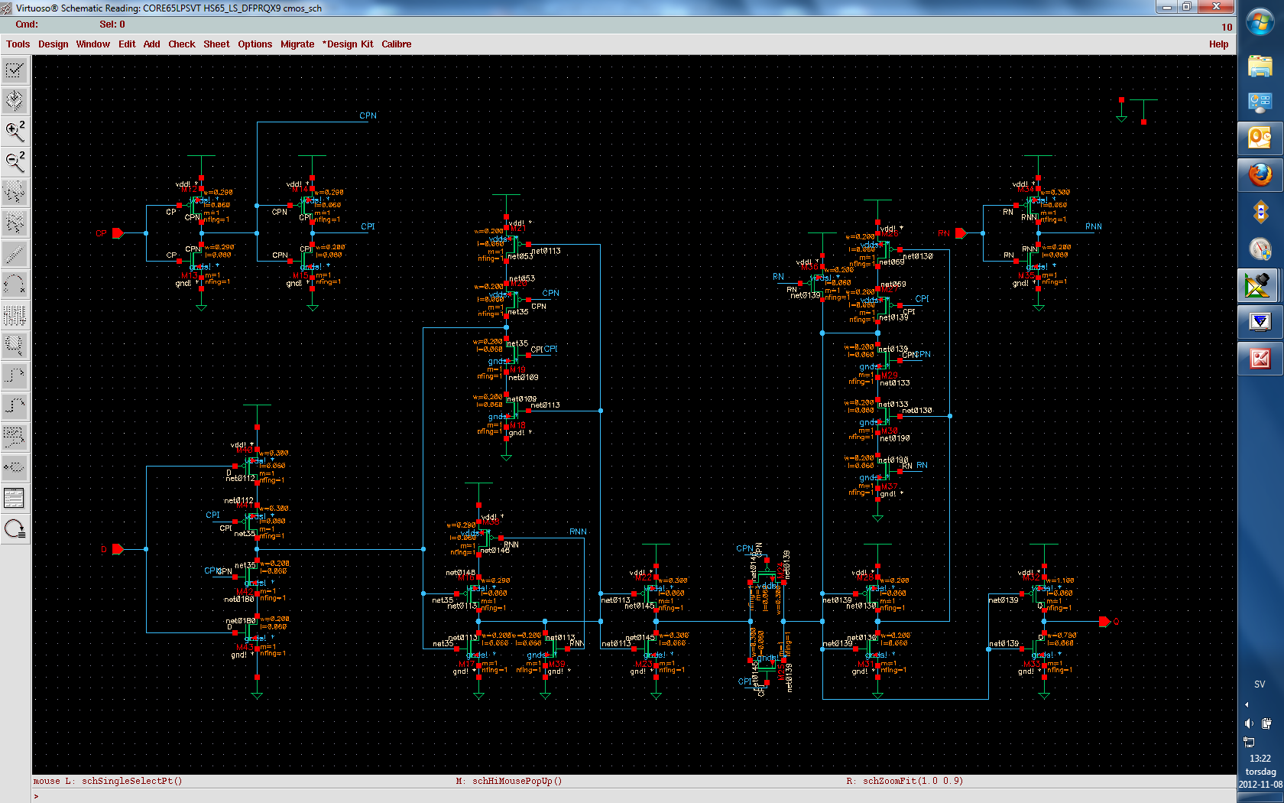

Slide 39
Master latch 2.6 um × 2.8 um
CPI
RN
CPN
CPN
CP
DATA
CPI
CPI
TO SLAVE
RN
INV
Tristate
Tristate
2NOR

Slide 40
Slave latch 2.6um × 3.2um
RN
CPN
Q
CPI
FROM MASTER
INV
INV+TG
INV
Tristate NAND
INV

Slide 41
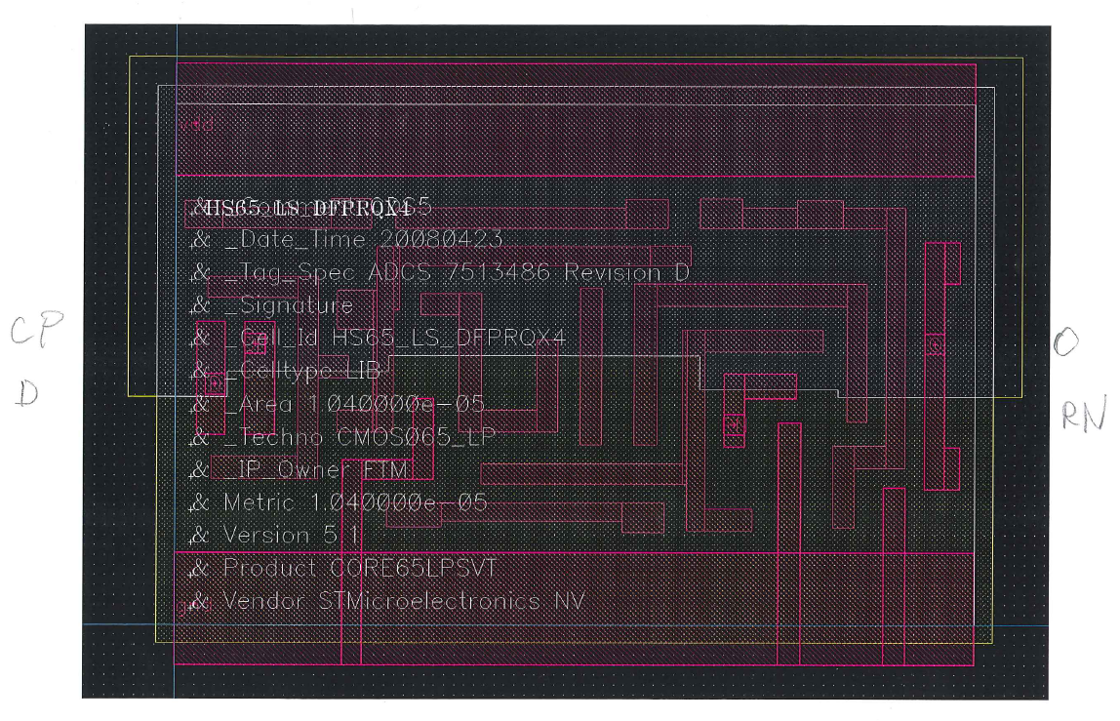
DFF layout in cell library
4.0 um
2.6 um

Slide 42
Summary
We took a step from combinatorial logic to sequential logic:
  CL delays
  FF delays
Setup and hold violations:
  Constraints on CL delays from f_{c}, flip-flop delays and clock skew
System tradeoffs – don’t overdesign any part!
Edge-triggered flip-flop from two back-to-back latches: one master, one slave
  Enable
  Set/Reset
  Scan chains
Had a look at a D-type FF in STMicroelectronics cell library
Compared to a master/slave design using our design template.
  Results: 6.0 μm wide compared with ST 4.0 μm
Next up: synchronization and metastability

