Slide 1
The CMOS Inverter
Lecture 3
Static properties
(VTC and noise margins)

Slide 2
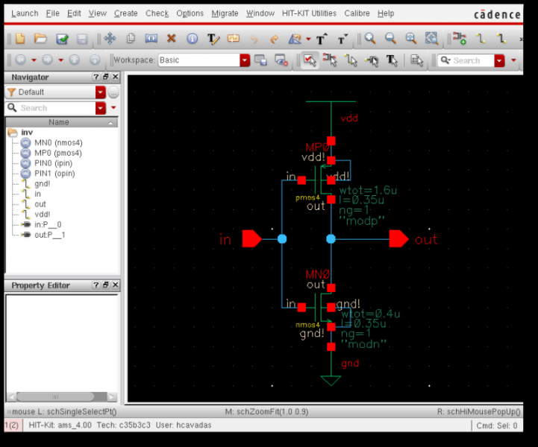
Where are we?
Inverter
Logic gates
P
P-type pull-up network
IN
OUT
IN
OUT
N
N-type
Pull-down
network
Designing w switches
Hands-on lab session

Slide 3
Where are we?
Inverter
Logic gates
P-type pull-up network
1
0
IN
OUT
N-type
Pull-down
network
Designing w switches
Hands-on lab session

Slide 4
Where are we?
Inverter
Logic gates
P-type pull-up network
0
1
IN
OUT
N-type
Pull-down
network
Designing w switches
Hands-on lab session

Slide 5
Where are we?
Inverter
Logic gates
P-type pull-up network
V_{SW}
I_{DS}
V_{SW}
IN
OUT
N-type
Pull-down
network
Designing w switches
Hands-on lab session

Slide 6
MOSFET I/V Characteristics
I_{DS}
ON
Saturation: I_{DSN}=I_{DSAT,N}
I_{DSN}=G_{ON}V_{DS}
V_{DS}
OFF: I_{DS}=0
OFF: I_{DS}=0
I_{DSP}=G_{ON}V_{DS}
Saturation: I_{DSP}=I_{DSAT,P}
ON

Slide 7
MOSFET I/V Characteristics
I_{DS}
ON
Saturation: I_{DSN}=I_{DSAT,N}
ON
Saturation: I_{SDP}=I_{DSAT,P}
I_{SDP}=G_{ON}V_{SD}
I_{DSN}=G_{ON}V_{DS}
V_{DS}
OFF: I_{DS}=0
OFF: I_{DS}=0

Slide 8
MOSFET I/V Characteristics
I_{DS}
ON
Saturation: I_{DSN}=I_{DSAT,N}
Saturation: I_{DSP}=I_{DSAT,P}
I_{DSN}=G_{ON}V_{DS}
V_{DS}
OFF: I_{DS}=0

Slide 9
V_{IN}/V_{OUT} voltage plane
V_{OUT}
V_{DD}, V_{DD}
V_{DD}
NMOS OFF
NMOS
V_{IN}
PMOS
PMOS OFF
V_{DD}

Slide 10
V_{IN}/V_{OUT} voltage plane
V_{OUT}
V_{DD}, V_{DD}
V_{DD}
NMOS OFF
PMOS OFF
V_{IN}
V_{DD}

Slide 11
Voltage Transfer Characteristic - VTC
V_{OUT}
Inverter
V_{DD}, V_{DD}
V_{DD}
NMOS OFF
PMOS OFF
I_{DS,P}=0
0
1
I_{DS,N}=0
I_{DS}
V_{IN}
V_{DD}
The ON p-switch pulls the output high
V_{DS}

Slide 12
Voltage Transfer Characteristic - VTC
V_{OUT}
Inverter
V_{DD}, V_{DD}
V_{DD}
NMOS OFF
PMOS OFF
I_{DS,P}=0
1
0
I_{DS,N}=0
I_{DS}
V_{IN}
V_{DD}
The ON n-switch pulls the output low
V_{DS}

Slide 13
Voltage Transfer Characteristic - VTC
V_{OUT}
Inverter
V_{SW}
V_{DD}, V_{DD}
V_{DD}
NMOS OFF
PMOS OFF
V_{SW}
I_{DS}
V_{SW}
I_{DS}
V_{IN}
V_{DD}
Switching occurs in the green region where both MOSFETs are saturated!
And saturation currents are equal:
Solving for V_{IN} using x=k_{N}/k_{P} yields
Saturation: I_{DSP,N}=I_{DSAT,P}
V_{DS}

Slide 14
Voltage Transfer Characteristic - VTC
V_{OUT}
ΔV
Inverter
V_{SW}
V_{DD}, V_{DD}
V_{DD}
NMOS OFF
PMOS OFF
V_{SW}
I_{DS}
V_{SW}
I_{DS}
V_{IN}
V_{DD}
The switching voltage equation
can be rewritten on a form easier to grasp if we introduce
Saturation: I_{DSP,N}=I_{DSAT,P}
V_{DS}

Slide 15
Voltage Transfer Characteristic - VTC
V_{OUT}
Inverter
V_{SW}
V_{DD}, V_{DD}
V_{DD}
NMOS OFF
PMOS OFF
V_{SW}
I_{DS}
V_{SW}
I_{DS}
V_{IN}
V_{DD}
Equal currents in top blue region
yields V_{OUT} vs. V_{IN!}
V_{DS}

Slide 16
Voltage Transfer Characteristic - VTC
V_{OUT}
Inverter
V_{SW}
V_{DD}, V_{DD}
V_{DD}
NMOS OFF
PMOS OFF
V_{SW}
I_{DS}
V_{SW}
I_{DS}
V_{IN}
V_{DD}
Equal currents in bottom blue region
yields V_{OUT} vs. V_{IN!}
V_{DS}

Slide 17
The voltage characteristic (VTC)
For x=k_{N}/k_{P}=1 we have
What if we make n-channel MOSFET wider, i.e. for x>1?
V_{OUT}
V_{DD}
What happens to VTC?
Will switching voltage V_{SW} increase or decrease?
Assume x=4 and we have
Assume x=1/4 and we have
0
V_{IN}
0
V_{TN}
V_{SW}
V_{DD}+V_{TP}
V_{DD}

Slide 18
The voltage characteristic (VTC)
Which VTC is NAND and which VTC is NOR?
V_{OUT}
V_{DD}
NAND
NOR
0
V_{IN}
0
V_{TN}
V_{SW}
V_{DD}+V_{TP}
V_{DD}

Slide 19
The voltage characteristic (VTC)
How about current flow?
No current flow in red regions!
”short-circuit” current I_{SC} flows in blue/green regions
V_{OUT}
n-channel MOSFET saturated for V_{IN}<V_{SW}
V_{DD}
p-channel MOSFET saturated
for V_{IN}>V_{SW}
0
V_{IN}
0
V_{TN}
V_{SW}
V_{DD}+V_{TP}
V_{DD}

Slide 20
Noise Margins- NML
V_{OUT}
V_{DD}
V_{IN}
Valid ”1”
V_{DD}
V_{OH,min}
NMH
V_{IN} not valid
Valid ”0”
V_{IH,min}
Valid ”1”
V_{IL,max}
V_{OL,max}
Valid ”0”
0
V_{IL,max}
V_{IH,min}
V_{IN}
V_{OUT}

Slide 21
Noise Margins- NML
V_{OUT}
V_{DD}
V_{IN}
Valid ”1”
V_{DD}
V_{OH,min}
V_{IN} not valid
V_{IH,min}
Valid ”1”
V_{IL,max}
NML
V_{OL,max}
Valid ”0”
0
0
V_{IL,max}
V_{IH,min}
V_{IN}
V_{OUT}

Slide 22
Butterfly Diagram
V_{OUT}
V_{DD}
Valid ”1”
V_{OH,min}
Memory cell characterization
NMH
V_{IN}
V_{OUT}
NML
V_{OL,max}
Valid ”0”
0
0
V_{IL,max}
V_{IH,min}
V_{IN}

Slide 23
Noise Margins – skewed inverters
NMH
NML
NML
NMH

Slide 24
Noise Margins – an example
Let´s define valid regions from points where slope A_{V} = -1!
NMH=V_{OH,min}-V_{IH,min} NML=V_{IL,max}- V_{OL,max}
V_{OUT}
These points yields numbers for (V_{OH,min}, V_{IL,max}) and (V_{OL,max,} V_{IH,min})
so that NMH and NML can be calculated!
V_{DD}
Valid ”1”
V_{OH,min}
V_{OL,max}
Valid ”0”
0
V_{IN}
0
V_{IL,max}
V_{IH,min}
V_{DD}

Slide 25
Noise Margins – an example
NMH=V_{OH,min}-V_{IH,min} NML=V_{IL,max}- V_{OL,max}
Let´s define valid regions from points where slope A_{V} = -1!
NMH=V_{OH,min}-V_{IH,min}1.12-0.68=0.44 V NML=V_{IL,max}- V_{OL,max} = 0.52-0.08=0.44 V
V_{OUT}
These points yields numbers for (V_{OH,min}, V_{IL,max}) and (V_{OL,max,} V_{IH,min})
so that NMH and NML can be calculated!
0.28 V
ΔV=0.64 V
0.28 V
V_{DD}
Valid ”1”
ΔV/8
V_{OH,min}
For x=1, V_{TN}=0.28 V and V_{TP}=-0.28 V we have V_{SW}=0.28+0.64/2=0.60 V
and ΔV=0.64 V
ΔV/8
ΔV/8
Formulas can be derived (for x=1): V_{OH,min}=V_{DD}-ΔV/8 V_{OL,max} = ΔV/8
V_{IL,max}=V_{SW}-ΔV/8
V_{IH,min}=V_{SW}+ΔV/8
Formulas can be derived (for x=1):
V_{OH,min}=V_{DD}-ΔV/8=1.12 V V_{OL,max} = ΔV/8=80 mV
V_{IL,max}=V_{SW}-ΔV/8=0.52 V
V_{IH,min}=V_{SW}+ΔV/8=0.68 V
V_{OL,max}
Valid ”0”
ΔV/8
0
V_{IN}
0
V_{IL,max}
V_{IH,min}
V_{DD}

Slide 26
Summary
CMOS inverter – schematic
Voltage transfer characteristics (VTC)
How to calculate switching voltage V_{SW}
Understand V_{SW} dependence on k_{N}/k_{P}
Understand switching current (I_{SC}) flow
Noise margins NMH and NML
Butterfly diagram
Match current curves

Slide 27
Why not n-switches in pull-up networks?
Initial value before switch is turned ON: V_{OUT}=0
Register cell
V_{DD}
Adder
cell
Logic “one”
V_{IN}
p-switch
V_{OUT}
V_{DD}
I_{DS}
Equivalent circuit:
V_{DD}
V_{OUT}
GND
V_{OUT}
V_{DD}
V_{OUT}=V_{DD}-V_{TN}

Slide 28
Why not p-switches in pull-down networks?
Initial value before switch is turned ON: V_{OUT}=V_{DD}
Register cell
V_{DD}
Adder
cell
Logic “zero”
V_{IN}
p-switch
V_{OUT}
V_{DD}
I_{DS}
Equivalent circuit:
V_{OUT}
V_{SS}
GND
V_{OUT}
V_{DD}
V_{OUT}=-V_{TP}

