Slide 1
Lab 2 Summary
Carry cell design

Slide 2
Prelab 2
Design task: design with MOSFETs the carry bit-cell for an 8-bit ripple-carry adder!
The 8-bit carry logic is to be implemented by an iterative logic array consisting of eight instances of the bit-cell that you have designed.
The carry bit-cell has three inputs (two bits a, b and a carry-in memory bit), and one output, the carry-out memory bit to the next more significant bit.

Slide 3
Iterative logic arrays: FULL ADDER
Adder word slice
Find Boolean equations from truth table!
a₀
b₀
c_{out}
FA
c_{in}
Sum₀
a₇
b₇
a₆
b₆
a₅
b₅
a₄
b₄
a₃
b₃
a₂
b₂
a₁
b₁
a₀
b₀
FA
FA
FA
FA
FA
FA
FA
FA
c_{out}
c_{in}
Sum₇
Sum₆
Sum₅
Sum₃
Sum₃
Sum₂
Sum₂
Sum₁
Sum₇
Sum₆
Sum₅
Sum₄
Sum₁
Sum₀
Sum₄
Sum₀
Notes:
One of the main themes of this course is the design of n-bit adders. For starters, we will do that by designing the adder as an iterative logic array. For this, we need to design one Full Adder cell as the one shown here. We will use the methods discussed in this lecture to design the cell with MOSFETs from the Boolean truth table.
Then we will build an iterative logic array from many instances of this cell.
The two numbers to be added are enetered at the top. The carry-in is entered to the LSB (least significant bit) to the right. As the carry ripples from cell to cell, from right to left, the sums pop out at the bottom.

Slide 4
Iterative logic arrays: FULL ADDER
Find Boolean equations from truth table!
a₀
b₀
c_{out}
FA
c_{in}
Sum₀
Design full adder by divide and conquer
a₂
b₂
a₁
b₁
X4
X2
X4
X2
c_{out}
Carry logic
c_{in}
c_{out}
Carry logic
c_{in}
Design 8-bit full adder as an iterative logic array!
SUM logic
Size of
SUM cell?
SUM logic
Sum₂
Sum₁
Notes:
One of the main themes of this course is the design of n-bit adders. For starters, we will do that by designing the adder as an iterative logic array. For this, we need to design one Full Adder cell as the one shown here. We will use the methods discussed in this lecture to design the cell with MOSFETs from the Boolean truth table.
Then we will build an iterative logic array from many instances of this cell.
The two numbers to be added are enetered at the top. The carry-in is entered to the LSB (least significant bit) to the right. As the carry ripples from cell to cell, from right to left, the sums pop out at the bottom.

Slide 5
Iterative logic arrays: FULL ADDER
Find Boolean equations from truth table!
Propagation delay estimation:
Assume carry cell has logical effort g and parasitic delay p.
8-bit adder delay: A first crude estimate!
d=8*(p+g*2+p_{inv}+1/2)≈8*10=80 → t_{pd}= 400 ps
Corresponding to 1.25 GHz clock frequency
But load from SUM cell was neglected and will slow down the design!
a₀
b₀
c_{out}
FA
c_{in}
Sum₀
a₂
b₂
a₁
b₁
X4
X2
X4
X2
c_{out}
Carry logic
c_{in}
c_{out}
Carry logic
c_{in}
Design 8-bit full adder as an iterative logic array!
SUM logic
Size of
SUM cell?
SUM logic
Sum₂
Sum₁
Notes:
One of the main themes of this course is the design of n-bit adders. For starters, we will do that by designing the adder as an iterative logic array. For this, we need to design one Full Adder cell as the one shown here. We will use the methods discussed in this lecture to design the cell with MOSFETs from the Boolean truth table.
Then we will build an iterative logic array from many instances of this cell.
The two numbers to be added are enetered at the top. The carry-in is entered to the LSB (least significant bit) to the right. As the carry ripples from cell to cell, from right to left, the sums pop out at the bottom.

Slide 6
Designing the carry cell
VDD
A
B
A
A
B
C
≥1
B
C
&
≥1
A
&
D
E
A
B
A
B
B
VSS

Slide 7
Designing the carry cell
VDD
A
B
A
A
B
C
≥1
B
C
&
≥1
A
&
A
B
A
B
B
VSS

Slide 8
Designing the carry cell
VDD
Logical effort g=2,
Parasitic delay p=4
A
4
B
4
4
A
4
A
B
C
≥1
4
B
C
&
≥1
2
2
A
&
A
B
A
2
B
2
2
B
8-bit adder delay: Improved estimate!
d=8*(p+g*2+p_{inv}+1/2)≈8*(4+2*2+1.3)=74.4 → t_{pd}= 372 ps
VSS

Slide 9
2015 hand-in examples
___ c_{out}
c_{out}
c_{in}

Slide 10
2015 hand-in examples
a₀
b₀
c_{in}
Carry logic
c_{out}
Design structure chosen by a number of 2015 students!

Slide 11
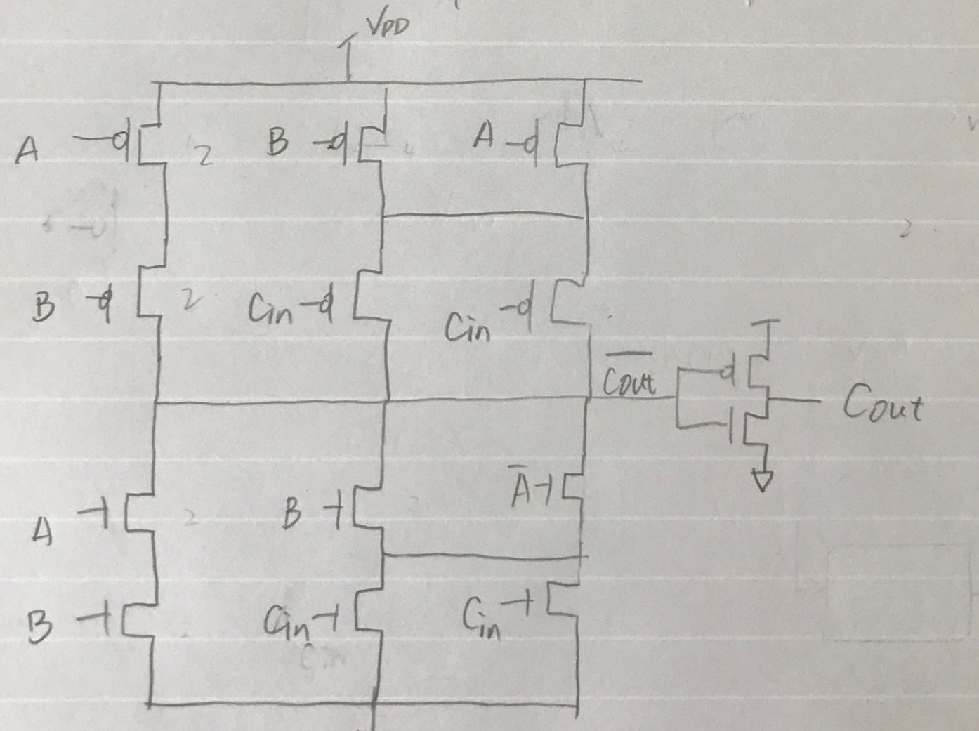
2017 hand-in example

Slide 12
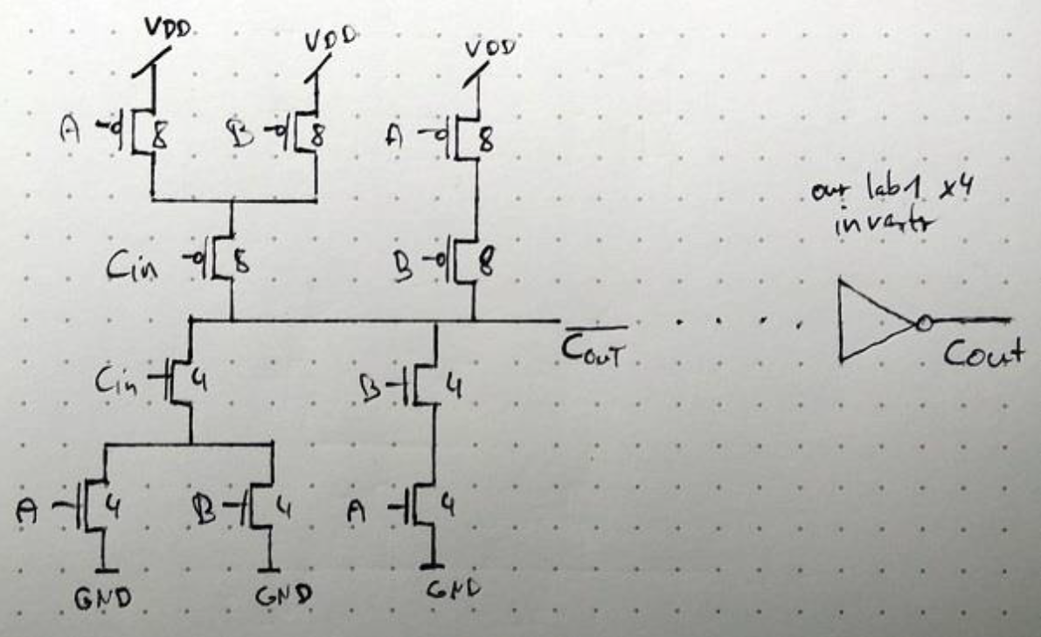
2017 hand-in example

Slide 13
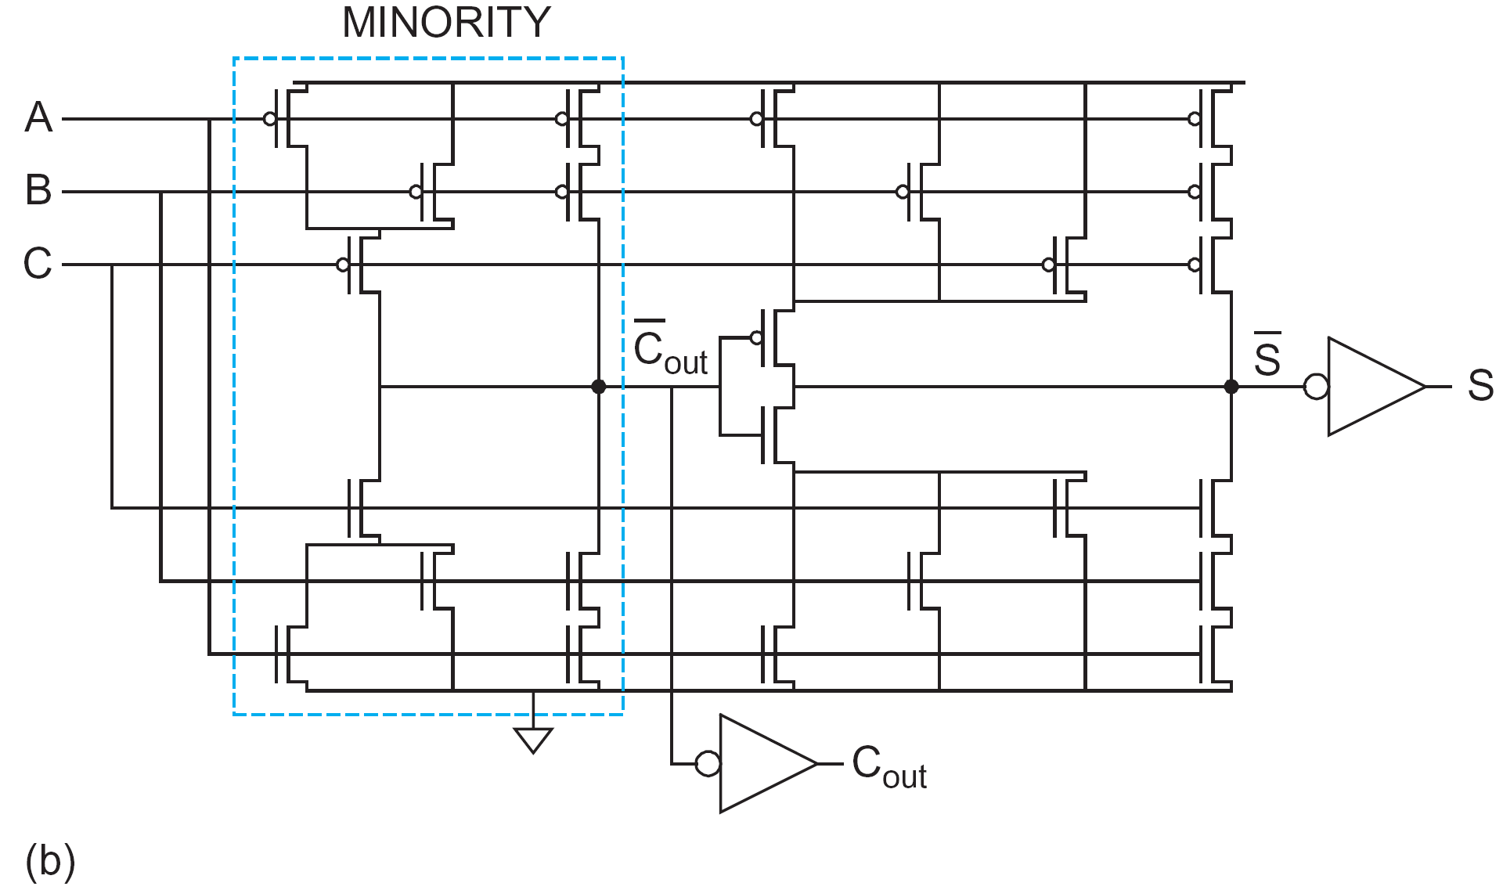
Textbook solution
a₀
b₀
X2 carry cell
X2 SUM cell
X2
Carry logic
c_{in}
X4
c_{out}
X4
a₀
X2
SUM logic
b₀
Sum₀
Design structure as proposed in textbook!
X4

Slide 14
Textbook solution
CARRY DELAY (CIN input)
d=4+2x(6+12)/6+1+(6+6+6)/12=4+6+1+1.5=12.5
X2 carry cell
X2 SUM cell
4
4
4
4
4
4
4
4
4
4
4
4
2
2
2
2
X4
2
2
2
2
2
2
2
2
CARRY LOGIC
(C input)
g=(2+4)/3=2
p=2x(2+4)/3=4
X4
8-bit adder delay: Consider also SUM cell load
d=8*(p+g*(2+4)/2+p_{inv}+3*2/4)≈8*(4+2*3+2.5)=100 → t_{pd}= 500 ps

Slide 15
Textbook solution
What if we resize MOSFETs in SUM cell?
X2 carry cell
X1 SUM cell
4
4
4
2
2
4
2
2
4
2
2
2
1
2
1
1
2
2
2
1
1
2
1
1
CARRY LOGIC
(C input)
g=(2+4)/3=2
p=2x(2+4)/3=4
8-bit adder delay: Consider also SUM cell load
d=8*(4+2x(1+2)/2+1+(2+1+1))=8*(4+3+1)=8*10=80
→ t_{pd}= 400 ps
X2

Slide 16
Textbook solution
What if we resize MOSFETs in SUM cell?
X2 carry cell
X1 SUM cell
4
4
4
2
2
4
2
2
4
2
2
2
1
2
1
1
2
2
2
1
1
X
2
1
1
CARRY LOGIC
(C input)
g=(2+4)/3=2
p=2x(2+4)/3=4
X2
Which size is optimal? X2? X4?

Slide 17
Textbook solution
CARRY DELAY (CIN input)
What if we resize the MOSFETs as shown in red, what is the parasitic delay, p, now?
X2
X1
4
2
2
2
2
4
2
2
4
2
2
2
1
2
1
1
2
1
1
1
1
2
1
1
CARRY LOGIC
(C input)
g=(2+4)/3=2
p=(2+4+2+1)/3=3
X2
CARRY DELAY (C input)
d=3+2x(1+2)/2+1+(2+1+1)/2=3+3+1+2= 9 units/stage
→ t_{pd}= 360 ps

Slide 18
The End
Q & A session!

