Slide 1
This week
Layout and fabrication of CMOS circuits
After an idea from Peter.Nilsson@es.lth.se

Slide 2
CMOS technology
Fabrication of CMOS circuits
A short introductory review
After an idea from Peter.Nilsson@es.lth.se

Slide 3
Photolithography
Deposit a layer
Spin-on photoresist
Use mask to pattern layer
Expose photo- resist
Develop photo-resist
Leaves only un-exposed resist
Etch pattern
Remove photo
resist (ashing)
Silicon substrate

Slide 4
CMOS Layout
in
Well-mask
Active-mask
Shallow trench
Isolation (STI)
out
VSS
in
VDD
poly-mask
N⁺-select-mask
out
N⁺-diffusion
P⁺-select-mask
P⁺-diffusion
Body-ties
Field oxide
Contact-mask
p+
n+
n+
p+
p+
n+
Contact-etch
Metal-mask
VSS-contact
n-well
p-type silicon substrate
VDD-contact
MCC091 – Introduction to Integrated Circuit Design

Slide 5
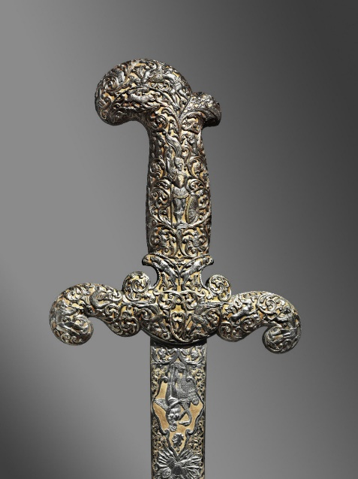
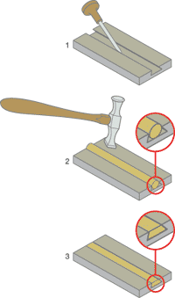
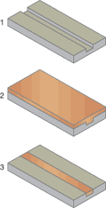
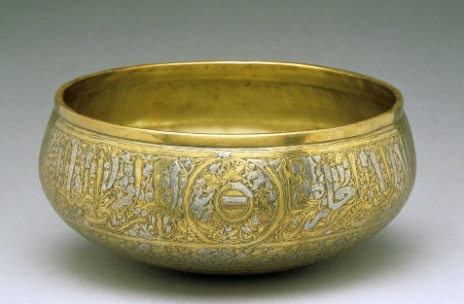
Damascene technology
Damascening technique
Damascening a computer chip
A pattern is
etched into the silicon substrate
A pattern is cut
into the substrate metal
Copper is applied to
completely cover the substrate
The inlay (gold) metal is
hammered into the carved areas
Process is complete, with
metal decorations inlaid into the metal
The applied metal is planarized by chemical/ mechanical polishing (CMP) to expose wires
Bowl, c. 1292-1341 Syrian-Egyptian Brass with silver and copper inlay

Slide 6
Copper Damascene
Tungsten
via plugs
Single and dual damascene
Intra- & inter-
metal insulator
Metal 2 trenches
Metal 2
electroplating
CMP
Insulator
Via etch
p+
n+
n+
p+
p+
n+
Metal3 trench etch
VSS-contact
n-well
Metal3 Cu
VDD-contact
CMP
p-substrate
MCC091 – Introduction to Integrated Circuit Design

