Slide 1
Geometric Design Rules
September 21 2017
Kjell Jeppson & Lena Peterson

Slide 2
Aim of the lecture
To give some basic understanding of intralayer and interlayer geometric design rules
  Intralayer rules concerns minimum dimensions and spacing between objects in the same layer
  Interlayer rules concerns minimum spacing and overlap rules between objects in two different layers:
    MOSFET rules between poly and active
    Contact and via rules between contacts or vias to their bottom and top contacting layers
Discuss the prelab assignment for the layout lab session

Slide 3
Why rules?
To minimize the risk of faulty circuits after fabrication.
  Malfunction due to shorts
  Improper forming of components or contacts
  Electrical charging during fabrication.
More complex nowadays due to:
  Smaller feature sizes
  More complex fabrication processes
    For example polishing for each metal layer

Slide 4
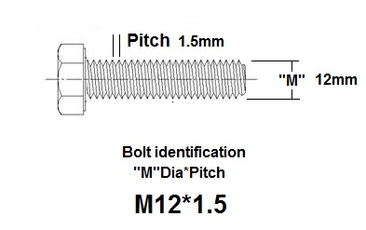
Geometric design rules
Interlayer rules
Active to poly
Intralayer rules
Interlayer rules
Contacts and vias
Pitch=W+S
Top layer extension
extension
extension
S
W
S
Bottom layer extension
pitch = width + separation

Slide 5
Geometric design rules
Intralayer rules
wide Metal 1
Metal 6-7
Metal 2-5
Metal 1
poly
diff
and parallell length >0.42
0.16
0.40
0.10
0.09
0.12
0.11
If W>0.42
0.40
0.10
0.09
0.11
0.06
0.08

Slide 6
Geometric design rules
Details of active/poly rules
Min width 0.40, min space 0.41
0.10
0.115
0.34
0.34
0.03
0.12
0.13
0.14
0.15 if
L>=0.09
P+ select

Slide 7
Geometric design rules
Contact and via rules
No Poly_con
or poly bends
on active
0.11
0.10
0.07
0.055
0.11
*Min metal end 0.05

Slide 8
Geometric design rules
Diff_con
0.03
Poly_con
0.03
Contact and via rules
0.09
0.09
0.04
0.04
0.04
0.04
For minimum width metal lines at least 0.04 enclosure is required on two opposite sides (bottom measures).
Via 1-4: 0.10x0.10
Via 5-6: 0.36x0.36
0.005**
**Met1 0.01
0.02
0.005
0.005*
0.05
0.05
0.08
0.08
At least two 0.05 metal
ends on metal pad
At least two 0.08 metal
ends on metal pad
0.34
(min 0.54 in array)

Slide 9
Geometric design rules
Standard cell template
with rails, n-well, pplus and nplus design rules
VDD
0.36
0.16
0.11
1.10
0.16
2.6
0.16
0.78
VSS
0.36

Slide 10
Prelab 3 assignment
Minimum metal extension beyond contact when minimum wire width is used
p-type
MOSFET
Poly Pitch 1
Poly Pitch 2
n-type
MOSFET
Poly pitch 3
Poly pitch 4
Min drain extension

Slide 11
Prelab 3 layout templates

Slide 12
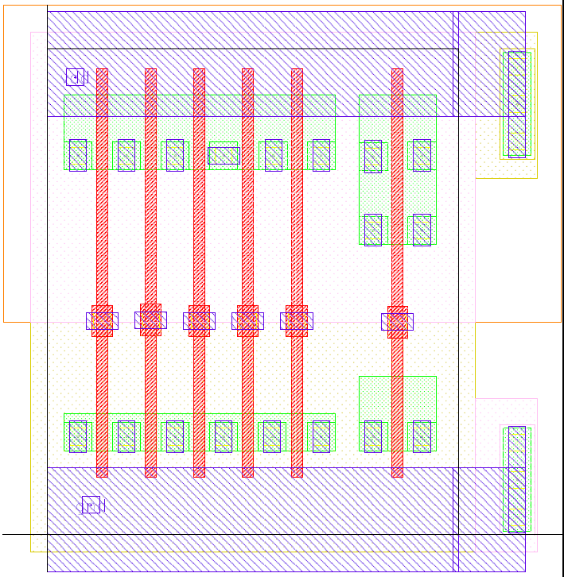
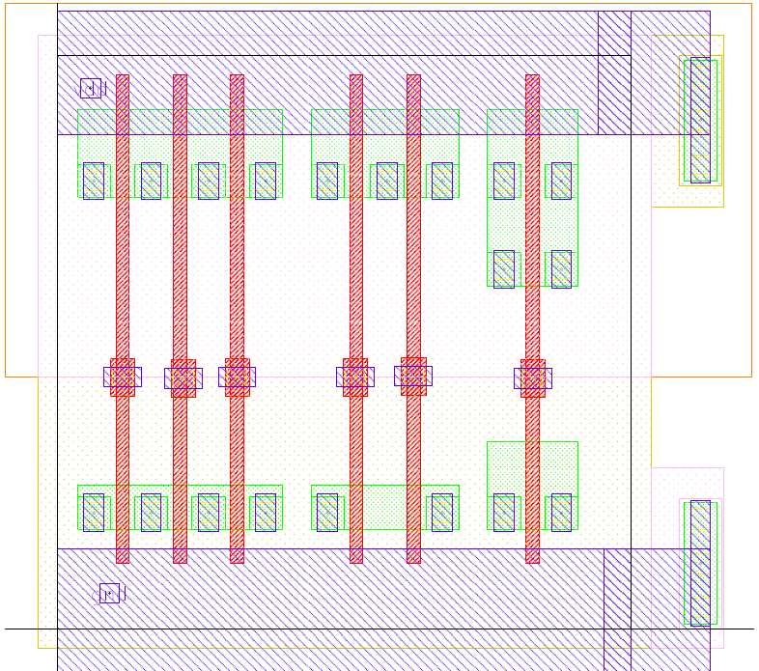
Prelab 3 layout templates

Slide 13
The layers
Physical layers in your layout:
  N-well (NW)
  Diffusion/Active (OD)
  Poly (PO)
  Metal-1 (M1)
  Contact hole (CO)
Non-physical layers required in your layout:
  P-select (PPLUS) (pink dots)
  N-select (NPLUS) (yellow dots)

Slide 14
CMOS Layout
in
Well-mask
Active-mask
Shallow trench
Isolation (STI)
out
VSS
in
VDD
poly-mask
N⁺-select-mask
out
N⁺-diffusion
P⁺-select-mask
P⁺-diffusion
Body-ties
Field oxide
Contact-mask
p+
n+
n+
p+
p+
n+
Contact-etch
Metal-mask
VSS-contact
n-well
p-type silicon substrate
VDD-contact
2017
Integrated Circuit Design

Slide 15
Summary
In this lecture, we have
introduced intralayer and interlayer geometric design rules
defined the minimum pitch:
  the sum of the minimum width and the minimum separation between two objects in the same layer
studied interlayer rules between objects in two different layers, like
  MOSFET rules between poly and active
  contact and via rules between contacts or vias to their bottom and top contacting layers
discussed the prelab assignment to the layout lab session

