Slide 1
Adder wrap-up
Lecture 14
2017

Slide 2
Purpose of todays lecture
To learn how to design a 32-bit adder/subtractor where all sum cells have received their incoming carry signals after only 5 AND-OR delay units! Will be synthesized in Methods course.
The 5 units delay is to be compared to the delay of a ripple-carry adder: 31 AND-OR units delay, see figure below.
Or a ripple-carry lookahead adder with 17 AND-OR unit delays
a_{32:25} b_{32:25}
a_{24:17} b_{24:17}
a_{16:9} b_{16:9}
a_{8:1} b_{8:1}
+
+
+
+
c_{out}
c_{in}
Sum_{32:25}
Sum_{24:17}
Sum_{16:9}
Sum_{8:1}

Slide 3
Ripple-carry timing
And that you have made yourself familiar with the timing of such a ripple-carry adder.

Slide 4
32-bit carry skip adder
Identify worst-case propagation delay for 32-bit adder!
For N-bit adder built with k n-bit blocks!
a_{32:25} b_{32:25}
a_{24:17} b_{24:17}
a_{16:9} b_{16:9}
a_{8:1} b_{8:1}
ADD/SUB logic
Bit P, G
ADD/SUB logic
Bit P, G
ADD/SUB logic
Bit P, G
ADD/SUB logic
Bit P, G
t_{pg}
P_{32:25}
P_{24:17}
P_{16:9}
P_{8:1}
c_{in}
c_{out}
1
0
+
1
0
+
1
0
+
1
0
+
Sum_{32:25}
Sum_{24:17}
Sum_{16:9}
Sum_{8:1}
Determine the worst case delay!
The delay between the generation of a carry in the least significant bit (LSB)
until the most significant SUM is calculated!!

Slide 5
32-bit carry skip adder
Identify worst-case propagation delay for 32-bit adder!
For N-bit adder built with k n-bit blocks!
a_{32:25} b_{32:25}
a_{24:17} b_{24:17}
a_{16:9} b_{16:9}
a_{8:1} b_{8:1}
ADD/SUB logic
Bit P, G
ADD/SUB logic
Bit P, G
ADD/SUB logic
Bit P, G
ADD/SUB logic
Bit P, G
t_{pg}
P_{32:25}
P_{24:17}
P_{16:9}
P_{8:1}
c_{in}
c_{out}
1
0
+
1
0
+
1
0
+
1
0
+
Sum_{32:25}
Sum_{24:17}
Sum_{16:9}
Sum_{8:1}
Determine the worst case delay!
The delay between the generation of a carry in the least significant bit (LSB)
until the most significant SUM is calculated!!

Slide 6
Carry-lookahead adder
DELAY = t_{pg(n)} = log₂(n)*t_{AO}= 3 t_{AO} for n=8
a_{32:25} b_{32:25}
a_{24:17} b_{24:17}
a_{16:9} b_{16:9}
a_{8:1} b_{8:1}
t_{pg(n)}
ADD/SUB logic
Bit P, G
t_{pg(n)}
ADD/SUB logic
Bit P, G
t_{pg(n)}
ADD/SUB logic
Bit P, G
t_{pg(n)}
ADD/SUB logic
Bit P, G
t_{pg}
c_{out}
≥1
G_{32:25}
P_{32:25}
≥1
G_{24:17}
P_{24:17}
≥1
G_{16:9}
P_{16:9}
≥1
G_{8:1}
P_{8:1}
&
&
&
&
c_{in}
+
+
+
+
Sum_{32:25}
Sum_{24:17}
Sum_{16:9}
Sum_{8:1}

Slide 7
Carry-lookahead adder timing
16 15 14 13 12 11 10 9 8 7 6 5 4 3 2 1 0
16:0 15:0 14:0 13:0 12:0 11:0 10:0 9:0 8:0 7:0 6:0 5:0 4:0 3:0 2:0 1:0 0:0

Slide 8
Binary trees
The “dot operator”
g(i:j)
g(i:k)=g(i:j)+p(i:j)g(j:k)
p(i:j)
p(i:k)=p(i:j)p(j:k)
g(j:k)
p(j:k)
G8
P8
G7
P7
G6
P6
G5
P5
G4
P4
G3
P3
G2
P2
G1
P1
P4
P3
P2
P1
G8:1
G7:1
G6:1
G5:1
G4:1
G3:1
G2:1
P4:1
&
&
&
P3:1
P2:1
P8:1
P7:1
P6:1
P5:1
P4:1
P3:1
P2:1
P8
P7
P6
P5
P4
P3
P2
P1
G8
P8
G7
P7
G6
P6
G5
P5
G4
P4
G3
P3
G2
P2
G1
P1
&
&
&
&
G8:7
P8:7
G6:5
P6:5
G4:3
P4:3
G2:1
P2:1
P8:7
P6:5
P4:3
P2:1
&
&
P8:5
P4:1
G8:5
P8:5
G4:1
P4:1
&
G8:1
P8:1
P8:1
Show that

Slide 9
Sklansky adder
16 15 14 13 12 11 10 9 8 7 6 5 4 3 2 1←CIN
Logic levels L=4
Extra levels l=0
Fanout 2^{f}+1=9
f=3
Wire tracks 2^{t}=1
t=0
l+f+t=L-1=3
(0, 3, 0)
16:0 15:0 14:0 13:0 12:0 11:0 10:0 9:0 8:0 7:0 6:0 5:0 4:0 3:0 2:0 1:0 0:0
Determine the worst case delay!

Slide 10
Ladner-Fischer adder
16 15 14 13 12 11 10 9 8 7 6 5 4 3 2 1←CIN
Logic levels L=5
Extra levels l=1
Fanout 2^{f}+1=5
f=2
Wire tracks 2^{t}=1
t=0
l+f+t=L-1=3
(1, 2, 0)
16:0 15:0 14:0 13:0 12:0 11:0 10:0 9:0 8:0 7:0 6:0 5:0 4:0 3:0 2:0 1:0 0:0

Slide 11
Kogge-Stone adder
16 15 14 13 12 11 10 9 8 7 6 5 4 3 2 1←CIN
Logic levels L=4
Extra levels l=0
Fanout 2^{f}+1=2
f=0
Wire tracks 2^{t}=8
t=3
l+f+t=L-1=3
(0, 0, 3)
16:0 15:0 14:0 13:0 12:0 11:0 10:0 9:0 8:0 7:0 6:0 5:0 4:0 3:0 2:0 1:0 0:0

Slide 12
Han-Carlson adder
16 15 14 13 12 11 10 9 8 7 6 5 4 3 2 1←CIN
Logic levels L=5
Extra levels l=1
Fanout 2^{f}+1=2
f=0
Wire tracks 2^{t}=4
t=2
l+f+t=L-1=3
(1, 0, 2)
16:0 15:0 14:0 13:0 12:0 11:0 10:0 9:0 8:0 7:0 6:0 5:0 4:0 3:0 2:0 1:0 0:0

Slide 13
Brent-Kung adder
16 15 14 13 12 11 10 9 8 7 6 5 4 3 2 1 CIN
Logic levels L=6
Extra levels l=3
Fanout 2^{f}+1=2
f=0
Wire tracks 2^{t}=1
t=0
l+f+t=L-1=3
(3, 0, 0)
16:0 15:0 14:0 13:0 12:0 11:0 10:0 9:0 8:0 7:0 6:0 5:0 4:0 3:0 2:0 1:0 0:0

Slide 14
Tree Adder Taxonomy
Extra logic levels
Extra fanout
Extra wire tracks

Slide 15
Tree Adder Taxonomy
Extra logic levels
Extra fanout
Extra wire tracks

Slide 16
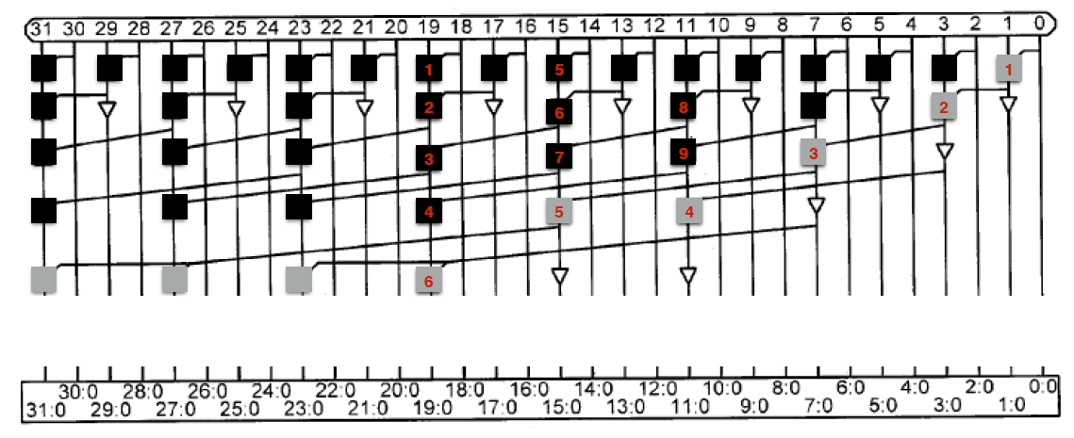
Home ssignment 3 adder task

Slide 17
64/32-bit Reconfigurable Intel adder ISSCC 2004 (paper 8.7)
A 4GHz 300mW 64b Integer Execution ALU with Dual Supply Voltages in 90 nm CMOS, Sanu Mathew, Mark Anders, Brad Bloechel, Trang Nguyen, Ram Krishnamurthy, Shekhar Borkar, Intel, Hillsboro, OR

Slide 18
Summary
After this interactive lecture you will know about
Carry-skip adders, carry-lookahead adders and prefix-tree adders like Sklansky adders, etc.
You can identify the worst-case propagation delay for N-bit carry-skip and carry-lookahead adders built from k n-bit blocks
You can identify the worst-case delay for prefix-tree adders like Sklansky adders.
Using the same principles, you should also be able to do so for the unknown prefix-tree adder in home assignment 3.
Using the same principles, you should also be able to do so in the written exam for some of the other prefix-tree adders like Brent-Kung and Ladner-Fischer.

Slide 19
Q & A

