Slide 1
Interactive exercise on adder design
going further . . .
larger blocks, not only small logic gates
exploring new design approaches

Slide 2
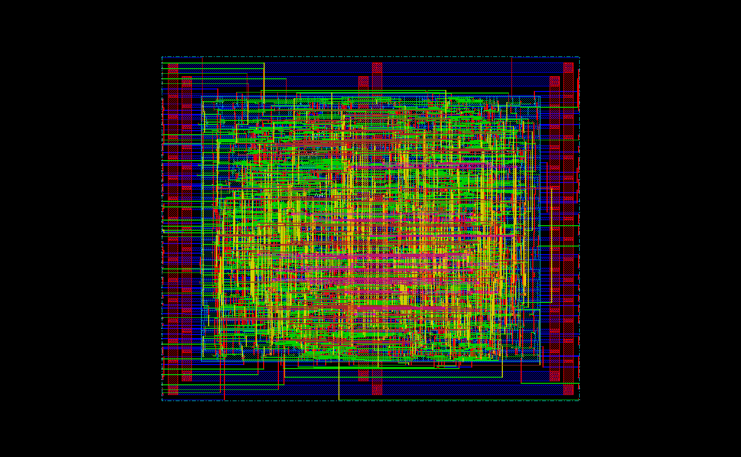
Purpose of this exercise
Apply our CMOS circuit design skills for designing larger blocks, like adders
Go through a step-by-step process for improving performance wrt timing constraints: ripple-carry, carry-skip, carry-lookahead, binary tree adders
This exercise is a preparation for a larger design task in next quarter:
A 32 bit ”super-fast” prefix binary-tree Sklansky adder

Slide 3
Purpose of this exercise
Understanding Adder PG networks
16 15 14 13 12 11 10 9 8 7 6 5 4 3 2 1 CIN
16:0 15:0 14:0 13:0 12:0 11:0 10:0 9:0 8:0 7:0 6:0 5:0 4:0 3:0 2:0 1:0 0:0
Sklansky type tree adder PG network
Carry-ripple adder group PG network

Slide 4
Outline
Interactive lecture where we play around designing adders in Excel
Why Excel?
Cell based like standard-cell design
Excel logic functions can be used to validate adder functionality
Unit delay model can be used to illustrate propagation delay
Types of adders
Ripple-carry adder
Carry generate and propagate prefix setup logic to improve speed
Carry-skip adders
Carry-lookahead adders
Prefix tree adders, like Sklansky adders, Ladner-Fischer, Brent-Kung adders

Slide 5
Datapath adder word slice
Adder word slice
Bitslice 6
Bitslice 5
Bitslice 4
Bitslice 3
Bitslice 2
Bitslice 1
MIPS datapath layout with adder ”word slice”
Notes:
This slide shows the datapath layout. We can see that the datapath is designed by 8 more or less identical bit slices, one for each bit. Each bit slice contains different functionalities, at the datapath level we can talk about functionality slices.
This is a design style that we are going to use in this course in some design examples concerning adder design. The use of bit slices to form functional arrays is sometimes referred to as iterative logic arrays, if all bit slices in the array are identical. This is a very efficient way of designing, since we only need to design one bit-slice cell to build a complete multi-bit array.
As I said, we shall apply this design style to the design of a full adder in a series of exercises later in the course.

Slide 6
Iterative logic arrays: FULL ADDER
Design adder by using 8 instances of bit adder cell
Adder word slice
a₀
b₀
CLK cycle time T
c_{out}
FA
c_{in}
Sum₀
a₇
b₇
a₆
b₆
a₅
b₅
a₄
b₄
a₃
b₃
a₂
b₂
a₁
b₁
a₀
b₀
FF
FF
FF
FF
FF
FF
FF
FF
FF
FF
FF
FF
FF
FF
FF
FF
CLK
FF
FA
FA
FA
FA
FA
FA
FA
FA
FF
c_{in}
c_{out}
Sum₇
Sum₆
Sum₅
Sum₃
Sum₃
Sum₂
Sum₂
Sum₁
Sum₇
Sum₆
Sum₅
Sum₄
Sum₁
Sum₀
Sum₄
Sum₀
Notes:
One of the main themes of this course is the design of n-bit adders. For starters, we will do that by designing the adder as an iterative logic array. For this, we need to design one Full Adder cell as the one shown here. We will use the methods discussed in this lecture to design the cell with MOSFETs from the Boolean truth table.
Then we will build an iterative logic array from many instances of this cell.
The two numbers to be added are enetered at the top. The carry-in is entered to the LSB (least significant bit) to the right. As the carry ripples from cell to cell, from right to left, the sums pop out at the bottom.

Slide 7
Boolean truth table
You can check your Boolean expression by inserting it to the Boolean truth table first!
SUM expression already inserted as a hint on how to write logic in Excel!
SUM=OR(AND(A;B;CIN);AND(NOT(COUT);OR(A;B;CIN)))*1
(A, B, CIN, COUT to be replaced by work sheet cell coordinates)
a₁
b₁
Carry cell
c_{IN}
SUM
logic
Sum₁

Slide 8
Boolean truth table
You can check your Boolean expression by inserting it to the Boolean truth table first!
SUM expression already inserted as a hint on how to write logic in Excel!
Text book full adder block solution
SUM LOGIC=OR(AND(A;B;C);AND(IN;OR(A;B;C)))*1”
(A, B, CIN, COUT to be replaced by cell coordinates)

Slide 9
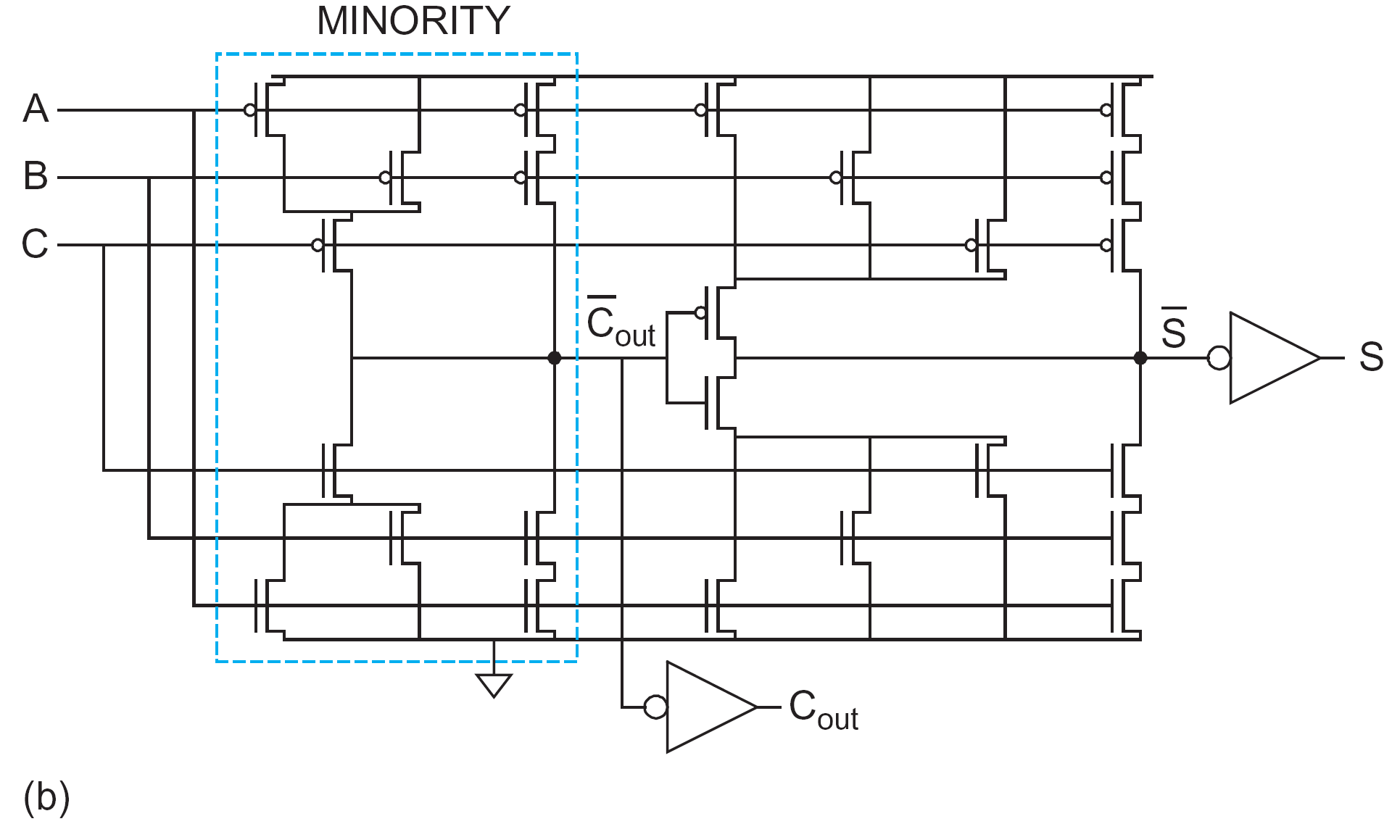
Boolean truth table
A
You can check your Boolean expression by inserting it to the Boolean truth table first!
SUM expression already inserted as a hint on how to write logic in Excel!
B
COUT
CIN
a₁
b₁
Text book full adder block solution
Carry cell
c_{IN}
SUM LOGIC=OR(AND(A;B;C);AND(IN;OR(A;B;C)))*1”
(A, B, CIN, COUT to be replaced by cell coordinates)
carry cell
SUM
logic
A
B
Sum₁
CIN
carry cell
SUM cell
SUM
SUM cell

Slide 10
Ripple-carry adder design in Excel
This is a geometrical representation of a ripple-carry adder.
Each row in in Excel work sheet corresponds to 2.6 μm in ST 65 nm CMOS cell library.
Your task: implement your carry cell using the adder template where the SUM cell logic has already been implemented.
a₁
b₁
Carry cell
SUM
logic
Sum₁
First task: Step 1: Enter carry logic expression into LSB carry cell using Excel AND/OR/NOT logic formulas
Step 2: Click-and-drag to get 8 instances of carry cell
CARRY LOGIC ”=(LOGIC EXPRESSION)*1”
Step 3: Validate your design by checking its functionality!
Does it work also for subtraction?

Slide 11
Ripple-carry adder design in Excel
Teacher demo: illustrating the carry-ripple delay by introducing a timing axis, and by letting each cell row height represent a unit delay. CUT-AND-PASTE exercise.
Each row in Excel is a timing representation using unit-delay model.
TIME AXIS

Slide 12
Ripple-carry adder design in Excel
Teacher demo: illustrating the carry-ripple delay by introducing a timing axis, and by letting each cell row height represent a unit delay. CUT-AND-PASTE exercise.
Each row in Excel is a timing representation using unit-delay model.
TIME AXIS

Slide 13
Improving the design
Finding faster carry cells!
Less complicated cell with smaller number of MOSFETs!
We are going to accomplish this by preparing the carry cell input signals!
As an example: SUM=XOR(A;B;CIN),
here P=XOR(A;B) can be prefixed while we are waiting for the carry!

Slide 14
Go back to Boolean truth table
Design adder by using 8 instances of bit adder cell
NOTE: COUT=Generate+Propagate*CIN
a₀
b₀
c_{out}
FA
c_{in}
Sum₀
Divide and conquer: Divide full adder cell into carry and SUM cells!
G=AND(A;B)
P=XOR(A;B)
G P
c_{out}
AO21
c_{in}
SUM=XOR(P;CIN)
SUM XOR
SUM

Slide 15
Our adder design so far . . .
a₈
b₈
a₇
b₇
a₆
b₆
a₅
b₅
a₄
b₄
a₃
b₃
a₂
b₂
a₁
b₁
Include propagate/generate logic setup cells
g₈
p₈
g₇
p₇
g₆
p₆
g₅
p₅
g₄
p₄
g₃
p₃
g₂
p₂
g₁
p₁
Carry cell
Carry cell
Carry cell
Carry cell
Carry cell
Carry cell
Carry cell
Carry cell
SUM
logic
SUM
logic
SUM
logic
SUM
logic
SUM
logic
SUM
logic
SUM
logic
SUM
logic
Sum₈
Sum₇
Sum₆
Sum₅
Sum₄
Sum₃
Sum₂
Sum₁

Slide 16
Using Propagate/Generate setup cells
a₈
b₈
a₇
b₇
a₆
b₆
a₅
b₅
a₄
b₄
a₃
b₃
a₂
b₂
a₁
b₁
HA
HA
HA
HA
HA
HA
HA
HA
g₈
p₈
g₇
p₇
g₆
p₆
g₅
p₅
g₄
p₄
g₃
p₃
g₂
p₂
g₁
p₁
AO12
AO12
AO12
AO12
AO12
AO12
AO12
AO12
SUM
logic
SUM
logic
SUM
logic
SUM
logic
SUM
logic
SUM
logic
SUM
logic
SUM
logic
Sum₈
Sum₇
Sum₆
Sum₅
Sum₄
Sum₃
Sum₂
Sum₁

Slide 17
Using Propagate/Generate setup cells
a₈
b₈
a₇
b₇
a₆
b₆
a₅
b₅
a₄
b₄
a₃
b₃
a₂
b₂
a₁
b₁
HA
HA
HA
HA
HA
HA
HA
HA
g₈
p₈
g₇
p₇
g₆
p₆
g₅
p₅
g₄
p₄
g₃
p₃
g₂
p₂
g₁
p₁
AO12
AO12
AO12
AO12
AO12
AO12
AO12
AO12
SUM
XOR
SUM
XOR
SUM
XOR
SUM
XOR
SUM
XOR
SUM
XOR
SUM
XOR
SUM
XOR
Sum₈
Sum₇
Sum₆
Sum₅
Sum₄
Sum₃
Sum₂
Sum₁
HS65_LS_AOI12
Logical symbol

Slide 18
Using Propagate/Generate setup cells
Fourth task: Enter G and P logic, enter carry AO21 logic and replace SUM cell logic with XOR logical function!
HA
p₁
Empty row of cells, to be left blank until the next task
AO12
SUM
XOR
Sum₁
Note: P and G is never =1 at the same time! It is either propagate or generate, never both!
Therefore the AO logic expression in the C1:0 cells can be written very simple like =G1+P1*CIN!

Slide 19
Using Propagate/Generate setup cells
Fifth task: Let the combined propagate signal ripple through the adder array along with the carry signal
Note: P and G is never =1 at the same time! It is either propagate or generate, never both!
Therefore the AO logic expression in the C1:0 cells can be written very simple like =G1+P1*CIN!
Next improvement is letting the combined propagate signal ripple along with the carry signal to the array output.
Why: The carry-skip adder!

Slide 20
Carry-Skip Adder
Carry-ripple is slow through all N stages
Carry-skip allows carry to skip over groups of n bits
Decision based on n-bit propagate signal
N-bit adder
n-bit blocks
k=N/n number of n-bit blocks
Verify the delay model given in eq. 10.13:

Slide 21
Carry-Skip Adder
Carry-ripple is slow through all N stages
Carry-skip allows carry to skip over groups of n bits
Decision based on n-bit propagate signal
N-bit adder
n-bit blocks
k=N/n number of n-bit blocks
For 32-bit adder we had 31*t_{AO}; Now only t_{PG}+14t_{AO} + 3t_{MUX}
Delay is cut in half!

Slide 22
Using Propagate/Generate setup cells
Once we realize that the carry arriving at the adder block output is actually a block generate signal, we are ready for the next improvement step!
THE CARRY-LOOKAHEAD ADDER
Why is that so? Because if G_{8:1}=1, a carry has been generated within the block!

Slide 23
Carry-Lookahead Adder
Carry generate allows us to replace MUX with another AO21 gate.
N-bit adder
n-bit blocks
a_{7:0}
”MUX”
k=N/n groups of n-bit blocks
Verify the delay model given in eq. 10.14:

Slide 24
Summary
We have
introduced Microsoft Excel as a tool for studying adder designs
introduced Excel timing graphs
identified the generate/propagate behaviour of the addition
built a new G and P based adder using AO21 cells for the carry
built a 32-bit carry-skip adder with reduced propagation delay compared with the ripple-carry solution
introduced the carry–lookahead concept using block G and P
used a binary tree design to form the block P and G outputs
Next week: a close look at our G/P cell design name it the ”dot operator” and, see how it can be used to build pre-fix tree adders

Slide 25
To think about until next Tuesday
Task 1: Try to appreciate the Excel adder design approach ☺
Task 2: Verify the carry-skip propagation delay formula given in textbook equation 10.13.
Task 3: Verify the carry-lookahead propagation delay formula given in textbook equation 10.14.
Task 4: Use the “dot operator” to show that the binary prefix-tree carry output is equal to the carry output from a ripple-carry array!

Slide 26
Example: synthesized 32-bit ALU/adder layout

Slide 27
Ripple-carry delay calculations
Full textbook solution as proposed in chapter 10 on adders
A
B
SUM
CIN
SUM cell
carry cell
COUT

Slide 28
Ripple-carry delay calculations
Redraw for identifying the critical timing path
A
B
COUT
CIN
carry cell
A
B
CIN
SUM
SUM cell

Slide 29
Ripple-carry delay calculations
Redraw for identifying the critical timing path
A
A
B
B
COUT
CIN
COUT
CIN
carry cell
carry cell
A
A
B
B
CIN
CIN
SUM
SUM
SUM cell
SUM cell

Slide 30
Ripple-carry delay calculations
Identifying the critical timing path
A
A
B
B
COUT
CIN
COUT
CIN
carry cell
carry cell
A
A
B
B
CIN
CIN
SUM
SUM
SUM cell
SUM cell

