Slide 1
Lecture 16
Introduction to Integrated Circuit Design
Course summary
Notes:
In this first lecture of the introductory course in integrated circuit design, we are going to learn how to design CMOS logical gates with a certain functionality.
But first, let me just say a few words on the context where we will meet combinational logic in a design.

Slide 2
Designing gates with switches
Already the first lecture we learnt how to design gates with switches
and in CMOS there are two complementary switches
P-switch
P-switch
VDD
A
pMOS
pull-up
network
A
A
A
ON
Inputs:
A, B, C, D
OFF
pMOSFET
pMOSFET
Y
N-switch
N-switch
nMOS
pull-down
network
Inputs:
A, B, C, D
A
A
A
&
A
AB
CD
OFF
ON
≥1
nMOSFET
VSS
Y
nMOSFET
&
input A is LOW
input A is HIGH
Notes:
When we are designing our gates, we will at this initial stage consider the MOSFETs as switches. In CMOS, we have complementary pairs of p-channel and n-channel MOSFETs. They are our building blocks. Initially, we will consider the MOSFETs as ideal switches. That is actually enough for designing functionality!
Since there are two types of MOSFETs, there are also two types of switches: n-switches and p-switches.
The n-switch is ON for HIGH inputs, i.e. for logic ones. Electrically, a logic one corresponds to a positiv supply voltage, VDD, while a logic zero corresponds to GND, or VSS.
The p-switch is ON for LOW inputs, i.e. for logic zeroes. This ´”inverted” function is indicated by the inverting bubble on the switch and pMOSFET symbols. The input to the p-switch is marked A, but due to the bubble it is when Abar is HIGH that the switch is turned ON.

Slide 3
Designing gates with switches
Already the first lecture we learnt how to design gates with switches
and in CMOS there are two complementary switches
P-switch
VDD
According to de Morgan´s theorem
A
A
pMOS
pull-up
network
Inputs:
A, B, C, D
pMOSFET
Y
N-switch
N-switch
A
C
A
B
D
A
A
&
A
AB
CD
VSS
≥1
nMOSFET
Y
nMOSFET
&
Notes:
Personally, I always start by designing the pull-down network. The output is supposed to go low when AB plus CD is HIGH. Products are realized as switches in series, since both switches need to be ON for the path to conduct. In this case, we have two parallel paths, each with two switches in series.

Slide 4
Designing gates with switches
Already the first lecture we learnt how to design gates with switches
and in CMOS there are two complementary switches
P-switch
VDD
According to de Morgan´s theorem
VDD
A
A
C
D
pMOSFET
A
B
Y
Y
N-switch
N-switch
A
C
A
B
D
A
A
&
A
AB
CD
VSS
≥1
nMOSFET
Y
nMOSFET
&
Notes:
Personally, I always start by designing the pull-down network. The output is supposed to go low when AB plus CD is HIGH. Products are realized as switches in series, since both switches need to be ON for the path to conduct. In this case, we have two parallel paths, each with two switches in series.

Slide 5
Designing gates with switches
Already the first lecture we learnt how to design gates with switches
and in CMOS there are two complementary switches
P-switch
VDD
According to de Morgan´s theorem
VDD
A
A
C
D
pMOSFET
A
B
Y
N-switch
N-switch
A
C
A
B
D
A
A
&
A
AB
CD
VSS
≥1
nMOSFET
Y
nMOSFET
&
Notes:
Personally, I always start by designing the pull-down network. The output is supposed to go low when AB plus CD is HIGH. Products are realized as switches in series, since both switches need to be ON for the path to conduct. In this case, we have two parallel paths, each with two switches in series.

Slide 6
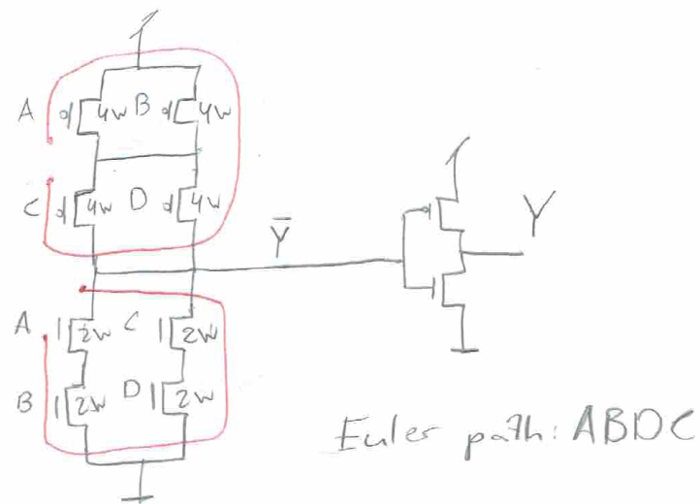
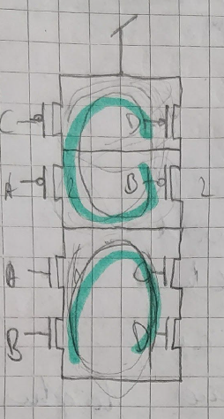
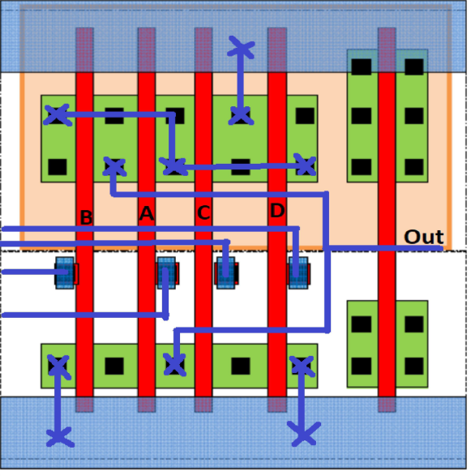
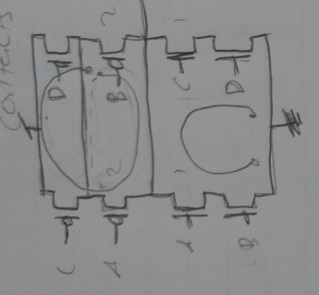

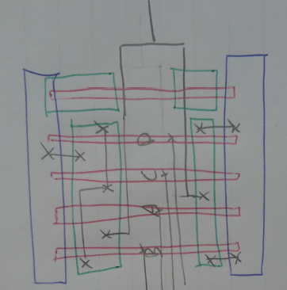
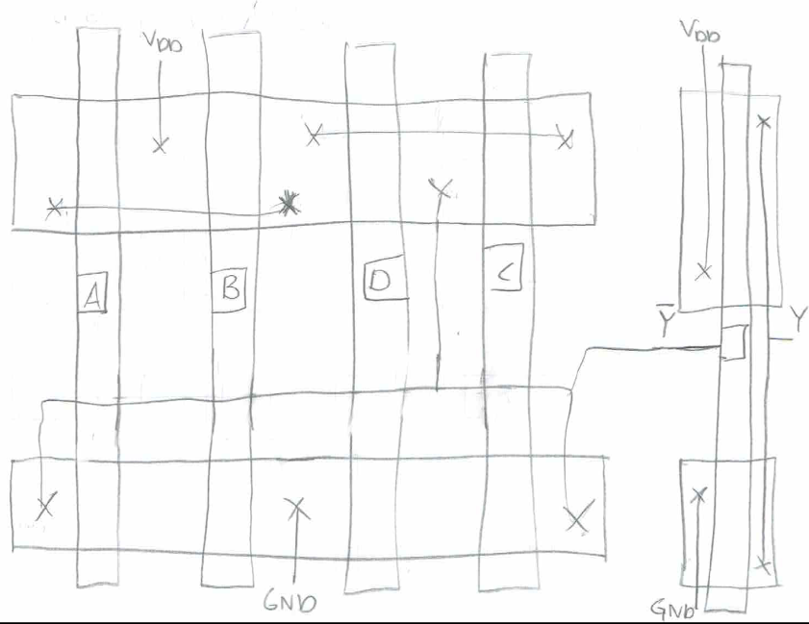
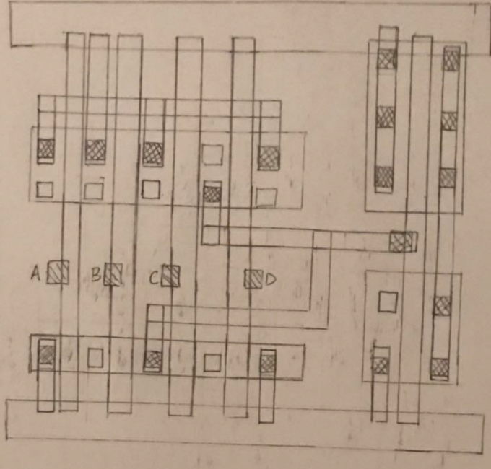
Layout and Euler paths
Fatal errors!

Slide 7

Fabrication
Chips are built in huge factories called fabs
Contain clean rooms as large as football fields
Courtesy of IBM Corporation. Unauthorized use not permitted.

Slide 8
Inverter mask set and fabrication
P-type silicon substrate
P+ select
Poly gate
Contact cuts
Active areas
Metal wires
N-well

Slide 9
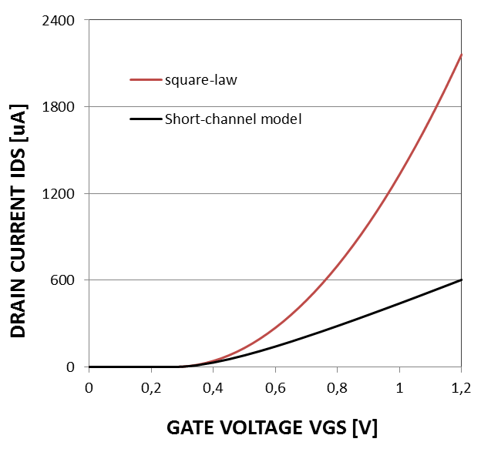
MOSFET – a square-law device
MOSFET transfer characteristic

Slide 10
MOSFET models
Models can predict I_{DS} for any V_{GS}/V_{DS}
I_{DS}
OFF
ON
Linear region
Max current
Saturation region
Saturation region
V_{DS}
OFF region
V_{DS}
OFF region
Linear region
Output characteristic
V_{GS}

Slide 11
CMOS Inverter
V_{OUT}
Equal saturation currents
yields the switching voltage
ΔV
V_{DD}
V_{SW}
0
V_{IN}
0
V_{TN}
V_{SW}
V_{DD}+V_{TP}
V_{DD}

Slide 12
CMOS Inverter
V_{OUT}
Simplify and assume V_{TN}=-V_{TP}=V_{DD}/4
1/2
V_{DD}
V_{SW}
0
V_{IN}
0
1/4
1/2
3/4
1

Slide 13
NAND/NOR VTC
Which VTC is NAND and which VTC is NOR?
V_{OUT}
V_{DD}
NOR3
NAND3
NAND
NOR
0
V_{IN}
0
1/4
3/8
5/8
3/4
1

Slide 14
CMOS Inverter – Noise margins
V_{OUT}
Simplify and assume V_{TN}=-V_{TP}=V_{DD}/4
1/2
Valid output
regions
V_{DD}
1/16
½-1/16
-1
V_{SW}
Non-valid
input region
½-1/16
-1
0
1/16
0
1/4
1/2
3/4
1
V_{IN}

Slide 15
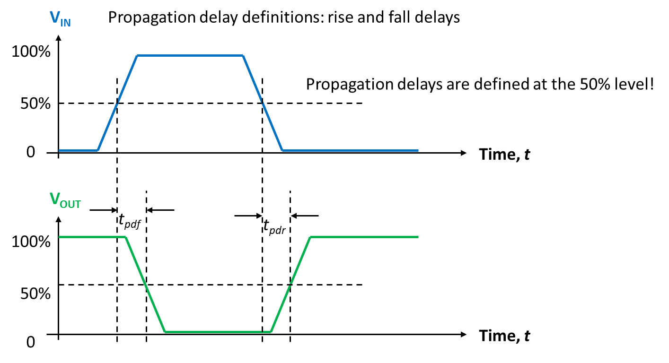
Switching the inverter
V_{DD}
ON
OFF
V_{IN}
V_{OUT}
V_{IN}=LOW
V_{IN}=HIGH
OFF
C_{L}
ON
V_{SS}

Slide 16
Defining the effective resistance . . .
I_{DS}
N-channel device - I_{DSAT,max} = 600 μA/μm
V_{DD}
R_{eff}
C_{G}
Slope G_{eff} =1/R_{eff}
I_{DSAT,max}
Defining the ideal, non-parasitic delay
tau = 0.7R_{eff}C_{G}= 5 ps in 65 nm CMOS
R_{eff}=V_{DD}/I_{DSAT,max}
V_{DS}
. . . and reference delay
tau
V_{DD}=1.2 V
V_{DD}
Notes:
During the lecture, we will exercise with some more examples, like these suggested here: the 3+1 AND-OR-INVERT, and the 3+1 OR-AND-INVERT, as well as some more examples similar to those just shown.

Slide 17
FO4 delay
X1
C_{G}
X1
V_{DD}
X1
C_{G}
X1
R_{eff}
C_{G}
X1
C_{D}
C_{G}
The FO4 propagation delay becomes

Slide 18
Defining logical effort
NAND3
NOR3
R
A
6
R
2
2
2
B
6
A
3
C
6
R
R
B
3
1
1
1
C
3

Slide 19
Wire delay
R₁
R₂
V_{in}
C₁
C₂
Each resistance is multiplied by its downstream capacitance!
R₁
V₁
R₂
V₂
V_{in}
C₁
C₂
Or: Each capacitance is multiplied by its upstream capacitance!

Slide 20
Elmore delay model
R₁
R₂
R₃
R₄
R₅
V₅
V_{in}
C₁
C₂
C₃
C₄
C₅
Estimate the propagation delay through the RC ladder knowing that the output voltage is given by
and realizing that we cannot determine any of the parameters involved analytically!
Hence, we use the Elmore delay model based on the assumption that one of the five time constants is dominant!
If so, the dominant time constant T_{E} (after W. C. Elmore) can be obtained by multiplying each of the resistances with its downstream capacitance!

Slide 21
Sizing the driver
driver inverter
receiver inverter
R
R_{W}
X
p_{inv}C
C_{W}/2
C_{W}/2
C
Wire π-model
1. Start by defining wire effort
2. Elmore
3. Normalize
4. Find minimum

Slide 22
Repeater insertion
driver inverter
receiver inverter
X120
R/m, C/m
X120
R/m, C/m
X120
driver model
R_{W} /m
receiver model
driver model
R_{W} /m
receiver model
R
C
R
C
p_{inv}C
C_{W}/2m
C_{W}/2m
C
p_{inv}C
C_{W}/2m
C_{W}/2m
C
Wire π-model
Wire π-model
Normalized delay m segments
Find minimum, i.e. ∂d/ ∂m=0, i.e. for
Minimum normalized delay is d=4√W_{E}.

Slide 23
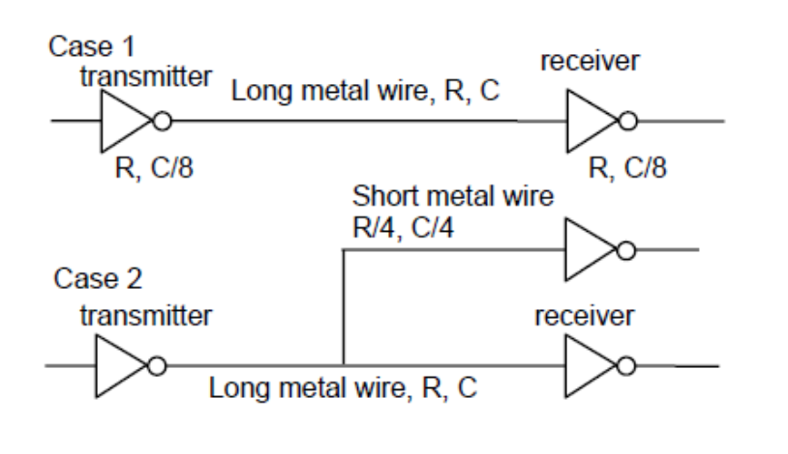
Divide and conquer
If they ask for the difference between x+a and x+b, i.e. a-b, we do not need to calculate x!
Branch contribution to delay is branch capacitance times upstream resistance
Total Elmore time constant is then 39RC/16≈2.5RC

Slide 24
Divide and conquer
The wire to the other receiver is shorter, only ¾ of the other wire length
Hence, the main path to the other receiver has resistance 3R/4 and capacitance 3C/4
Main path delay contribution is found to be 22RC/16, and branch contribution is 15RC/16
Total Elmore time constant is then 37RC/16≈2.3RC

Slide 25
The dot operator
The “dot operator” is associative and idempotent
G8
P8
G7
P7
G6
P6
G5
P5
G4
P4
G3
P3
G2
P2
G1
P1
G8:7
P8:7
G6:5
P6:5
G4:3
P4:3
G2:1
P2:1
G8:5
P8:5
G4:1
P4:1
G8:1
P8:1
Show that
Show that

Slide 26
The dot operator
Properties of the dot operator
  Associativity i.e. parallelization
    Easy to prove since logical OR and AND operations are associative
    With the definition G_{i} becomes the carry-out signal at stage i of an adder
  The operation is idempotent
  which implies
    where i≥j and m≥n

Slide 27
32-bit carry skip adder
Identify worst-case propagation delay for 32-bit adder!
For N-bit adder built with k n-bit blocks!
a_{32:25} b_{32:25}
a_{24:17} b_{24:17}
a_{16:9} b_{16:9}
a_{8:1} b_{8:1}
ADD/SUB logic
Bit P, G
ADD/SUB logic
Bit P, G
ADD/SUB logic
Bit P, G
ADD/SUB logic
Bit P, G
t_{pg}
P_{32:25}
P_{24:17}
P_{16:9}
P_{8:1}
c_{out}
1
0
+
1
0
+
1
0
+
1
0
+
c_{in}
Sum_{32:25}
Sum_{24:17}
Sum_{16:9}
Sum_{8:1}
Determine the worst case delay!

Slide 28
32-bit carry-lookahead adder
a_{32:25} b_{32:25}
a_{24:17} b_{24:17}
a_{16:9} b_{16:9}
a_{8:1} b_{8:1}
t_{pg(n)}
ADD/SUB logic
Bit P, G
t_{pg(n)}
ADD/SUB logic
Bit P, G
t_{pg(n)}
ADD/SUB logic
Bit P, G
ADD/SUB logic
Bit P, G
t_{pg}
c_{out}
≥1
G_{32:25}
P_{32:25}
≥1
G_{24:17}
P_{24:17}
≥1
G_{16:9}
P_{16:9}
≥1
G_{8:1}
P_{8:1}
&
&
&
&
c_{in}
+
+
+
+
Sum_{32:25}
Sum_{24:17}
Sum_{16:9}
Sum_{8:1}

Slide 29
Sklansky adder
16 15 14 13 12 11 10 9 8 7 6 5 4 3 2 1←CIN
Logic levels L=4
Extra levels l=0
Fanout 2^{f}+1=9
f=3
Wire tracks 2^{t}=1
t=0
l+f+t=L-1=3
(0, 3, 0)
16:0 15:0 14:0 13:0 12:0 11:0 10:0 9:0 8:0 7:0 6:0 5:0 4:0 3:0 2:0 1:0 0:0
Determine the worst case delay!

Slide 30
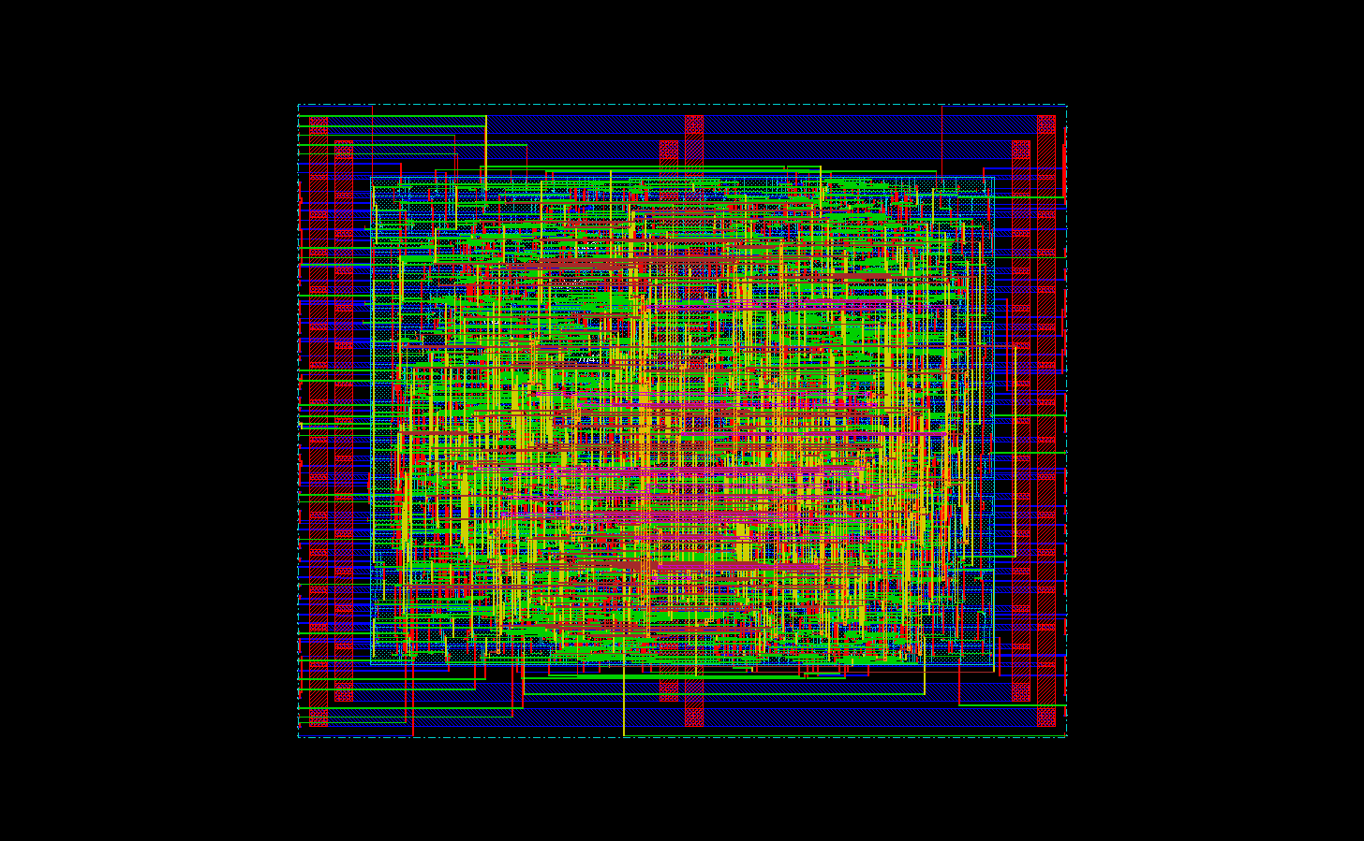
Example: synthesized 32-bit ALU layout

Slide 31
End of course wrap-up lecture!
Q & A?
Notes:
In this lecture, I have given you a little teaser of what this course is all about, on how to design CMOS logic gates, and how to put cells together to build multi-bit logic arrays. We will do a lot more of this during the course.
In this introduction, focus has been on functioanlity. Later, we will go into details about performance in terms of speed and power dissipation.
Questions you might have will answered, and problems you might have encountered will be discussed during the lecture.
Thank you very much for listening!

