Slide 1
Lecture 2
The MOSFET

Slide 2
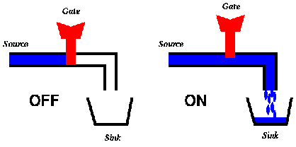


The MOSFET as a switch
In the digital world, the MOSFET is a switch that is either ON with conductance G_{ON}, or OFF with zero conductance, G_{OFF}=0
gate
gate
ON
G_{ON}
source
source
source
drain
source
S=1
drain
drain
gate
gate
OFF
G_{ON}
source
source
drain
G_{OFF}
drain
S=0
drain

Slide 3
Lecture outline
In this lecture we are going to have a closer look at some basic properties of the MOSFET beyond the switch model
Why?
Because, even if the switch model is good enough for designing logic CMOS gates based on their functionality . . .
. . . it is not good enough for determining the performance in terms of switching speed and power dissipation

Slide 4
Lecture outline
First we are going to learn how to calculate the voltage depen-dence of the ON resistance (or rather the ON conductance) of the MOSFET based on the principles of the field-effect.
Then we are going to learn why, for any gate voltage, there is a maximum current that a MOSFET switch can deliver or sink.

Slide 5
MOSFET output and transfer characteristics
I_{DS}
I_{DS}
V_{GT}
gate voltage overdrive
The MOSFET is turned ON
and a current that appears
to be proportional to V_{DS}
starts to flow
The MOSFET is turned ON
but for each gate voltage there is a maximum current that the MOSFET can sink or deliver
V_{GT2}
gate voltage overdrive
V_{DS}
V_{GS}
V_{DSAT}=
V_{GT}
OFF: I_{DS}=0
V_{T}
V_{DD}
Output characteristics
Transfer characteristics
The MOSFET is basically a “square-law” device!

Slide 6
The MOSFET structure
The metal-oxide-semiconductor structure
L_{S}
L_{D}
Metal gate
source
oxide
drain
W, the channel width
STI
L
STI
Silicon substrate
L is the channel length

Slide 7
The MOSFET capacitances
that must be lumped to the available ckt nodes, i.e. to source and drain
There is a distributed gate capacitance
The metal-oxide-semiconductor structure
And then we have the parasitic source and drain capacitances
L_{S}
L_{D}
C_{sidewall}
C_{sidewall}
Metal gate
source
drain
W, the channel width
STI
C_{bottom}
L
C_{bottom}
STI
Silicon substrate
L is the channel length

Slide 8
Equivalent electrical two-port circuit model
C_{GD}
C_{G}/2
The distributed gate to channel capacitance must be lumped to the available ckt nodes, i.e. to source and drain
V_{GS}
V_{DS}
C_{GS}
G_{ON}
C_{G}/2
C_{D}
V_{GS}
V_{DS}
V_{SS}
V_{SS}
Model for linear device
C_{G}
R_{eff}
C_{D}
C_{GD}=0
V_{GS}
V_{DS}
C_{G}
I_{DSAT}
C_{D}
V_{SS}
V_{SS}
V_{SS}
V_{SS}
“Average” model during switching of device output
Model for saturated device
where C_{ox} is the gate insulator capacitance per unit area, typically 20 fF/μm²
where p is a certain fraction of the gate capacitance, typically p=1

Slide 9
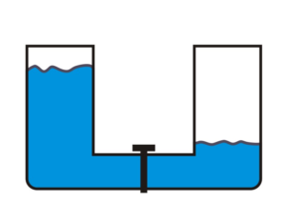
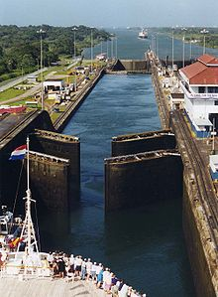
ON/OFF MOSFET operation
I_{DS}
V_{GS}=0
V_{S}=0
V_{DS}=0
source
drain
p-type substrate
source
drain
V_{DS}
In this illustration of the MOSFET operation, the source and drain will be considered like two oceans of charge carriers isolated from each other through a potential barrier.

Slide 10
ON/OFF MOSFET operation
– The drain level is lowered, but the source is still isolated by the potential barrier!
What if we apply small drain voltage?
I_{DS}
V_{GS}=0
V_{GS}=V_{T}
The MOSFET is turned ON
and a current that appears
to be proportional to V_{DS}
starts to flow
V_{GS}>V_{T}
V_{S}=0
V_{DS}=0
V_{DS}>0
source
drain
However, applying a certain gate voltage called the threshold voltage V_{T} will just about remove the barrier.
p-type substrate
source
drain
V_{DS}>0
V_{DS}
drain
OFF: I_{DS}=0
Increasing the gate voltage beyond the threshold voltage will lower the potential barrier at the source even further and form a conducting channel between source and drain.
In this illustration of the MOSFET operation, the source and drain will be considered like two oceans of charge carriers isolated from each other through a potential barrier.

Slide 11
Calculating the ON conductance, G_{ON}
For calculating the ON conductance G_{ON}, let´s have a look at the mobile charge in the channel!
I_{DS}
The MOSFET is turned ON
and a current that appears
to be proportional to V_{DS}
starts to flow
V_{GS}>V_{T}
V_{S}=0
V_{DS}>0
source
drain
Mobile charge Q_{S} at source (per unit length):
p-type substrate
Charge carrier drift velocity at the source: v_{S}=μE
Q_{S}
source
v_{S}
V_{DS}>0
, E=V_{DS}/L
V_{DS}
drain
OFF: I_{DS}=0
Drain current: I_{DS}=Q_{S}×v_{S}
C_{ox} is the gate capacitance per unit area
W is the channel width
V_{GT} =V_{GS}-V_{T} is the gate voltage overdrive
C_{ox} is the gate capacitance per unit area
W is the channel width
V_{GT} =V_{GS}-V_{T} is the gate voltage overdrive
μ is the charge carrier mobility [cm²/Vs]
E=V_{DS}/L is the electric field along the channel
In this illustration of the MOSFET operation, the source and drain will be considered like two oceans of charge carriers isolated from each other through a potential barrier.
If we introduce the conductance parameter
The drain current can be written

Slide 12
Having a closer look along the channel
I_{DS}
The MOSFET is turned ON
and a current that appears
to be proportional to V_{DS}
starts to flow
V_{GS}>V_{T}
V_{S}=0
V_{DS}>0
source
drain
Mobile charge Q_{S} at source (per unit length):
The result is a parabolic current model
w/ slope G_{ON} for small V_{DS}
p-type substrate
Mobile charge Q_{D} at drain (per unit length):
Q_{S}
(Q_{S}+Q_{D})/2
v_{S}
Q_{D}
v_{D}
V_{DS}>0
source
drain
V_{DS}
v=μV_{DS}/L
OFF: I_{DS}=0
C_{ox} is the gate capacitance per unit area
W is the channel width
V_{GT} =V_{GS}-V_{T} is the gate voltage overdrive
μ is the charge carrier mobility [cm²/Vs]
E=V_{DS}/L is the electric field along the channel
Here, Q_{D}<Q_{S} because of the drain voltage.
Hence, drift velocity is higher at drain than at source, v_{D}>v_{S},
This follows from the current being constant along the channel.
A thorough analysis based on the classical “gradual channel approximation” shows that the drain current is given by the average mobile charge density (Q_{S}+Q_{D})/2 times the average drift velocity v=μV_{DS}/L

Slide 13
Understanding current saturation
I_{DS}
The drain current seems to saturate as V_{DS}→V_{GT}
The MOSFET is turned ON
and a current that appears
to be proportional to V_{DS}
starts to flow
V_{GS}>V_{T}
V_{S}=0
V_{DS} → V_{GT}
source
drain
Mobile charge Q_{S} at source (per unit length):
The result is a parabolic current model
w/ slope G_{ON} for small V_{DS}
p-type substrate
Mobile charge Q_{D} at drain (per unit length):
Q_{S}
≈Q_{S}/2
source
v_{S}
Q_{D}≈0
v_{D}
V_{DS}→V_{GT}
V_{DS}
v=μV_{GT}/L
drain
V_{GT}
OFF: I_{DS}=0
C_{ox} is the gate capacitance per unit area
W is the channel width
V_{GT} =V_{GS}-V_{T} is the gate voltage overdrive
μ is the charge carrier mobility [cm²/Vs]
E=V_{DS}/L is the electric field along the channel
Here, Q_{D}→0 when V_{DS}→V_{GT} Hence, drift velocity at drain approaches “infinity”, i.e. v_{D} →∞.
This follows from the current being constant along the channel.
Hence, the drain current I_{DS}→ charge Q_{S}/2 × drift velocity μV_{GT}/L as V_{DS}→V_{GT}.

Slide 14
Understanding current saturation
I_{DS}
What if we increase the drain voltage beyond the gate voltage overdrive, i.e. V_{DS}>V_{GT}
The MOSFET is turned ON
and a current that appears
to be proportional to V_{DS}
starts to flow
V_{GS}>V_{T}
V_{S}=0
V_{DS} > V_{GT}
source
drain
Actually, the conditions within the channel does not change with the height of the “water fall” between the drain end of the channel and the drain!
The result is a parabolic current model
w/ slope G_{ON} for small V_{DS}
p-type substrate
Q_{S}
≈Q_{S}/2
source
v_{S}
Q_{D}≈0
v_{D}
V_{DS}
V_{DS}>V_{GT}
OFF: I_{DS}=0
v=μV_{GT}/L
V_{DSAT}=
V_{GT}
drain
The saturation current I_{DSAT} is given by the gate voltage overdrive V_{GT} squared!
The saturation voltage V_{DSAT} is given by Q_{D}=0, → V_{DSAT}=V_{GS}-V_{T} , i.e. the gate voltage overdrive V_{GT}
Drain current stays constant!

Slide 15
Piecewise linear MOSFET Model
I_{DS}
V_{GS}>V_{T}
What if we simplify the model, focusing on the two main behaviors of the MOSFET?
The MOSFET is turned ON
and a current that appears
to be proportional to V_{DS}
starts to flow
V_{GS}>V_{T}
V_{S}=0
V_{S}=0
V_{DS} > V_{GT}
V_{DS} > V_{GT}
source
source
drain
drain
Linear behavior for small drain voltages - G_{ON}
Saturated behavior for large drain voltages - I_{DSAT}
p-type substrate
p-type substrate
Q_{S}
Q_{S}
v_{S}
≈Q_{S}/2
Q_{D}≈0
v_{D}
v_{S}
≈Q_{S}/2
Q_{D}≈0
v_{D}
source
source
V_{DS}>V_{GT}
What if we decrease the gate voltage overdrive?
V_{DS}
v=μV_{GT}/L
V_{DS}>V_{GT}
OFF: I_{DS}=0
v=μV_{GT}/L
V_{DSAT}=
V_{GT}
drain
drain

Slide 16
MOSFET output and transfer characteristics
I_{DS}
I_{DS}
V_{GT}
gate voltage overdrive
The MOSFET is turned ON
and a current that appears
to be proportional to V_{DS}
starts to flow
The MOSFET is turned ON
but for each gate voltage there is a maximum current that the MOSFET can sink or deliver
V_{GT2}
gate voltage overdrive
V_{DS}
V_{GS}
V_{DSAT}=
V_{GT}
OFF: I_{DS}=0
V_{T}
V_{DD}
Output characteristics
Transfer characteristics
The MOSFET is basically a “square-law” device!

Slide 17
Example
V_{GT}/2
I_{DS}
Maximum current that a
MOSFET can deliver or sink
A fully turned on MOSFET has an on resistance of 1 kΩ. What is the maximum current that this device can deliver or sink? Assume V_{DD}=1.2 V, and V_{T}=0.3 V.
Solution: We know that a long-channel MOSFET saturates for V_{DSAT}=V_{GT}=V_{GS}-V_{T}. Hence, in this case we have V_{DSAT}=0.9 V.
Since the MOSFET is a square-law device (w/ parabolic I-V model) we know that the piecewise linear model breakpoint occurs at V_{GT}/2.
V_{DS}
V_{DSAT}=
V_{GT}
Hence, maximum current is given by

Slide 18
Model can predict I_{DS} for any V_{GS}/V_{DS}
V_{DS}
V_{DD}
OFF
ON
V_{DS}=V_{DSAT}=V_{GS}-V_{T}
Saturation region
Linear region
V_{GS}
V_{T}
V_{DD}

Slide 19
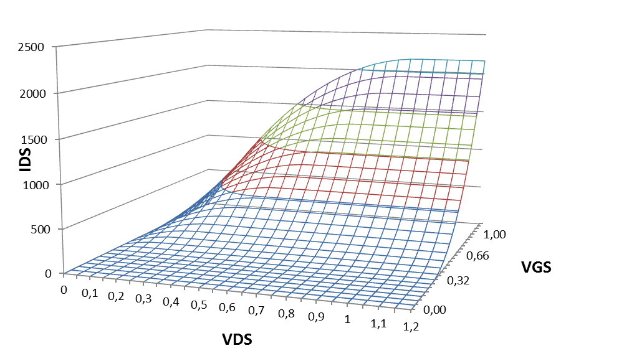
I_{DS} can be plotted in 3D vs. V_{GS}&V_{DS}
I_{DS} vs V_{GS}: transfer characteristic
V_{DS}
V_{GS}
V_{GS}
I_{DS} vs V_{DS}: output characteristic

Slide 20
MOSFET regions of operation
Why are colored MOSFET regions of operation important?
Because they visualize the formula to use for estimating the drain durrent
SATURATION REGION
OFF REGION
OUTPUT VOLTAGE VDS
LINEAR REGION
R_{OFF}=∞
CONTROL VOLTAGE VGS

Slide 21
VDS
SATURATION REGION
OFF REGION
OUTPUT VOLTAGE VDS
N-channel MOSFET
LINEAR REGION
R_{OFF,N}=∞
CONTROL VOLTAGE VGS
CONTROL VOLTAGE VGS
VGS
LINEAR REGION
R_{OFF,P}=∞
OUTPUT VOLTAGE VDS
OFF REGION
P-channel MOSFET
SATURATION REGION

Slide 22
I_{DS}
I_{DSAT}
saturation
N-channel MOSFET
V_{DS}
P-channel MOSFET
I_{DSAT}
saturation

Slide 23
Summary
In this lecture, The MOSFET has been regarded as an electrically controlled ON/OFF switch.
Input and output voltages are referred to source
Current controlling gate voltage V_{GS}.
The output drain voltage V_{DS}.
The MOSFET current is a function of both voltages, V_{GS} and V_{DS}.
When ON, the MOSFET behaves
like a resistor R_{ON} in its linear region,
like a constant-current source I_{DSAT} in its saturation region.
First-order approximation yields a square-law model for I_{DSAT}=f(V_{GT}²)
When OFF, there is a subthreshold leakage current, I_{SUB}.
Very useful to color code the three regions of operation
Red for OFF
Green for ON and saturated (and blue for ON and linear operation)

Slide 24
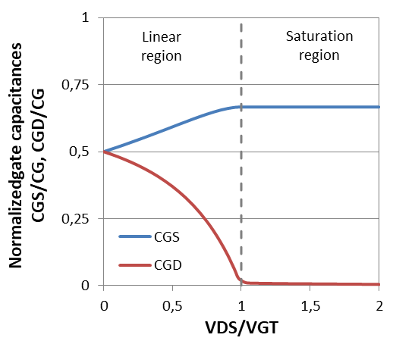
Equivalent electrical two-port circuit model
C_{GD}
C_{G}/2
In the linear region, the capacitance splits equally between source and drain
The distributed gate to channel capacitance must be lumped to the available ckt nodes, i.e. to source and drain
V_{GS}
V_{DS}
C_{GS}
G_{ON}
C_{G}/2
V_{GS}
V_{DS}
V_{SS}
V_{SS}
Model for linear device
C_{G}
R_{eff}
C_{GD}=0
C_{GD}
V_{GS}
V_{DS}
C_{GS}
I_{DSAT}
⅔C_{G}
V_{SS}
V_{SS}
V_{SS}
V_{SS}
In the saturation region, the capacitance tilts towards the source!
“Average” model during switching of device output
Model for saturated device
Q: Why use C_{GS}=C_{G} and not C_{GS}=⅔C_{G}?
A: Integers are easier to handle and there are parasitic overlap and fringing field caps there to motivate the approximation!
The field-effect upon which the operation of a
MOSFET relies, gives the MOSFET a capacitive input!

Slide 25
Effective resistances: 65 nm MOSFETs
R_{N,eff}=2 kΩ.μm
R_{P,eff}=4 kΩ.μm
I_{DS}
N-channel device
I_{DS}
P-channel device
I_{DSAT,max} =
600 μA/μm
I_{DSAT,max} =
300 μA/μm
V_{DS}
V_{DS}
V_{DSAT}
V_{DD}=1.2 V
V_{DSAT}
V_{DD}=1.2 V
Q: Why is there a difference between n- and p-channel effective resistances?
A: Hole mobility in p-channel device is only half of electron mobility in n-channel device!

Slide 26
MOSFET gate capacitance
FYI, there are also parasitic overlap and fringing field capacitances between the gate and source/drain
L_{S}
L_{D}
Metal gate
source
drain
W, the channel width
STI
STI
L, the channel length
The capacitance between gate and channel, C_{G}=WLC_{ox}, is intrinsic to the field effect!
In a 65 nm CMOS process, typically C_{ox}=20 fF/μm²
When using fixed channel lengths, L=65 nm, as in digital designs, gate cap C_{G} scales with channel width

Slide 27
Source/drain parasitic capacitances
L_{S}
L_{D}
C_{sidewall}
Metal gate
C_{sidewall}
source
drain
W, the channel width
STI
STI
C_{bottom}
C_{bottom}
The source and drain capacitances are extrinsic to the field effect!
Therefore regarded as parasitic capacitances, but are non-negligible, i.e. C_{D}=pC_{G}, where p≈1.
Sidewall caps due to source/drain lateral dimensions L_{S} and L_{D}, are usually small
Just as for the gate cap, we will consider source/drain caps scalable with channel width

Slide 28
65 nm CMOS capacitances
C_{ox}≈20 fF/um²
(corresponds to 1.2 nm effective oxide thickness)
60 nm effective channel length yields: C_{G}=1.2 fF/um
Drain/source parasitic caps
The parasitic caps are of the same order of magnitude as the
gate capacitance, C_{S}=C_{D}=pC_{G}
Generic approach is to use p=1 for simplicity
But sometimes p=0.5 or p=0.8!
L_{D}
W
channel
length, L
L_{S}
STI:
shallow trench isolation

Slide 29
Equivalent electrical two-port circuit model
C_{GD}
C_{G}/2
The distributed gate to channel capacitance must be lumped to the available ckt nodes, i.e. source and drain
V_{GS}
V_{DS}
C_{GS}
G_{ON}
C_{G}/2
C_{D}
V_{GS}
V_{DS}
V_{SS}
V_{SS}
Model for linear device
C_{G}
R_{eff}
C_{D}
C_{GD}=0
V_{GS}
V_{DS}
C_{G}
I_{DSAT}
C_{D}
V_{SS}
V_{SS}
V_{SS}
V_{SS}
“Average” model during switching of device output
Model for saturated device
where C_{ox} is the gate insulator capacitance per unit area, typically 20 fF/μm²
where p is a certain fraction of the gate capacitance, typically p=1

Slide 30
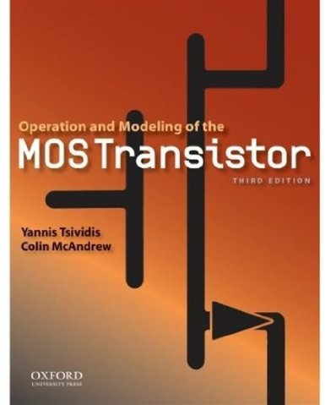

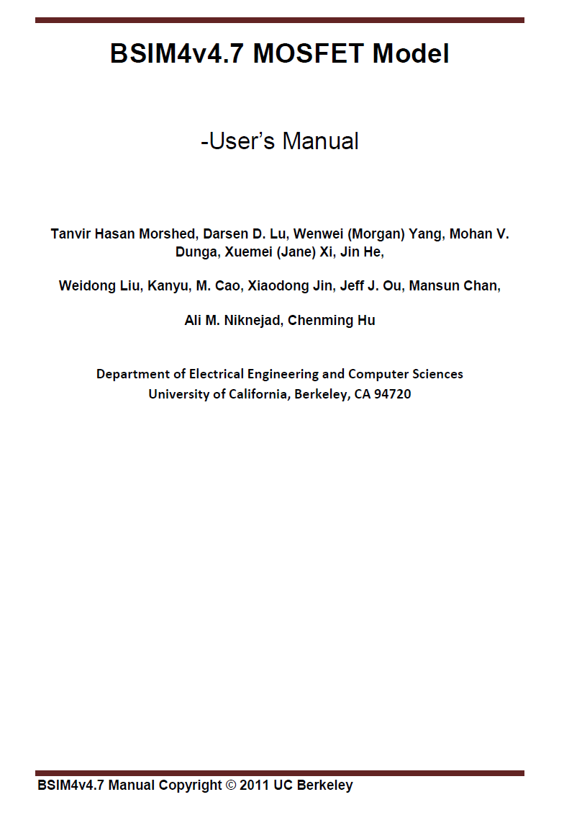
The MOSFET in detail
A number of textbooks treat MOSFET models in great detail, including their physical background and short-comings due to short-channel effects in nanoscale devices

Slide 31
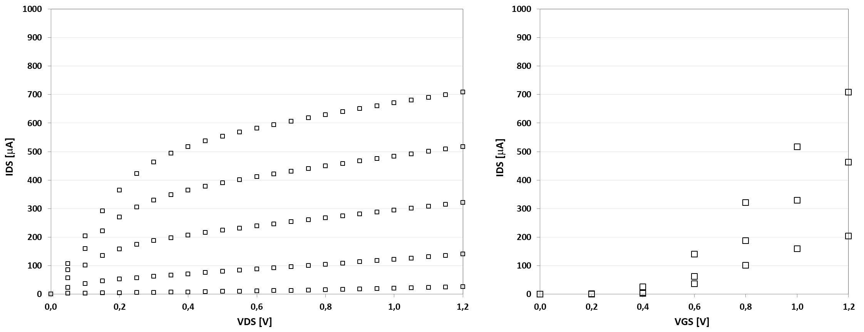
How good is my model?
More parameters considering second-order effects must be included for fitting model to experimental data

Slide 32
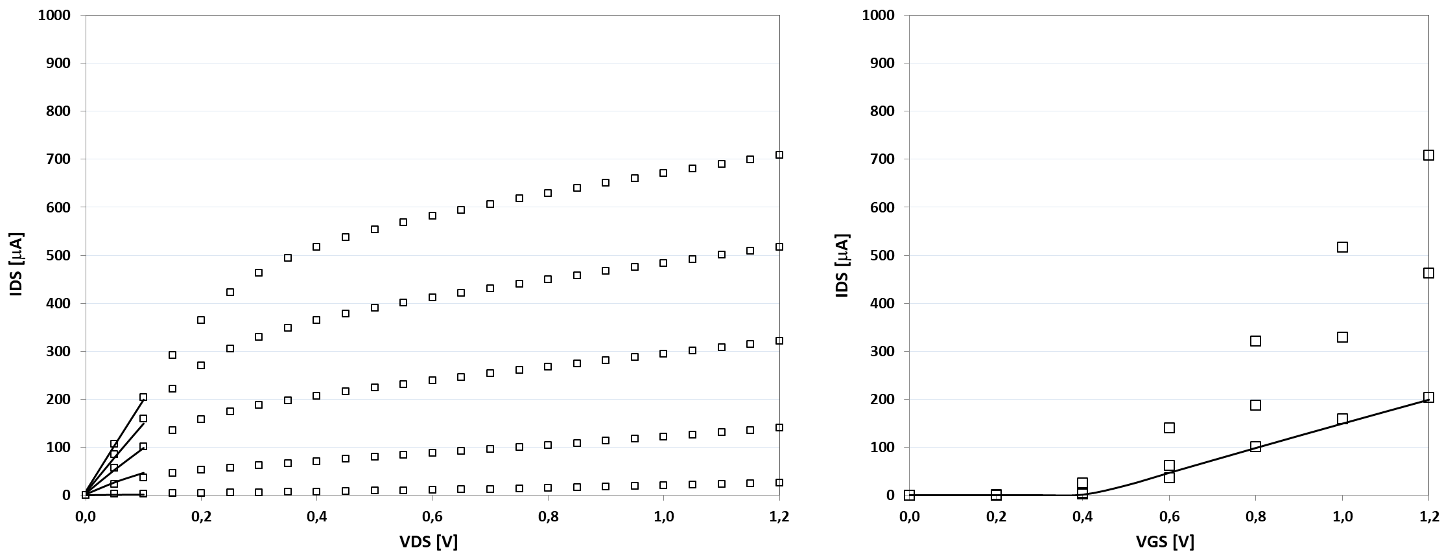
Determine k and V_{T} @ V_{DS}=100 mV
More parameters considering second-order effects must be included for fitting model to experimental data

Slide 33
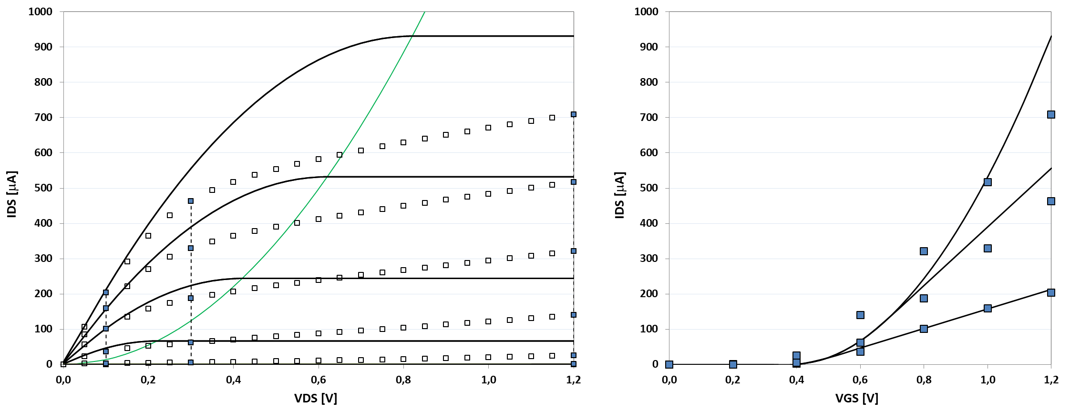
Determine k and V_{T} @ V_{DS}=100 mV
More parameters considering second-order effects must be included for fitting model to experimental data

Slide 34
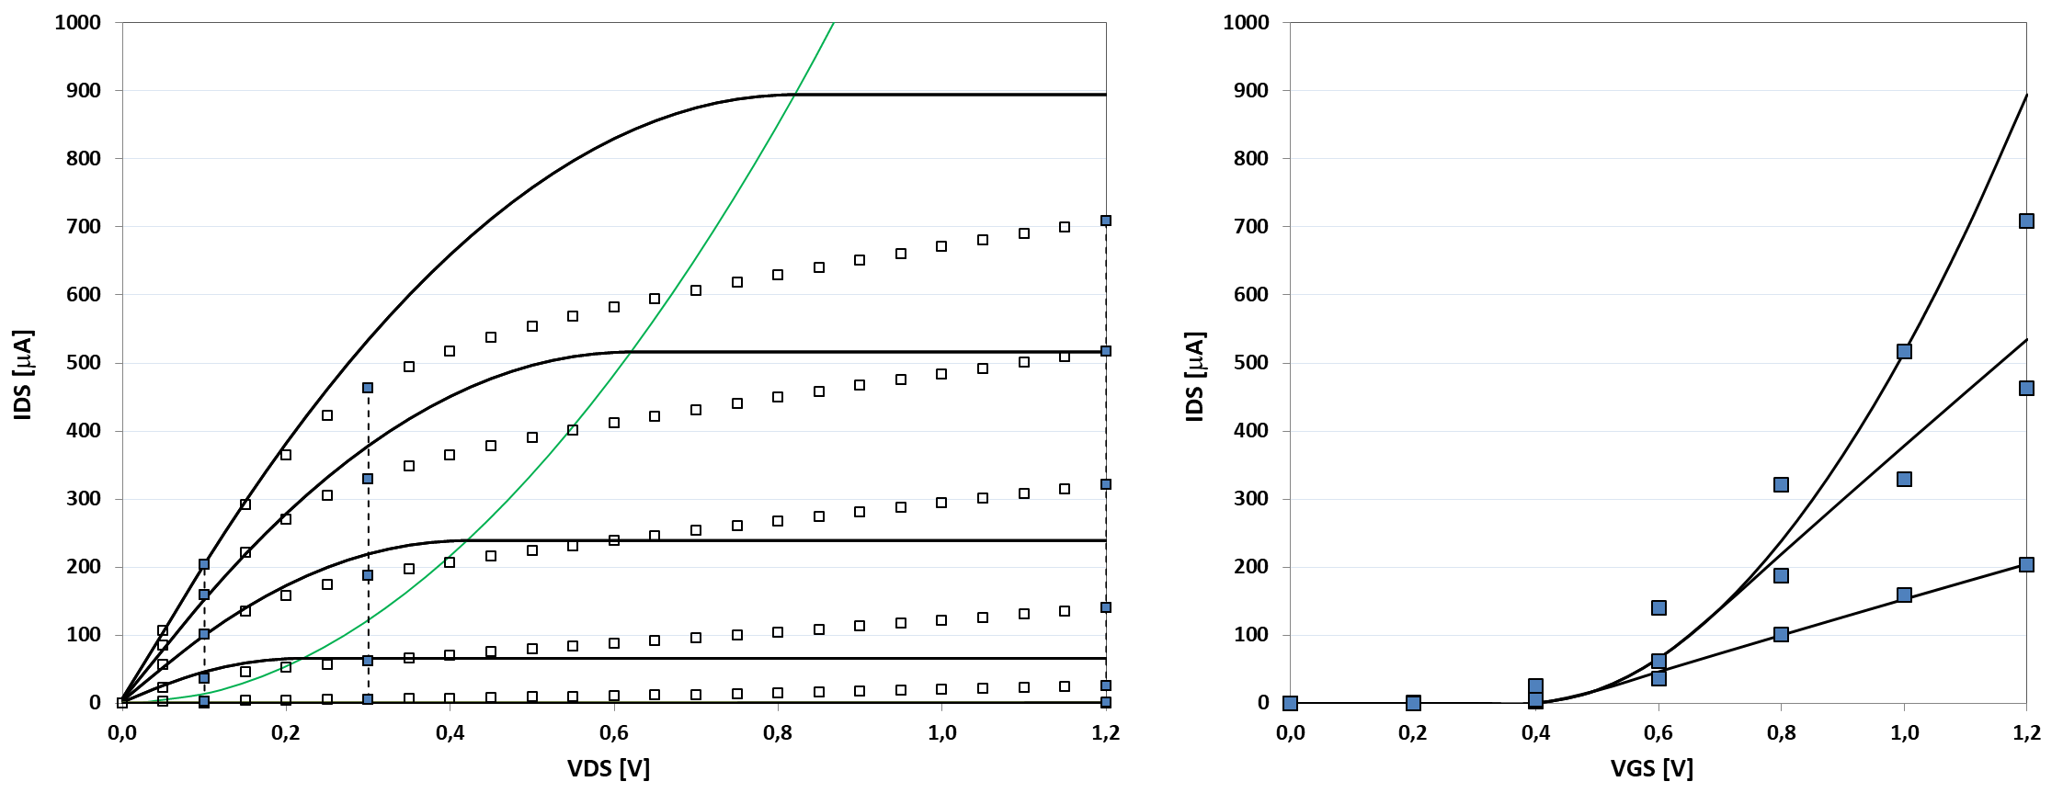
Include mobility roll-off

Slide 35
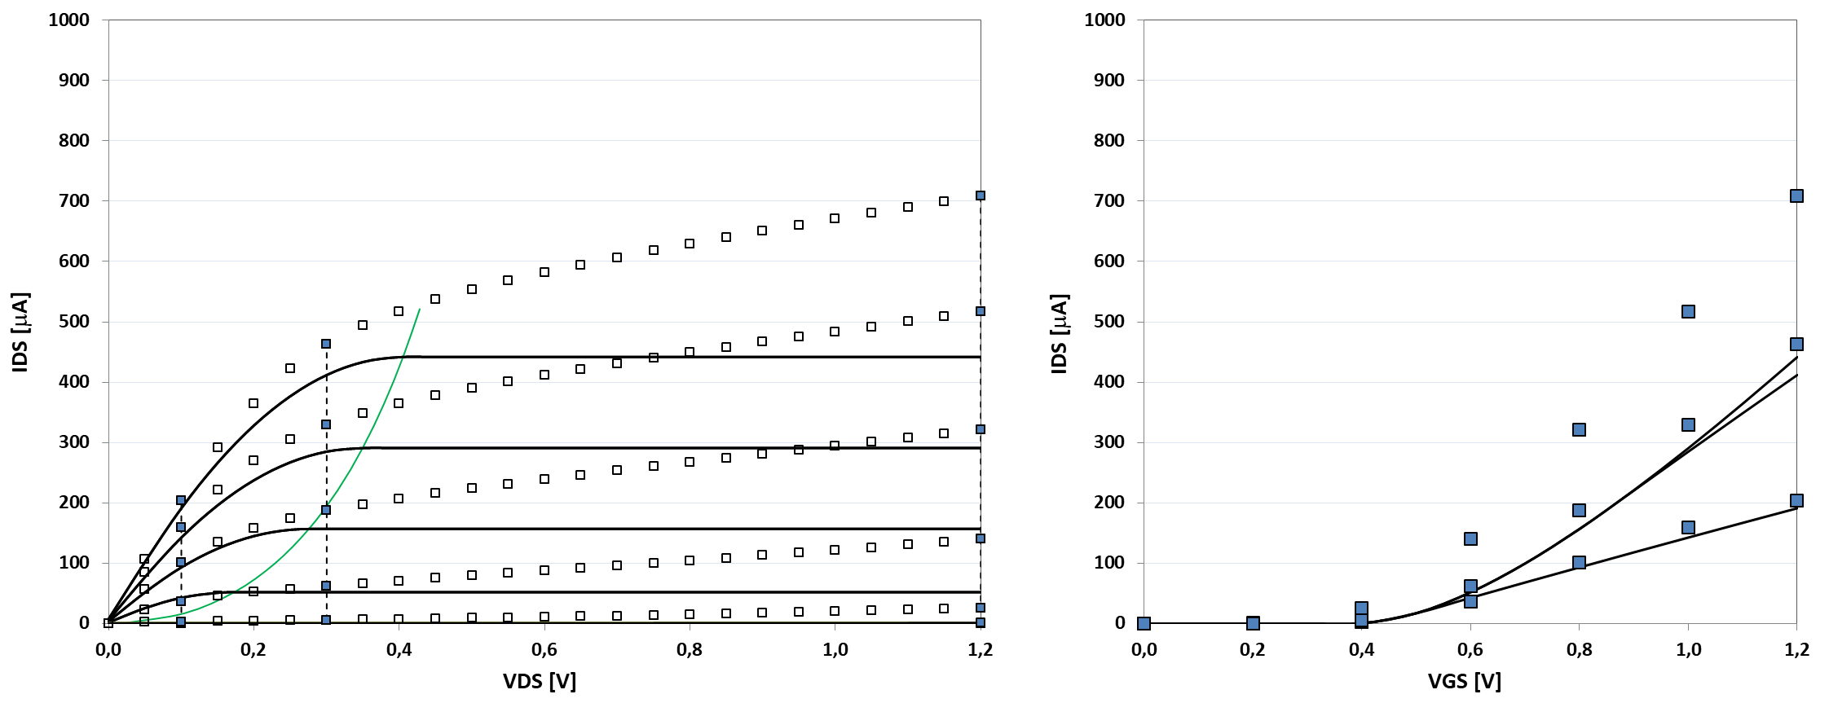
Consider velocity saturation

Slide 36
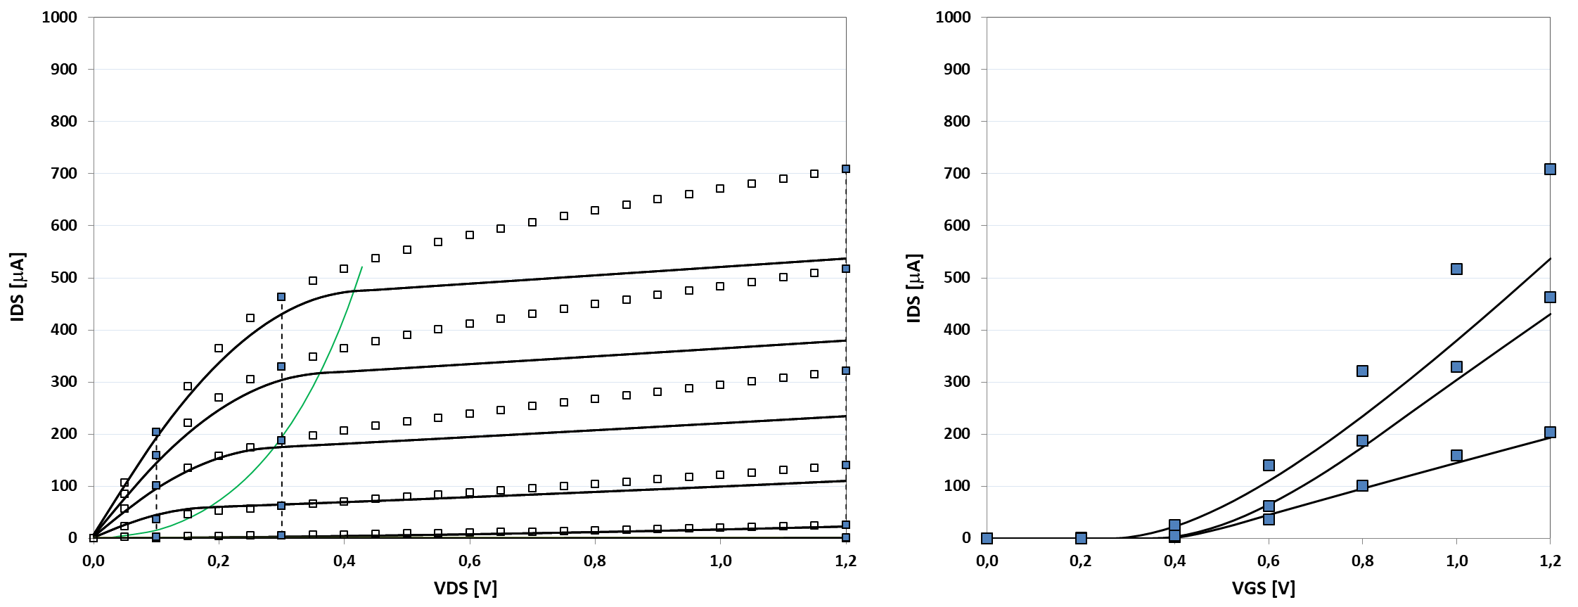
Consider drain-induced barrier-lowering (DIBL)

Slide 37
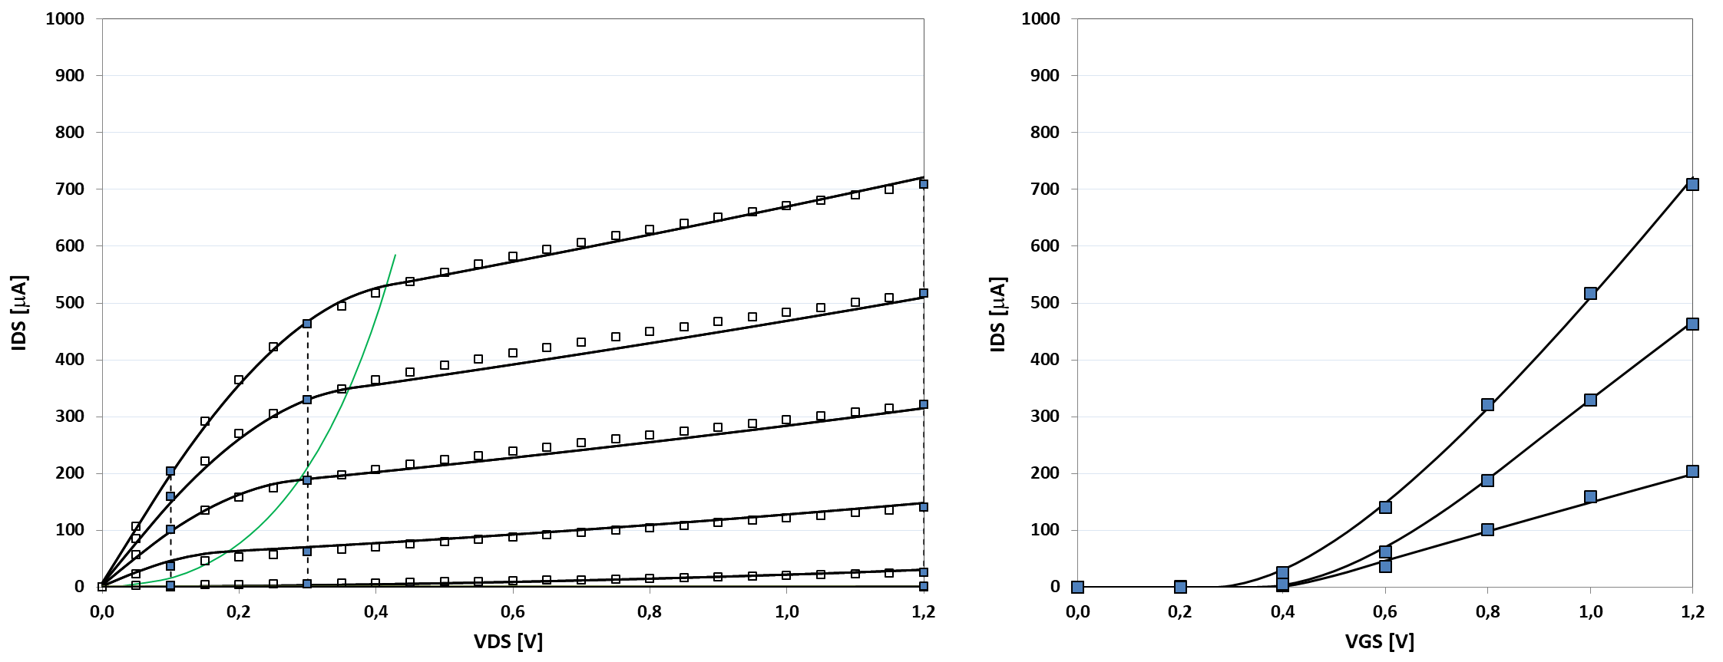
Consider channel length modulation (CLM)

Slide 38
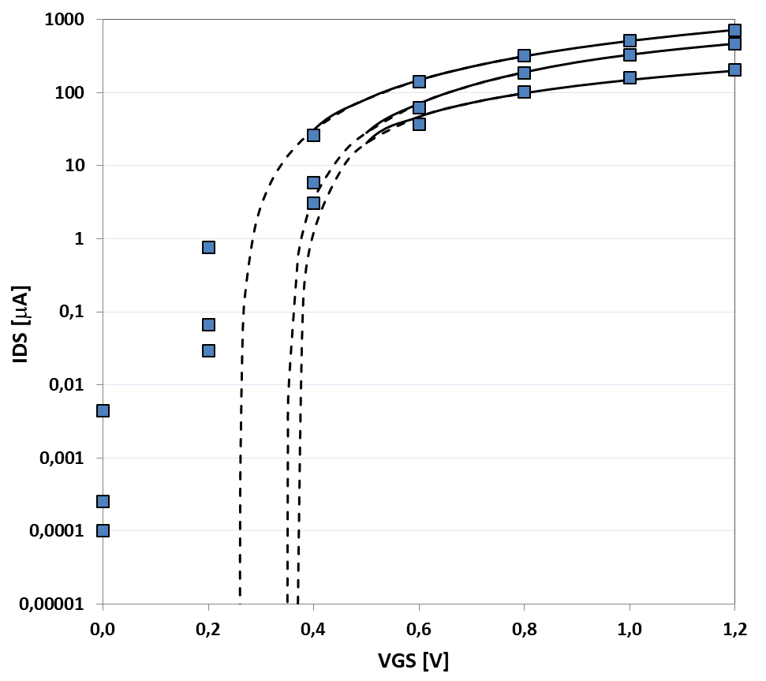
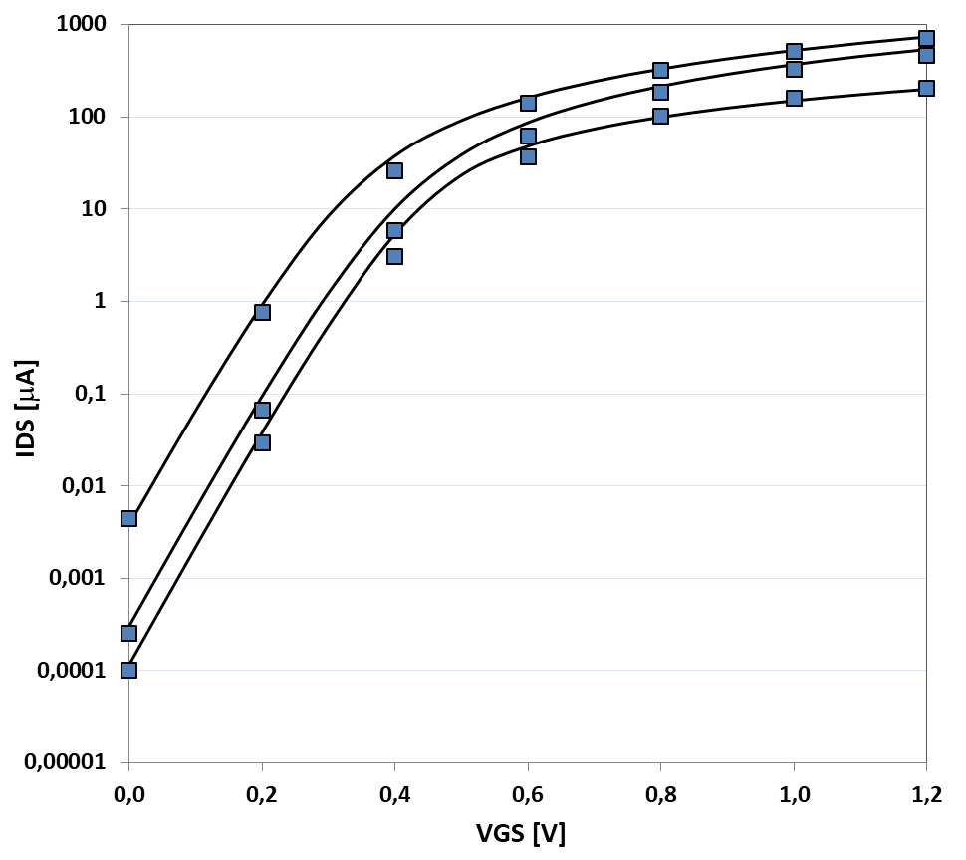
Subthreshold leakage
Replot transfer characteristic on a semilogarithmic scale!

Slide 39
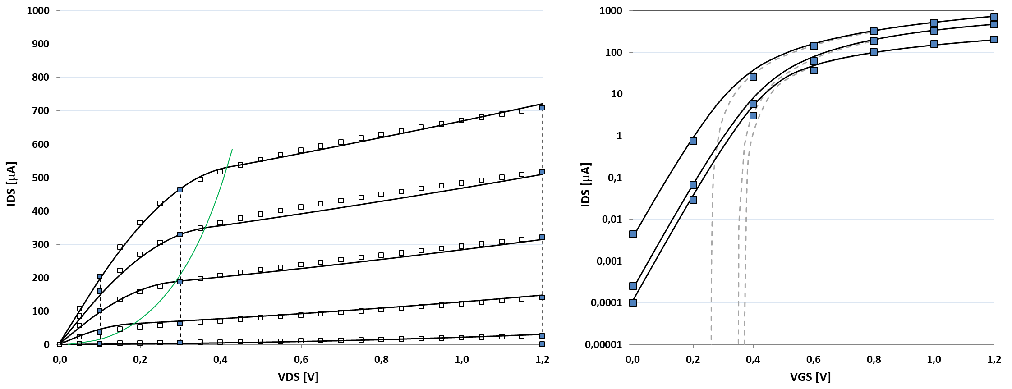
Subthreshold leakage
Replot transfer characteristic on a semilogarithmic scale!
I_{ON}
I_{OFF}
Subthreshold swing
S= 80 mV/decade

Slide 40
Conclusion
In this lecture, we started considering MOSFET static properties
Three regions of operation
Two ON regions: linear or saturated
One OFF region: subthreshold
In second half of lecture we also considered dynamic properties
The intrinsic gate capacitance
The extrinsic, or parasitic drain capacitance
We came up with a two-port model including both static circuit elements (resistor or current-source), and dynamic elements, i.e. capacitances!

