Slide 1
CMOS Logic Gates a delay model
Introducing logical effort
Lecture 5

Slide 2
Weekly schedule
Week 1
  Intro & the transistor
Week 2
  The CMOS inverter – one or more (tapered buffer)
Week 3
  Lab 1 Inverter schematic entry
  Delay model for CMOS gates – optimal path delay + ILAs
Week 4
  Lab 2 Carry circuit ILA schematic entry
  Physical design, layout, geometrical design rules
Week 5
  Lab 3 Carry circuit ILA layout and verification
  Wires, delay with wires & gates
Week 6
  Lab 4 Clock tree w. wires text entry & simulation
  Sequential & adders
Week 7
  Power & speeding up adders
Week 8
  Review

Slide 3
Week 3
Monday lab1
  CMOS inverter static and dynamic
Tuesday
  Lecture Delay with gates, logical effort
  Postlab review lab 1
Thursday
  Prelab lab 2, Lecture on optimal path delay
  Tutorial POTW (Victor)
Friday Deadline prelab 2 –
  Schematic entry of carry ckt of full adder

Slide 4
From MUD cards
Definitions
  Why is rise and fall time defined as 20 % to 80 %?
  Why is propagation delay defined from 50 % to 50 %?
Model of inverter
  Explanation of the step response model
  How to derive the equivalent model of one inverter
  Inverter output changes from input voltage confusing
One inverter driving on other inverter
  How resistance R_{eff} and C_{G} could give time constant?
  The relationship between C_{L} and width.
Fanout-of-four (FO4) delay
  How to derive the delay
  How does scaling work with FO4
Tapered buffer (will review on Thursday)
  What is fanout (H) and the concept of optimum fanout.
  How calculate the number of inverters needed to minimize delay.

Slide 5
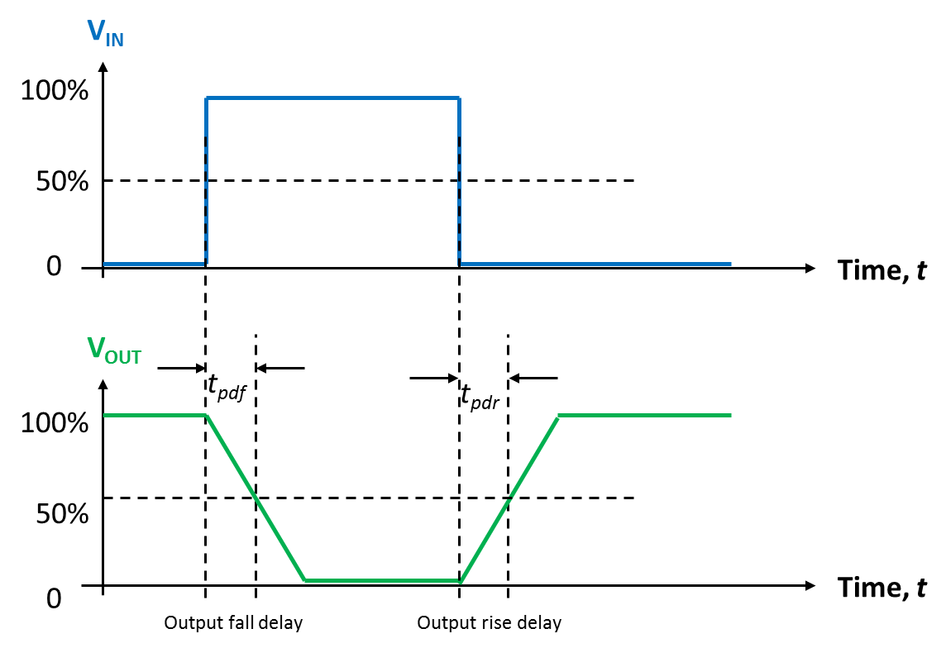
Step-response model
1. Charging the load capacitor through the p-channel MOSFET
V_{DD}
V_{IN} goes LOW
ON
V_{IN}
V_{OUT}
V_{IN}=LOW
C_{L}
OFF
V_{OUT} goes HIGH
I_{DS,P}
V_{SS}
I_{DSAT,P}
V_{OUT}
Output rise delay
V_{DD}/2
V_{DD}
pMOS current flow in detail
Notes:
Note that the xcharging current is constant!

Slide 6
Step-response model
2. Discharging the load capacitor through the n-channel MOSFET
V_{DD}
V_{IN} goes HIGH
OFF
V_{IN}
V_{OUT}
V_{IN}=HIGH
ON
C_{L}
V_{OUT} goes LOW
I_{DS,N}
V_{SS}
I_{DSAT,N}
V_{OUT}
V_{DD}/2
V_{DD}
Output fall delay
nMOS current flow in detail
Notes:
Note that the current is constant!

Slide 7
Electrical model for saturated MOSFET
(from lecture 2)
V_{G}
V_{D}
C_{G}
I_{DSAT}
C_{D}
V_{S}
V_{S}
Model for saturated MOSFET
Valid for both nMOS and pMOS transistors
Notes:
Model has been slightly updated so that it is correct also for pMOSFETs

Slide 8
The inverter and its electrical model
Replace the MOSFETs with their equivalent electrical circuits!
V_{DD}
C_{GP}
I_{DSP}
C_{DP}
PMOS
V_{IN}
V_{OUT}
V_{DD}
V_{DD}
V_{IN}
V_{OUT}
NMOS
C_{GN}
I_{DSN}
I_{DSN}
C_{DN}
V_{SS}
V_{SS}
V_{SS}

Slide 9
The inverter and its electrical model
Change the sign of the pMOS current so that all currents are positive
(We also made the pMOS voltages positive, although it is not necessary)
V_{DD}
C_{GP}
I_{SDP}
C_{DP}
PMOS
V_{IN}
V_{OUT}
V_{DD}
V_{DD}
V_{IN}
V_{OUT}
NMOS
C_{GN}
I_{DSN}
I_{DSN}
C_{DN}
V_{SS}
V_{SS}
V_{SS}

Slide 10
The inverter and its electrical model
Place all capacitors to signal ground! Both rails are constant voltages, no dV/dt
V_{DD}
V_{DD}
V_{DD}
I_{SDP}
V_{IN}
V_{OUT}
V_{IN}
V_{OUT}
C_{G}=C_{GN}+C_{GP}
I_{DSN}
I_{DSN}
C_{D}=C_{DN}+C_{DP}
V_{SS}
V_{SS}
V_{SS}
Inverter input capacitance: C_{G}=C_{GN}+C_{GP}; MOSFET gate capacitances add!
Inverter parasitic output capacitance: C_{D}=C_{DN}+C_{DP}. Drain caps also add!

Slide 11
The inverter and its electrical model
Eliminate V_{DD} rail by inserting power supply to signal ground!
V_{DD}
V_{IN}
V_{OUT}
V_{IN}
V_{OUT}
C_{G}=C_{GN}+C_{GP}
I_{SDP}
I_{DSN}
C_{D}=C_{DN}+C_{DP}
V_{DD}
V_{SS}
V_{SS}
V_{SS}
Inverter input capacitance: C_{G}=C_{GN}+C_{GP}; MOSFET gate capacitances add!
Inverter parasitic output capacitance: C_{D}=C_{DN}+C_{DP}. Drain caps also add!

Slide 12
The inverter and its electrical model
Replace MOSFET constant-current sources with their effective resistances!
V_{DD}
R_{N,eff}=2 kΩ.μm
R_{P,eff}=4 kΩ.μm
V_{IN}
V_{OUT}
V_{IN}
V_{OUT}
C_{G}=C_{GN}+C_{GP}
R_{P,eff}
R_{N,eff}
C_{D}=C_{DN}+C_{DP}
V_{DD}
V_{SS}
V_{SS}
V_{SS}
Inverter input capacitance: C_{G}=C_{GN}+C_{GP}; MOSFET gate capacitances add!
Inverter parasitic output capacitance: C_{D}=C_{DN}+C_{DP}. Drain caps also add!

Slide 13
Inverter pair delay
Task: Calculate the inverter pair delay!
Note: identical inverters
V_{DD}
R_{eff}

Slide 14
Inverter pair delay
V_{OUT}
Equivalent electrical circuit for propagation delay calculations
R_{eff} and C_{G} come from
different inverters to form
tau = 0.7 R_{eff}C_{G}
V_{DD}
R_{eff}
With fanout = 1, that is the
two inverters having the
same widths, tau is the
resulting time
constant.
C_{D}
C_{G}
Propagation delay:
All delay calculations are made wrt to this technology time constant tau (𝜏)

Slide 15
FO4 delay
V_{OUT}
Equivalent electrical circuit for propagation delay calculations
V_{DD}
The load 4C_{G} can be due to
four inverters with width = 1
or
one inverter with width = 4
or some other combination.
So C_{L} is related to the
widths of the loading inverters.
R_{eff}
C_{D}
4C_{G}
Propagation delay:

Slide 16
FO4 delay scaled
V_{OUT}
Make all the inverters twice as wide as before
also the loading ones
V_{DD}
R_{eff} /2
4 × 2C_{G} = 8C_{G}
2C_{D}
Propagation delay:

Slide 17
FO4 delay scaled
V_{OUT}
Make all the inverters half as wide as before – also the loading ones
V_{DD}
2R_{eff}
C_{D}/2
4 × C_{G}/2 =2C_{G}
Propagation delay:

Slide 18
Delay with any load
V_{OUT}
Equivalent electrical circuit for propagation delay calculations
C_{L} is the placeholder for the load capacitance.
C_{L} can be due to anything capacitive connected to the driving inverter’s output.
If C_{L} stems from inverters then C_{L} is related to the
widths of the loading inverters.
V_{DD}
R_{eff}
C_{D}
C_{L}
Propagation delay:
h = electrical effort

Slide 19
Background
In previous lecture, lecture 4, we have developed a propagation delay model for CMOS inverters.
For equal rise and fall delays, we have decided to use p-channel devices twice as wide as the n-channel device.
An n-channel MOSFET of unit width was assumed to have effective resistance R and gate capacitance C.
Hence, a p-channel device of two units width has the same effective resistance R, but gate capacitance 2C.
The inverter designed with such MOSFETs has input capacitance 3C, and equal pull-up and pull-down resistances.

Slide 20
CMOS inverter –Transistor sizing
2 units wide
IN
OUT
3C
3C_{drain}
1 unit wide
Note:
C is the gate capacitance of a MOSFET 1 unit wide
C_{drain} is the drain capacitance of a MOSFET 1 unit wide

Slide 21
CMOS inverter – cell sizing
2 units wide
IN
OUT
3C
3C_{drain}
V_{IN}
X2
V_{OUT}
1 unit wide
V_{IN}
X10

Slide 22
CMOS inverter – cell sizing
VDD supply rail
In ST cell library, size X refers to the input cap
(and for inverters also to the driving capability)!
N-well
V_{IN}
X2
V_{OUT}
V_{IN}
V_{IN}
X10
VSS supply rail

Slide 23
Inverter propagation delay model with load
Propagation delay definitions: rise and fall delays
t_{pdf}
V_{IN}
V_{OUT}
50%
C_{G}
C_{D}
C_{L}
t_{pdr}
We defined time constant tau equal to 5 ps in 65 nm CMOS technology. Furthermore, we introduced parasitic delay p_{inv}=C_{D}/C_{G}, and electrical effort h=C_{L}/C_{G}.

Slide 24
Inverter propagation delay model
Two-port electrical representation of propagation delay model
R
V_{IN}
V_{OUT}
C_{G}
V_{DD}
C_{D}
V_{SS}
V_{SS}

Slide 25
Logic gate propagation delay model
Now we want to apply the same model to any CMOS logic gate
VDD
The pull-up and pull-down networks may have many different paths, but we want to design for equal effective resistance R_{eff} in all paths!
But . . . what price do we have to pay for this in terms of input capacitance, C_{IN}?
And in parasitic capacitance, C_{par}?
pMOS
pull-up
network
One input
OUT
C_{L}
C_{IN}
nMOS
pull-down
network
C_{par}
R_{eff}
V_{IN}
V_{OUT}
C_{IN}
V_{DD}
C_{par}
VSS
V_{SS}
V_{SS}
C_{IN} is the input capacitance for one of the inputs to the logic gate
C_{par} is the total parasitic capacitance at the gate output

Slide 26
Prerequisite: same worst-case resistance in all paths
Example: 2–input NAND gate
With 2/1 P vs N scaling
W
W
Worst case:
A=0 & B=1
Or B=1 & A=1
=> R_{eff}/2
Conclusion:
Need to change
widths in
p-net or n-net
(or both).
Many possible solutions with
same worst-case resistance
in n-net and p-net
W
2W
2W
W
A
W
Worst case:
A=1 & B=1
=> R_{eff}
2W
2W
B
W
2W
2W
If we don’t scale for same resistance we
cannot use equivalent gate model with R_{eff} to the right of the switch.
Notes:
If we do not perform this scaling we cannot move Reff to the right of the switch in the model!

Slide 27
Logic gate propagation delay model
Now we want to apply the same model to any CMOS logic gate
Assume all pull-up/down paths have same resistance R_{eff}. Obviously, the logic gate will have larger RC product than the inverter! What is the delay with load C _{L} from one of the inputs to the logic gate?
As before, normalize to process time constant tau!
VDD
pMOS
pull-up
network
One Input
OUT
C_{L}
C_{IN}
nMOS
pull-down
network
C_{par}
R_{eff}
V_{OUT}
V_{IN}
C_{IN}
V_{DD}
C_{par}
C_{L}
VSS
V_{SS}
V_{SS}

Slide 28
Logic gate propagation delay model
Now we want to apply the same model to any CMOS logic gate
VDD
Consider one delay term at a time!
pMOS
pull-up
network
One Input
OUT
C_{L}
C_{IN}
nMOS
pull-down
network
C_{par}
VSS
Here, we have defined the logical effort of a logic gate, g
The logical effort tells us how much larger the logic gate RC product is wrt inverter RC product!

Slide 29
Logic gate propagation delay model
To simplify, we suggest sizing MOSFETs for equal effective resistances, i.e. R_{eff}=R
VDD
Consider one delay term at a time!
pMOS
pull-up
network
One Input
OUT
C_{L}
C_{IN}
nMOS
pull-down
network
C_{par}
This method conveniently separates the driving strength of a logic gate in terms of its logical effort, g, and its external load in terms of its electrical effort, h. And all with respect to the properties of the inverter.
VSS

Slide 30
Overview important concepts
d: (normalized) stage delay
f: stage effort
g: logical effort
h: electrical effort
p: parasitic delay
d = f + p
f = gh
All concepts related
to reference inverter
with (RC_{G})_{inv}, p_{inv} = C_{Dinv}/C_{Ginv}
The gate itself has parameters
C_{IN}, R_{eff} and C_{par}
and is connected to load C_{L}
If R_{eff} ≠ R_{inv}
If R_{eff} = R_{inv}
Note:
C_{IN} can be different for different
gate inputs =>
Different g for different inputs!
Notes:
Var tar 0.7:an vägen? Ah, men den är ju I tau som vi ska multiplicera med sen!

Slide 31


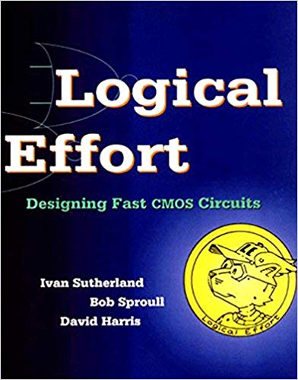
Who invented logical effort?
Ivan Sutherland
Bob Sproull
“The father of computer graphics”
Together they worked on head-mounted displays.
Work on graphics hardware spurred the invention of logical effort

Slide 32
Quiz time!
  Go to socrative.com
  Select Student login
  Go to room: “MCC0922018”

Slide 33
Delay estimations using logical effort
Once the logical effort of a logic gate is known we can easily calculate the propagation delay of any critical timing path
Calculate delay
to here!
Calculate delay!
CMOS logic
X2
X4
X2 logic
g₃, p₃
X6 logic
g₄, p₄
p₁, g₁
p₂=1, g₂=1
X2 logic
g₅, p₅
X9 logic
g₆, p₆
Notes:
NAND 3: g = 5/3 p = 3
Normalized delay d = 5/3x 2 + 3 + 1 + 1 +5/3x3 + 3 = 13 + 10/3 = 16 1/3

Slide 34
Inverter propagation delay model
Two-port electrical representation of propagation delay model
Consider a unit size inverter with a unit size n-channel device and
a p-channel device of twice that width
2
2C
2C_{drain}
R
IN
V_{IN}
1
V_{OUT}
OUT
3C
3C_{drain}
C_{drain}
1
C
R
V_{IN}
V_{OUT}
C_{G}=3C
V_{DD}
C_{D} =p_{inv}C_{G}
V_{SS}
V_{SS}

Slide 35
Effective resistance
Pull-up/down paths may have MOSFETs in series! Effective resistances add up!
V_{out}
V_{out}
Solution: widen the MOSFETs
to obtain effective resistance R!
N MOSFETs in series – make them 3 units wide!
V_{out}
V_{out}
I_{DS}
I_{DS}
1
R
3
R/3
VDD
1
R
VDD
3
R/3
1
R
3
R/3
Pull-down
network
Pull-down
network
R_{eff}=3R
R_{eff}=R
Notes:
This means that there are less current when transistors are in series! How can we understand that?

Slide 36
Effective resistance
Pull-up/down paths may have MOSFETs in series! Effective resistances add up!
V_{out}
V_{out}
Cost:
Increased input capacitance!
V_{out}
V_{out}
I_{DS}
I_{DS}
1
R
3
R/3
3C
VDD
1
R
3
R/3
3C
1
R
3
R/3
3C
Pull-down
network
Pull-down
network
R_{eff}=3R
R_{eff}=R

Slide 37
Effective resistance
Pull-up/down paths may have MOSFETs in series! Effective resistances add up! This is for p-channel devices!
V_{DD}
Again, widen MOSFET a factor 3 since they are 3 in series.
Cost:
Increased input capacitance!
V_{DD}
I_{DS}
I_{DS}
2
R
6
R/3
6C
VDD
2
R
6
R/3
6C
2
R
6
R/3
6C
V_{out}
V_{out}
V_{out}
V_{out}
Pull-up
network
Pull-up
network
R_{eff}=3R
R_{eff}=R

Slide 38
Effective resistance
The propagation delay, t_{pd} is defined as the worst-case delay, that is the longest delay.
(We did not mention that in lecture 4 because an inverter only has one input.)
Pull-up/down paths may have MOSFETs parallel! Effective resistances can be combined as resistors in parallel. But what is the worst-case resistance?
If A=0 & B=1
or A=1 & B=0
If A=1 & B=1
V_{out}
V_{out}
V_{out}
A
1
B
1
R
R/2
Worst case
because highest R

Slide 39
Effective resistance
The same but for pMOS FETs in parallel.
If A=0 & B=1
or A=1 & B=0
If A=0 & B=0
A
2
B
2
R
R/2
V_{out}
V_{out}
V_{out}
Worst case

Slide 40
The NAND/NOR VTC revisited
Which VTC is NAND and which VTC is NOR?
Assume all transistors have the same k and all three inputs switch together.
Now we can use our knowledge about R_{eff} to find the effective k_{n} and k_{p}. R_{eff} is inversely related to the maximum saturation current. So for entire path combined R gives us the inverse of the k factors.
V_{OUT}
where x = k_{n}/k_{p}
V_{DD}
3R => k_{p} = 1/3
NAND
R/3 => k_{n} = 3
R/3 => k_{p} = 3
NOR
3R => k_{n} = 1/3
0
0
V_{TN}
V_{SW}
V_{DD}+V_{TP}
V_{DD}
V_{IN}

Slide 41
Example 1: The tri-state inverter
Make all MOSFETs twice as wide to cut effective resistance in half!
Input cap = twice that of reference inverter: C_{G}=6C
where C is gate capacitance of a unit width MOSFET
4
R
4C
Parasitic output cap = 6C_{drain} which is twice that of the unit inverter
_
φ
4
4C_{drain}
R
V_{in}
V_{out}
V_{IN}
V_{OUT}
2C_{drain}
φ
2
R
6C
V_{DD}
6C_{drain}
V_{SS}
V_{SS}
2
2C
While inverter RC-product is 3RC, tristate inverter
RC-product is 6RC, i.e. twice that of the inverter!
This ratio is defined as the “logical effort”, g, and g=6C/3C=2!
Parasitic delay =6C_{drain}/3C=2p_{inv}
V_{in}
V_{out}
φ
Tristate inverter symbol

Slide 42
Example 1: The tri-state inverter
Make all MOSFETs at original widths to keep input capacitances @ 3C.
Say that we want input capacitance to be same as for the inverter! Then path resistances become 2R!
But parasitic delay and logical effort are the same!
Independent of gate sizing!
2
2R
2C
_
φ
2
2C_{drain}
2R
V_{in}
V_{out}
V_{IN}
V_{OUT}
C_{drain}
φ
1
2R
3C
V_{DD}
3C_{drain}
V_{SS}
V_{SS}
1
While inverter RC-product is 3RC, tristate inverter
RC-product is 6RC, i.e. twice that of the inverter!
Because
C
V_{in}
V_{out}
φ
Tristate inverter symbol

Slide 43
Example 2: 2+2 AND-OR-invert (AOI22)
Make all MOSFETs twice as wide to cut effective resistance in half!
This gate also has logical effort, g=2 for all inputs A-D
C
4
R
4
D
A
4
4
B
R
V_{IN}
V_{OUT}
A
4C
F
6C
V_{DD}
12C_{drain}
A
2
R
2
D
2C
V_{SS}
V_{SS}
B
2
2
C
Its parasitic RC-product p, the parasitic delay, is defined as
R
V_{IN}
1
V_{OUT}
3C
3C_{drain}
Unit inverter

Slide 44
Exercise:
Calculate NAND2, NOR2 logical efforts
A
B
A
B
NAND2
NOR2

Slide 45
Exercise:
Calculate NAND3 & NOR3 logical efforts
A
B
A
C
B
C
NAND3
NOR2

Slide 46
Exercise: compound gate
OR-AND-INVERT 3+1
Note: Different inputs
to a gate can have different
logical efforts!

Slide 47
OAI invert 3+1 gate done as quiz
Question 1: What is the logical effort of ABC inputs?
Question 2: What is the logical effort of D input?
Question 3: What is the parasitic delay expressed as p x pinv?
Work in small groups

Slide 48
Exercise: compound gate
OR-AND-INVERT 3+1 (solution)
Gate capacitance is proportional to
transistor width. Here we write out
capacitance for the scaling rather than width.
Drain capacitance is also proportional to width.
6C R/3
6C R/3
2C R
6C R/3
2C R/2
2C R/2
2C R/2
2C R/2

Slide 49
Why all this?
In ST cell library, size X refers to the input cap!
Simplify delay calculations and making them technology independent!
Calculate delay
to here!
Calculate delay!
CMOS logic
X2
X4
X2 logic
g=5/3, p=3
X6 logic
g=7/3, p=3
p₁=4, g₁=2
p₂=1, g₂=1
X2 logic
g=7/3, p=3
X9 logic
g=7/3, p=3
Propagation delay=18*tao=90 ps

Slide 50
Why all this?
Minimize path delays with gates other than inverters.
We will do that in lecture 6.

Slide 51
Model for a non-inverting gate
d = f + p should hold also for non-inverting gate
f is the part that depends on C_{L}, f = gh where h is defined as C_{L}/C_{IN}
Thus f_{gate} = C_{IN}/C_{INinv}× C_{L}/C_{IN} = g_{gate} × h_{gate}
p is static part of the delay: the part that does not depend on C_{L}
We will do this on
Thursday!
CMOS logic
X2
X4
C_{IN}
C_{L}
2C_{IN}
p₁=4, g₁=2
p₂=1, g₂=1
The parasitic delay p=9
Logical effort g=0.5

Slide 52
Overview important concepts
d: (normalized) stage delay
f: stage effort
g: logical effort
h: electrical effort
p: parasitic delay
d = f + p
f = gh
All concepts related
to reference inverter
with (RC_{G})_{inv}, p_{inv} = C_{Dinv}/C_{Ginv}
The gate itself has parameters
C_{IN}, R_{eff} and C_{par}
and is connected to load C_{L}
If R_{eff} ≠ R_{inv}
If R_{eff} = R_{inv}
Note:
C_{IN} can be different for different
gate inputs =>
Different g for different inputs!

Slide 53
Conclusion
In this lecture we have
Adapted the two-port delay model previously developed for inverters to any CMOS logic gate
Learnt how to size MOSFETs for equal worst case rise and fall delay
Noticed that logic gates have larger R_{eff}C_{G} products than inverters
Introduced two new concepts: logical effort and parasitic delay
Logical effort and parasitic delay quantifies
  Logical effort: (R_{eff}C_{G})_{gate} relative to (3RC)_{inv}
  Parasitic delay: (R_{eff}C_{par})_{gate} relative to (3RC)_{inv}
Learnt how to calculate these parameters for any logic gate
Learnt how to calculate the electrical effort h= C_{LOAD}/C_{IN}
Learnt to calculate all propagation delays as a multiple of tau, where tau=5 ps in STMicroelectronics 65 nm CMOS process

