Slide 1
Path delay optizimization Review logical effort Prelab 2
Extending inverter delay optimization to other types of gates

Slide 2
Week 3
Monday lab1
CMOS inverter static and dynamic
Tuesday
Lecture Delay with gates, logical effort
Postlab review lab 1
Thursday
Prelab lab 2, Lecture on optimal path delay
Tutorial POTW (Victor)
Friday Deadline prelab 2
Schematic entry of carry ckt of full adder

Slide 3
From MUD cards
Too many efforts!
Inputs to the gate & logical effort
How to calculate g, and, p, for different inputs.
Not very clear on the input capacitance C_{IN}. What if we have more than one input, which one should we choose?
Resistance and scaling
Worst-case R for parallel and series connection.
How to decide nMOS and pMOS widths during calculation of logical effort.
For bigger schematics how to find worst-case scenario.
The constant part
How to calculate C_{par} for compound network..

Slide 4
Too many efforts
Stage effort
or
Effort delay
f = g × h
Logical effort
Electrical effort
Only three efforts - all in the delay that depends on the external load C_{L}!
Two of them combined make up the third one.
“h” is our variable, our “x”, as we will see later in this lecture.
And then there is a constant part, p, the parasitic delay
d = g × h + p
Compare to standard linear equation: y = k × x + m

Slide 5
Graph of normalized inverter delay as a function of C_{L}
d
C_{IN} = 2C_{L}
Slope ½
C_{IN} = C_{L}
Slope 1
Different slope for each
value of C_{IN}, that is
each inverter size
C_{IN} = ½ C_{L}
Slope 2
C_{IN} = 4C_{L}
Slope 1/4
d = p_{inv} + (1/C_{IN}) × C_{L}
p_{inv}
C_{L}

Slide 6
Graph of normalized delay for inverter as a function of h
d
slope = 1
d = p_{inv} + h
p_{inv}
h1
h = C_{L}/C_{IN}

Slide 7
Graph of normalized delay other gates
d
Other gate:
slope > 1
g > 1
Inverter:
slope = 1
g = 1
p
p_{inv}
h = C_{L}/C_{IN}

Slide 8
Example: NAND3

Slide 9
Unclear things
Propagation delay, t_{pd}, from one input signal to the output
is modeled with the normalized delay, d,
so C_{IN} is the input capacitance for ONE of the gate inputs
(the one where we assume our input signal is entering).
Often all gate inputs have same C_{IN}, but not always.

Slide 10
Logic gate propagation delay model
Now we want to apply the same model to any CMOS logic gate
VDD
pMOS
pull-up
network
Note that already here R_{eff} is placed to the right of the switch, which means we assume the the n-net path and p-net path worst-case resistances are the same.
One input
OUT
C_{L}
C_{IN}
nMOS
pull-down
network
C_{par}
R_{eff}
V_{IN}
V_{OUT}
C_{IN}
V_{DD}
C_{par}
VSS
V_{SS}
V_{SS}
C_{IN} is the input capacitance for one of the inputs to the logic gate
C_{par} is the total parasitic capacitance at the gate output

Slide 11
Logic gate propagation delay model
Now we want to apply the same model to any CMOS logic gate
Assume all pull-up/down paths have same resistance R_{eff}. Obviously, the logic gate will have larger RC product than the inverter! What is the delay with load C _{L} from one of the inputs to the logic gate?
As before, normalize to process time constant tau!
VDD
pMOS
pull-up
network
One Input
OUT
C_{L}
C_{IN}
nMOS
pull-down
network
C_{par}
R_{eff}
V_{OUT}
V_{IN}
C_{IN}
V_{DD}
C_{par}
C_{L}
VSS
V_{SS}
V_{SS}

Slide 12
Logic gate propagation delay model
To simplify, we suggest sizing MOSFETs for equal effective resistances, i.e. R_{eff}=R
VDD
Consider one delay term at a time!
pMOS
pull-up
network
Same for
all inputs
One Input
OUT
One input
C_{L}
C_{IN}
nMOS
pull-down
network
C_{par}
This method conveniently separates the driving strength of a logic gate in terms of its logical effort, g, and its external load in terms of its electrical effort, h. And all with respect to the properties of the inverter.
VSS

Slide 13
Deciding on resistances/scaling
Make all paths have the same resistance:
Parallel paths:
Assume that only one of any parallel path is conducting at a time
Serial paths
All transistors groups in series have to conduct for a path to be formed, but only one of any transistors in parallel within groups.
As long as possible assign all transistors in series the same resistance (if there is no particular reason to do otherwise).

Slide 14
Parasitic capacitances
All FETs have parasitic capacitances at drain and source
Our simplified model is that only parasitic capacitances at the output node contribute to parasitic delay – not entirely true.
Drain capacitances are proportional to transistor width & proportional to gate capacitance.
Approach to find parasitic delay p:
Sum widths of all FETs connected to output node of gate.
Divide by width of FETS connected to output node in inverter with same R.
Multiply by p_{inv} factor (C_{D}/C_{G})

Slide 15
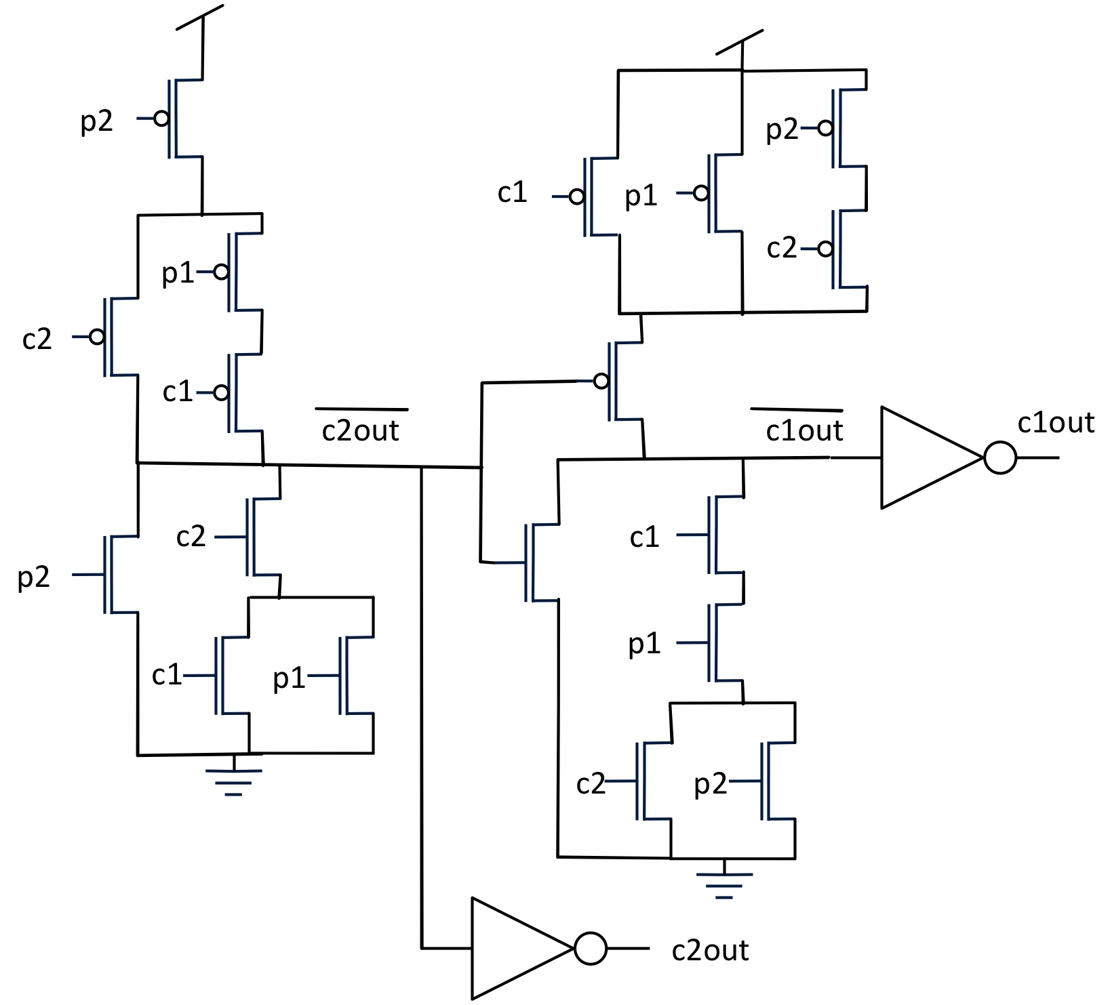
Two complex gates for you to practice on (but not right now)
I will post the solution(s).

Slide 16
Solution 1 complex gate 1
Resistances for equal worst-case
path resistance R
Corresponding widths
R/3
6W
gc1 = (6+2)/3 =8/3
gc2 = (3+2)/3 =5/3
gp1 = (6+2)/3= 8/3
gp2 = (6+1)/3 = 7/3
p =(1+2+3+6)/3 pinv=
12/3 pinv = 4 pinv
R/3
6W
2R/3
3W
R/3
6W
R/2
2W
R
W
R/2
R/2
2W
2W

Slide 17
Solution 2 complex gate 1
Resistances for equal worst-case
path resistance R, p-net changed
Corresponding widths
R/2
4W
g_{c1} = (8+2)/3 =10/3
g_{c2} = (4+2)/3 =6/3
g_{p1} = (8+2)/3= 10/3
g_{p2} = (4+1)/3 = 5/3
p =(1+2+4+8)/3 p_{inv}=
15/3 p_{inv} = 5 p_{inv}
R/4
8W
R/2
4W
R/4
8W
R/2
2W
R
W
R/2
R/2
2W
2W

Slide 18
Complex gate 1 which solution is better?
It depends on which one is the critical input, the one on the critical path, that limits the speed, but unless it is p2, solution 1 is better. The resistances are more similar and also the parasitic delay is smaller.
Note: There was a constraint due to the physical layout that made us not put the p-net upside down (more about layout next week!).

Slide 19
Solution 1 complex gate 2
Resistances for equal worst-case
path resistance R
Corresponding widths
R/3
6W
3W
3W
gc1 = (3+3)/3 =2
gc2 = (6+3)/3 =3
gp1 = (3+3)/3= 2
gp2 = (6+3)/3 =3
gCoutin = 7/3
p =(1+3+6)/3 pinv=
10/3 pinv
2R/3
2R/3
6W
R/3
R/3
6W
R/3
3W
W
R
R/3
3W
R/3
R/3
3W
3W

Slide 20
Solution 2 complex gate 2
Resistances for equal worst-case
path resistance R, p-net changed
Corresponding widths
R/4
8W
4W
4W
gc1 = (3+4)/3 =7/3
gc2 = (8+3)/3 =11/3
gp1 = (3+4)/3= 7/3
gp2 = (8+3)/3 =11/3
gCoutin = 5/3
p =(1+3+4)/3 pinv=
8/3 pinv
R/2
R/2
8W
R/4
R/2
4W
R/3
3W
W
R
R/3
3W
R/3
R/3
3W
3W

Slide 21
Complex gate 2 which solution is better?
Also here it depends on which one is the critical input (the one that is on the critical path and thus limits the speed), but from the schematic it looked like it would be c_{outin}. In that case solution 2 is better. It also has a lower parasitic delay.

Slide 22
Outline
A linear model for non-inverting gates
Still d = gh + p, find p and g
An example
Prelab 2 task
ILAs
The carry circuit
Review tapered buffer – only inverters
Optimal h,optimal N
Review the example
Path delay with other gates
Optimal f
An example

Slide 23
Model for a non-inverting gate
Linear model d = f + p = gh + p should hold also for non-inverting gate
f is the part that depends on C_{L}, f = gh where h is defined as C_{L}/C_{IN}
Thus f_{gate} = C_{IN}/C_{INinv}× C_{L}/C_{IN} = g_{gate} × h_{gate}
p is the static part of the delay: the part that does not depend on C_{L}
CMOS logic
X2
X4
C_{IN}
C_{L}
2C_{IN}
p₁=4, g₁=2
p₂=1, g₂=1
The parasitic delay p=9
Logical effort g=0.5
Note that g < 1 is possible because here it depends on scaling between gates!

Slide 24
Quiz about 3-input AND gate = 3-input NAND + inverter
&
X2
X6
C_{IN}
C_{L}
3C_{IN}
g₁=5/3, p₁=3
g₂=1, p₂=1
What is p_{AND} and g_{AND} (the same for all three inputs)?
Work in small groups.
Enter your answers in Socrative: Room: MCC0922018.

Slide 25
Prelab 2
Iterative Logic

Slide 26
Prelab 2
Design task: design with MOSFETs the carry bit-cell for an 8-bit ripple-carry adder!
The 8-bit carry logic is to be implemented by an iterative logic array consisting of eight instances of the bit-cell that you have designed.
The carry bit-cell has three inputs (two bits a, b and a carry-in memory bit), and one output, the carry-out memory bit to the next more significant bit.
2018-09-20
MCC092 Integrated Circuit Design

Slide 27
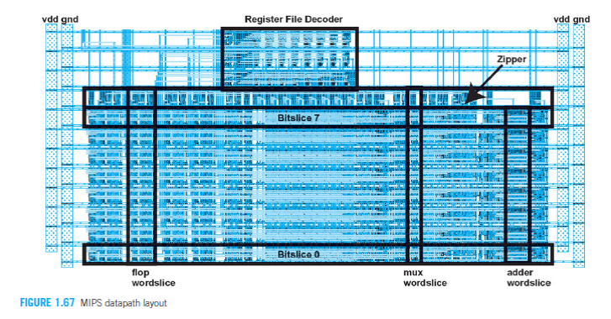
Designing an adder word slice
Adder word slice
Bitslice 6
Bitslice 5
Bitslice 4
Bitslice 3
Bitslice 2
Bitslice 1
2018-09-20
MCC092 Integrated Circuit Design
Notes:
This slide shows the datapath layout. We can see that the datapath is designed by 8 more or less identical bit slices, one for each bit. Each bit slice contains different functionalities, at the datapath level we can talk about functionality slices.
This is a design style that we are going to use in this course in some design examples concerning adder design. The use of bit slices to form functional arrays is sometimes referred to as iterative logic arrays, if all bit slices in the array are identical. This is a very efficient way of designing, since we only need to design one bit-slice cell to build a complete multi-bit array.
As I said, we shall apply this design style to the design of a full adder in a series of exercises later in the course.

Slide 28
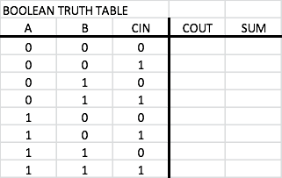
Iterative logic arrays: FULL ADDER
a₀
b₀
c_{out}
FA
c_{in}
Sum₀
a₇
b₇
a₆
b₆
a₅
b₅
a₄
b₄
a₃
b₃
a₂
b₂
a₁
b₁
a₀
b₀
Adder word slice
c_{out}
FA
FA
FA
FA
FA
FA
FA
FA
c_{in}
Sum₇
Sum₆
Sum₅
Sum₃
Sum₂
Sum₁
Sum₇
Sum₆
Sum₅
Sum₄
Sum₃
Sum₂
Sum₁
Sum₀
Sum₄
Sum₀
2018-09-20
MCC092 Integrated Circuit Design
Notes:
One of the main themes of this course is the design of n-bit adders. For starters, we will do that by designing the adder as an iterative logic array. For this, we need to design one Full Adder cell as the one shown here. We will use the methods discussed in this lecture to design the cell with MOSFETs from the Boolean truth table.
Then we will build an iterative logic array from many instances of this cell.
The two numbers to be added are enetered at the top. The carry-in is entered to the LSB (least significant bit) to the right. As the carry ripples from cell to cell, from right to left, the sums pop out at the bottom.

Slide 29
Iterative logic arrays: FULL ADDER
a₀
b₀
c_{out}
FA
c_{in}
Sum₀
a₀
b₀
Prelab design tasks (see prelab 2 instructions):
Design carry logic as a SUM of products!
Draw MOSFET schematic!
Calculate logical effort and parasitic delay of the inverting carry-logic cell that you have designed!
Calculated delay through carry chain
Carry logic
c_{out}
c_{in}
SUM logic
Sum₀
2018-09-20
MCC092 Integrated Circuit Design
Notes:
One of the main themes of this course is the design of n-bit adders. For starters, we will do that by designing the adder as an iterative logic array. For this, we need to design one Full Adder cell as the one shown here. We will use the methods discussed in this lecture to design the cell with MOSFETs from the Boolean truth table.
Then we will build an iterative logic array from many instances of this cell.
The two numbers to be added are enetered at the top. The carry-in is entered to the LSB (least significant bit) to the right. As the carry ripples from cell to cell, from right to left, the sums pop out at the bottom.

Slide 30
Prelab 2
What is still unclear?

Slide 31
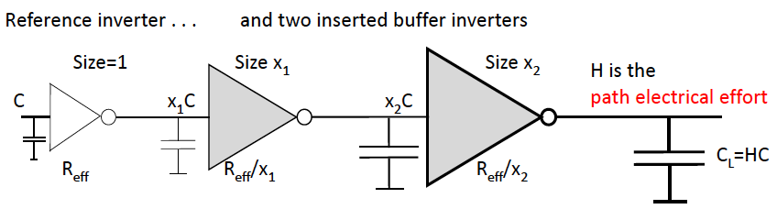
Review from lecture 4: Tapered buffer

Slide 32
The tapered buffer
Please note that H is the
path electrical effort
while h is the
stage electrical effort.
Reference inverter . . .
and two inserted buffer inverters
Size=1
Size x₁
Size x₂
H is the
path electrical effort
C
x₁C
x₂C
C_{L}=HC
R_{eff}
R_{eff}/x₁
R_{eff}/x₂
With two intermediate buffer inverters we obtain a normalized delay relative to tau: D=(p_{inv}+h₁)+(p_{inv}+h₂)+(p_{inv}+h₃)
where we have defined the stage electrical efforts, or fanouts, h.
Here h₁=x₁, h₂=x₂/x₁, and h₃=x₃/x₂).
We know we must have h₁h₂h₃ = H, So only h₁ and h₂ are independent variables, the third, h_{3,} becomes h₃=H/h₁h₂.
TASK: Show that minimum delay is obtained for h₁=h₂=h₂=h=³√H >>> D=3(p_{inv}+³√H)

Slide 33
The tapered buffer
Please note that H is the
path electrical effort
while h is the
stage electrical effort.
Reference inverter . . .
and two inserted buffer inverters
Size=1
Size x₁
Size x₂
H is the
path electrical effort
C
x₁C
x₂C
C_{L}=HC
R_{eff}
R_{eff}/x₁
R_{eff}/x₂
With two intermediate buffer inverters we obtain a normalized path delay:
D=(p_{inv}+h₁)+(p_{inv}+h₂)+(p_{inv}+H/h₁h₂).
Taking partial derivatives wrt h₁ and h₂ we obtain

Slide 34
The tapered buffer
Reference inverter . . .
and two inserted buffer inverters
Size=1
Size x₁=4
Size x₂=16
Example with path
electrical effort H=64
C
4C
16C
C_{L}=64C
R_{eff}
R_{eff}/x₁
R_{eff}/x₂
Sharing the load equally between the inverters yields equal stage fanouts h=³√64=4
The total delay is then equal to 3 FO4 delays, i.e. 15tau=75 ps (assuming p_{inv}=1).

Slide 35
The tapered buffer
Solving this problem we start by having derived that minimum delay occurs when stage electrical efforts, h, are equal.
Hence path propagation delay is given by
Furthermore, h=^{N}√H, i.e. H= h^{N}.
Taking natural logarithms we obtain number of inverters
We rewrite path delay equation as
Looking for minimum path delay by taking derivatives of D wrt h
we obtain
Analytical solution is possible only for p_{inv}=0:
h=e=2.72 which gives N = ln H
Note: Derivation inserted for
completeness.
You don’t have to learn to do
this derivation!

Slide 36
The tapered buffer
For p_{inv}≠0 the equation has to be solved numerically
5
h=3.6
e
Delay
Normalized area
1
Normalized delay
stage fanout
Area
p_{inv} =1
0
Parasitic delay, p_{inv}
3
0
Stage fanout, h
8
[Hedenstierna & Jeppson 1987]
For typical values of p_{inv} the optimum tapering factor is between 3.6 and 5. Typically a FO4!
Note that the propagation delay minimum is rather flat, while total inverter area on the silicon decreases rapidly when larger stage fanout is used.
Silicon real estate (=cost) can be saved for relatively little loss of speed!

Slide 37
Review from lecture 4: Tapered CMOS inverter stages
H = C_{L}/C_{IN}: path electrical effort
Equal stage electrical effort, h, gives shortest delay
h_{opt}^{N} = H, where N is number of stages
That is h_{opt} = ^{N}√H
Normalized path delay for path is called D_{opt}:
D_{opt} = N×h_{opt} + P, with P sum of all parasitic delay
D_{opt} = N×h_{opt} + N×p_{inv}
If N not given, select N such that h is close to 4; to save area make h a bit higher than 4.

Slide 38
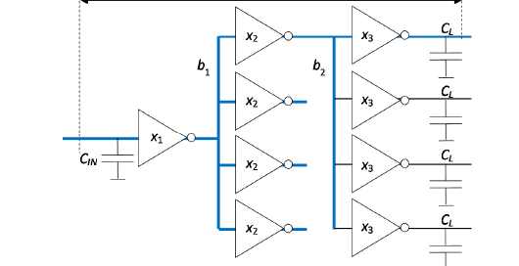
CMOS inverter stages with branching
Introducing b = the branching effort
b = (c_{onpath} + c_{offpath})/c_{onpath}
b is 1 or larger
Notes:
We do not only have to achieve the total scaling up H there are some additional capacitances that have to be driven on the way.

Slide 39
Path delay with branching
Equal stage electrical effort gives shortest delay
Path effort: F = H×B
B: path branching effort
B = b₁×b₂×b₃×…b_{N-1} (assuming N stages)
b = (c_{onpath} + c_{offpath})/c_{onpath} branching effort
Determine f_{opt}= ^{N}√F
Normalized path delay D_{opt}
D_{opt} = N×f_{opt} + P where P is sum of parasitic delay
D_{opt} = N×f_{opt} + N×p_{inv}

Slide 40
Path delay – when (some) gates are not inverters
Equal stage effort still gives shortest delay
Now includes also logical effort: g
Path effort: F = G×H×B
G: path logical effort
G = g₁×g₂×g₃×…g_{N} (assuming N stages)
B defined as before
Determine f_{opt} as ^{N}√F.
Normalized path delay D_{opt}
D_{opt} = N×f_{opt} + P, P is sum of parasitic delay
Notes:
On the way we have to scale up some more…

Slide 41
Approach for delay optimization= path sizing
Read W&H section 4.5.4
For more practical considerations
Given: N stages, g and p for all gates + any branching efforts b
Calculate path effort F from F = G×H×B
Calculate stage effort f_{opt} as ^{N}√F
(Calculate path delay D = N×f_{opt} + P)
Find gate sizes X₂ to X_{N} starting from start or end of path.
Note that X₁ (input capacitance of first stage) does not change!
Don’t forget to include branching efforts!
Check also that f₁ /f_{N} (for the remaining stage) is also f_{opt} so you did not make a mistake!

Slide 42
Clock tree task from latest exam
Solution:
f_{opt} = 32/3
D_{opt} = 38
(assuming p_{inv} = 1)
Stage 3: C_{IN} =
(4/3)× 32C/(32/3) = 4C
Stage 2: C_{IN} =
(4/3) × (4Cx4)/(32/3) = 2C
Find f_{opt}, D_{opt} and
the input capacitances at
stages 2 and 3
Work in small groups
Replies in socrative.com room: MCC0922018 as usual

Slide 43
Improve delay by adding one inverter stage – how much is path delay improved?
Solution:
F =(32/3)^3
f_{opt} = 4√F≈ 5.9
D_{opt} = 4 × 5.9 + 7pinv=
30.6 (assuming p_{inv} = 1)
C_{IN2} = 5.9C
C_{IN3} = 6.5C
C_{IN4} = 7.2C
Find new
f_{opt}, D_{opt}
with added stage
Later you can calculate the sizes too
I will post those numbers

Slide 44
Summary path delay optimization
Goal: minimize normalized path delay (that is, critical path delay)
Path effort F= G × H × B (general expression for all cases)
path electrical effort: H = C_{L}/C_{IN} (for entire path)
path branch effort: B = b₁ × ….. × b_{N} (for entire path)
path logical effort : G = g₁ × …..× g_{N} (for entire path)
Optimal stage effort is f_{opt} = ^{N}√F
Optimal path delay D_{opt} is then: D_{opt} = N × f_{opt} + P
where P is path parasitic delay = sum of all p
Read W&H section 4.5 Logical Effort of Paths

Slide 45
Conclusion
Review of logical effort muddy issues
Linear model for non-inverting gate
d + gh, g due to scaling between gate and inverter, p the internal delay
Prelab 2
Design a carry cell
Review tapered buffer
h_{opt}, N_{opt}
h_{opt} = ^{N}√H
N_{opt} corresponds to FO4 stage delay but shallow minimum
Path delay optimization
Path effort: F = GHB
f_{opt} = ^{N}√F
D_{opt} = N×f_{opt} + P
Finding the sizes from start or end of path.

