Slide 1
DAT096
Ultrasonic Sound Localization using Microphone Array
Beamforming
Group M3
John Croft
Hezhe Xiao
(presenting)
Ashwin Kumar Balakrishnan
Prema Manickavasagam
Notes:
Good afternoon.
Welcome to our final presentation on Ultrasonic Sound Localization using Microphone Array Beamforming.
My name is John Croft and I am presenting along with Hezhe Xiao.

Slide 2
Agenda
Review project goals, specifications & limitations
Recap beamforming theory
Hardware & Interfacing
Design Implementation
Results
Conclusions
Future Work
Notes:
Purpose: Tell them what you will tell them.
Time (approx):
In this presentation we’ll first review the original project goals and specifications, as well as some limiting factors.
We’ll then recap some of the fundamental beamforming theory, before moving on to a description of the main hardware used, as well as how they are interfaced.
Xiao will then give a detailed summary of our design implementation.
Finally, we will finish with some of the results that we obtained, a brief discussion about them, and possiblities for future work.

Slide 3
Introduction

Slide 4
Goals
Locate and track a moving ultrasonic audio source using beamforming.
Implement system on an Artix-7 FPGA equipped with linear microphone arrays.
Adhere to SCRUM principles throughout project.
Notes:
Purpose: Re-iterate project goals.
Time (approx):
The goal of this project was to locate, and eventually track, a moving ultrasonic audiosource using beamforming.
This was to be implemented using Digital Signal Processing techniques, on an Artix-7 FPGA equipped with linear mic arrays.
Another significant goal was to use the SCRUM methodology in executing the project.

Slide 5
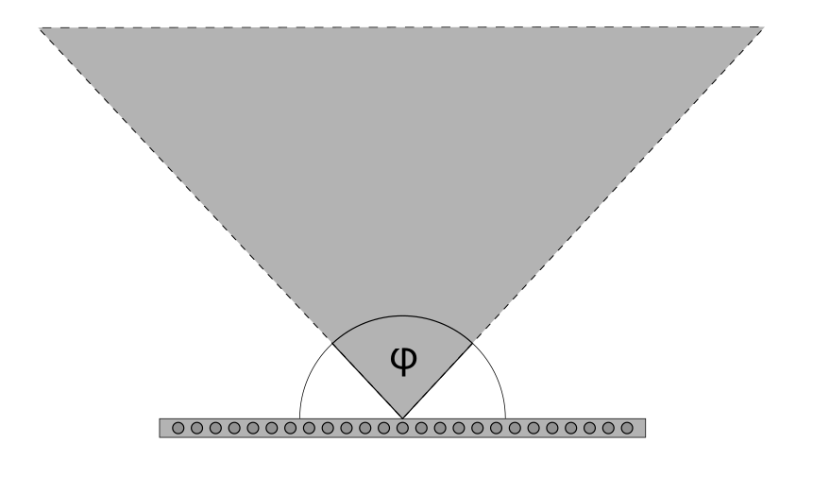
Specifications
Locate audio source in two dimensions.
Determine direction of source to within 2° in the cone of interest.
Detect changes in location with a latency of <1s.
Display direction of audio source in real time.
Notes:
Purpose: Re-iterate specs
Time (approx):
The main specifications for the project design were to:

Slide 6
Limitations
Beamforming can be accomplished using many different techniques of varying complexity
  We use the simplest variant: delay-and-sum (DAS).
Due to unfortunate circumstances, only one sensor array was available, constraining the system to one dimension.
Notes:
The two main limitations that constrained the scope of the project were:
the fact that we chose delay-and-sum as our beamforming technique. This was due to the relatively low design complexity.
the fact that a second sensor array was not available by the end of the project. This constrained the system to one spatial dimension.

Slide 7
Background Theory

Slide 8
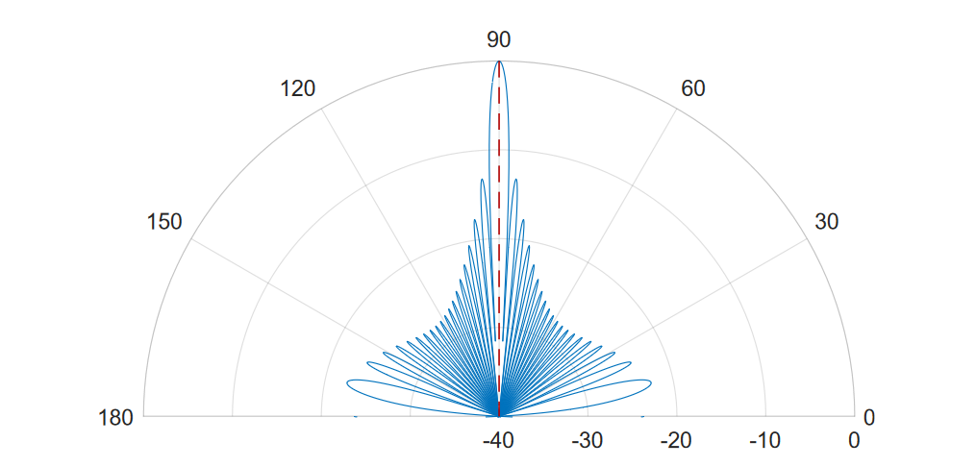
Delay-and-Sum Beamforming
Beamforming is a spatial filtering technique in which an array of omnidirectional sensors approximates a directional sensor.
The beamforming filter-response can be represented as a beampattern (right), with gain vs. incident angle of signal.
Theoretical beampattern modelled in MATLAB.
24 sensors, 25 kHz source signal
Notes:
Read slide

Slide 9
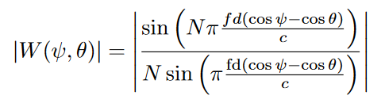
Delay-and-Sum Beamforming
The filter response is computed using the following expression:
Ψ: Incident angle of signal.
𝛉: “look-direction” - direction of sensitivity.
N: number of sensors.
d: distance between adjacent sensors.
c: signal propagation speed.
f: signal frequency.
Theoretical beampattern modelled in MATLAB.
24 sensors, 25 kHz source signal
Notes:
Where the filter response is primarily a function of incident-angle of a signal, and “look-direction” - the direction of maximum sensitivity.

Slide 10
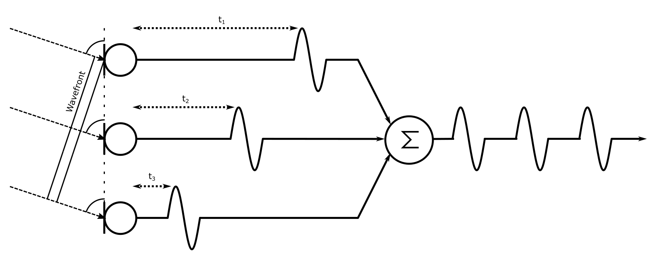
Delay-and-Sum Beamforming
In linear, equidistant sensor arrays, signals (waves) reach each adjacent sensor with a constant time-offset corresponding to the incident angle.
Time-offsets correspond to a phase-offset, leading to interference after summation.
Summation without delay
Notes:
In linear, equidistant arrays (such as those used in this project), incoming signals reach each adjacent sensor with a constant time-offset, as can be seen in the figure to the right.
Time-offsets are equivalent to phase-offsets, leading to constructive or destructinve interference when summing such signals together.

Slide 11
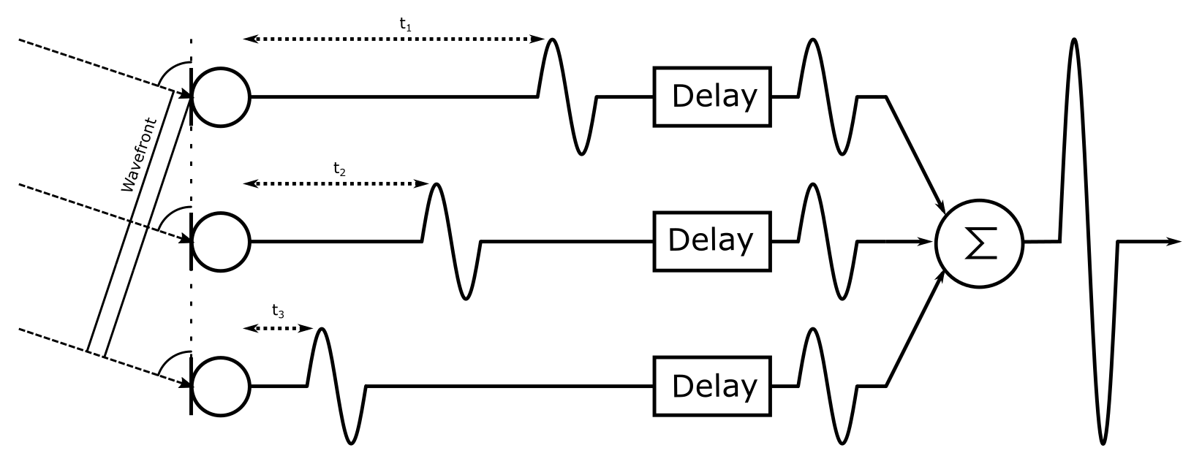
Delay-and-Sum Beamforming
By delaying these signals by some amount, this phase-offset can be compensated for.
A maximum output value occurs when the signals are delayed such that they are all in phase.
A particular set of delay values that maximizes the output thus corresponds to the incident angle of the signal.
Summation after delay, showing constructive interference
Notes:
By delaying each received signal by some amount, the phase shift can be compensated for.
A maximum output value is obtained when the signals are delayed such that they are all back in phase.
If a specific delay-pattern is associated with a specific angle, the maximum output value will directly determine the direction of the signal source.

Slide 12
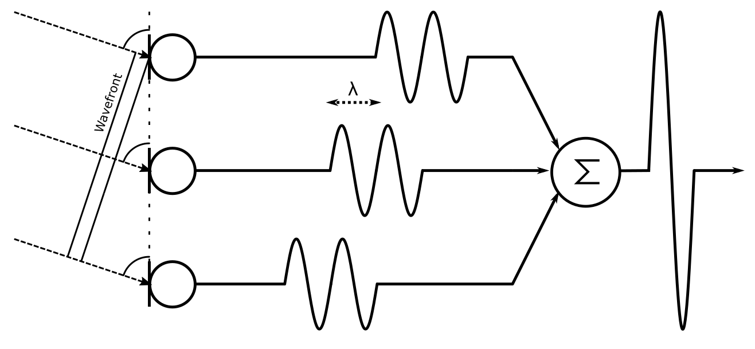
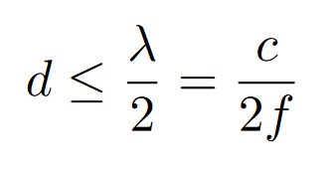
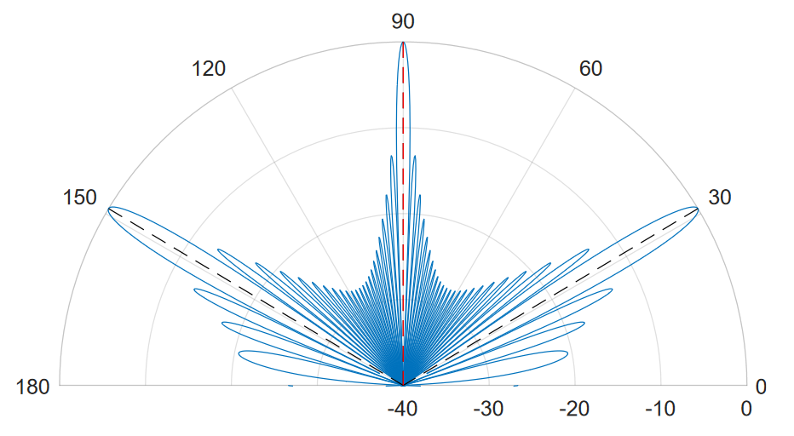
Delay-and-Sum Beamforming
A fundamental limit of this technique comes in the form of spatial aliasing - if adjacent signals are offset by a multiple of a wavelength, it will appear as though they are in-phase!
Analogous to the Nyquist criterion, in order to avoid spatial aliasing, the array must satisfy
d: distance between adjacent sensors.
λ: signal wavelength.
c: signal propagation speed.
f: signal frequency.
Notes:
Results can sometimes be ambiguous, however.
Spatial aliasing will occur if the physical distance between sensors exceeds half a wavelength!
This results in a beampattern such as the one to the right. There are now 3 maxima, and the source direction cannot be determined.

Slide 13
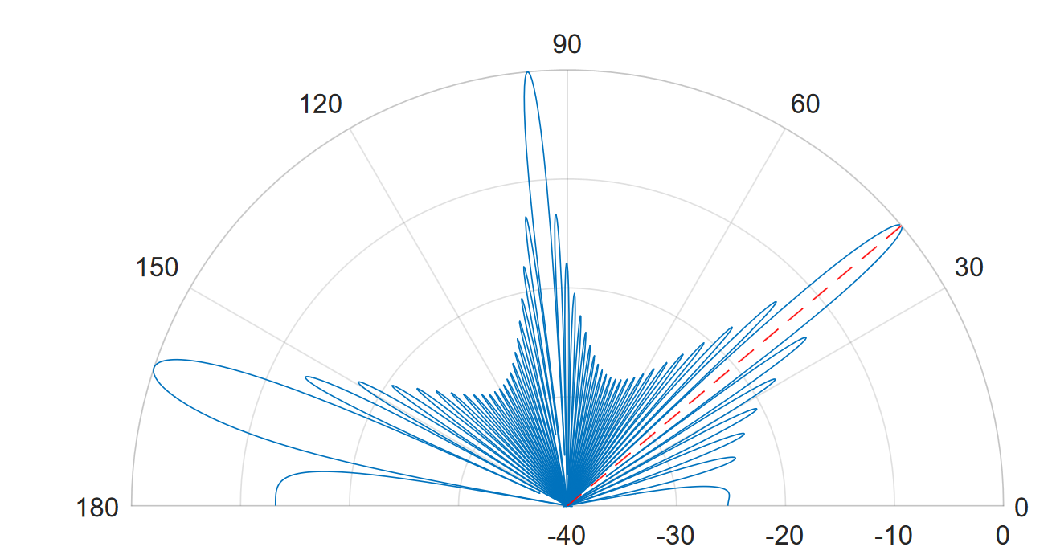
Delay-and-Sum Beamforming
Since delays in DAS phase-shift by a constant, relative amount, aliasing cannot be eliminated through selection of delay values.

Slide 14
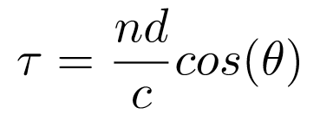
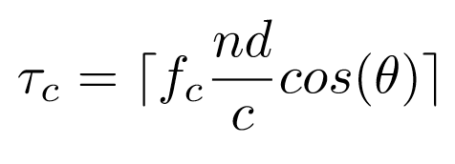
Delay Values
Delays (expressed as time-offsets) are calculated using for each sensor (indexed by n [0, N-1]):
n: current sensor.
d: distance between adjacent sensors.
c: signal propagation speed.
𝛉: “Look-direction” - direction of sensitivity.
Since we are working with a digital implementation, and thus discrete time units, this calculation must be adapted.
fc: frequency of discrete time unit.
This gives the delay in terms of clock cycles.
Notes:
The amount that we need to delay to compensate for a given incident angle is given by the following expression.

Slide 15
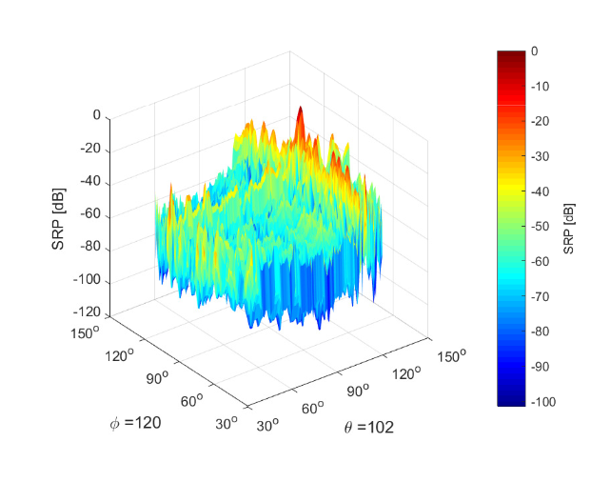
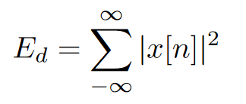
Energy Values
The output of DAS is a summed signal, with a magnitude corresponding to the relative phase of the constituent signals.
In order to find the maximum, and thus the source direction, the signal energy must be calculated.
For a discrete signal, it is given by the following expression:
Note! Our range clearly cannot be infinite, and so any calculation is an approximation.
Fig. 4.8b)
Ultrasonic Source Localization with a Beamformer Implemented on an FPGA Using a High-density Microphone Array - Antonsson,Li
Notes:
MAYBE SKIP

Slide 16
Hardware & Interfacing
Notes:
Here we will present the

Slide 17
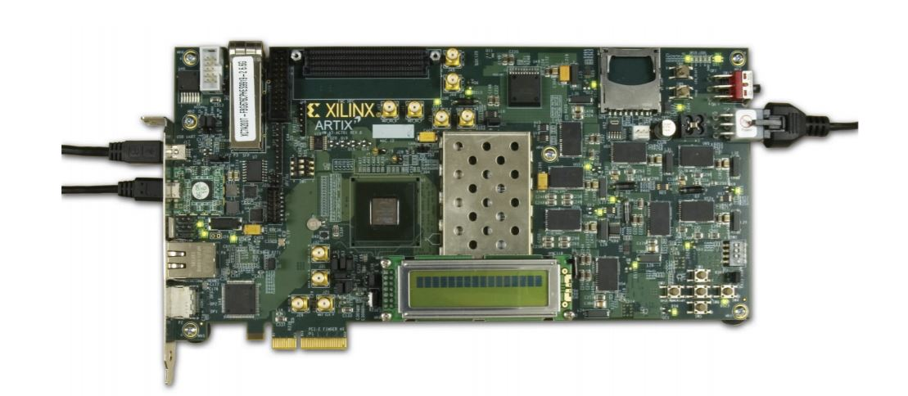
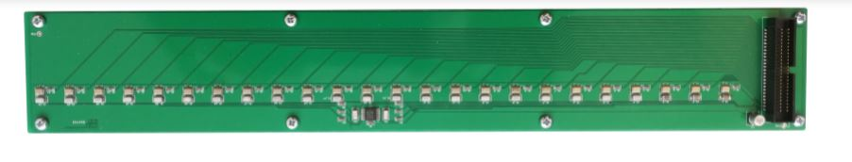
Main Components
Xilinx Artix-7 FPGA AC701
Syntronic AB linear microphone array
Consists of 24 MEMS ultrasonic microphones, using PDM.
d = 11,43mm
Notes:
The main components of the system are the Xilinx AC701 FPGA development kit, and the Syntronic linear microphone array.

Slide 18
GRLIB
In order to effectively interface components, both internally and externally, support hardware must implemented on the FPGA.
This is provided in the Cobham-Gaisler Research Library (GRLIB), which contains many useful IPs.
Examples used in this project are:
ethernet controllers
AMBA AXI4 streaming-interface controllers
RAM controllers
CPU (LEON3) with debug monitor (GRMON)
Notes:
To implement interfacing with and on the FPGA, the Gaisler Research library (GRLIB) is used to implement support IPs, such as ethernet controllers, AXI4 stream controllers, and especially the GRMON debug monitor, which is used to directly access memory contents from a remote machine.

Slide 19
Data Flow
PDM
Ethernet
(GRMON debug monitor)
Microphone Arrays
AC701
PC
N
AMBA AXI4 used internally
Notes:
The principle data flow through the system is as follows:
PDM data from the microphones is sent in parallel to the FPGA, where it is processed and forwarded to different functional units using the AXI4 streaming interface, before being written to memory.
This memory is then directly read by a remote machine using GRMON, as described in the previous slide.

Slide 20
Implementation

Slide 21
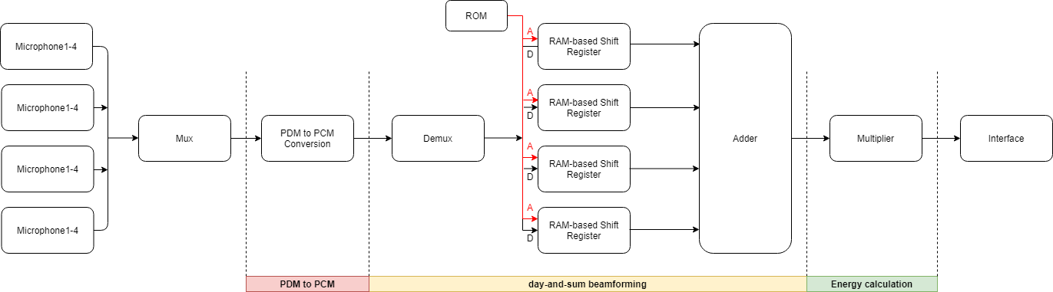
System Architecture
Notes:
The system can simultaneously take 4 input channels from 4 micros, using a multiplexer block to transmit them to one channel in 1 bit PDM format, and then processed by filters to be converted into a 16-bit PCM signal. After conversion, the data is separated by a demulitplexer block and a channel containing the number of clock cycles corresponding to the delay values for each scanning angle is driven to the input address of the shift register. These delay values of microphones for each angle are pre-calculated and saved in Read-Only Memory (ROM). After adding the delayed waveforms, the energy of the signal is calculated, ﬁnding the peak value (in order to obtain the total energy) and sending it to the PC for further analysis to get the sound source direction.

Slide 22
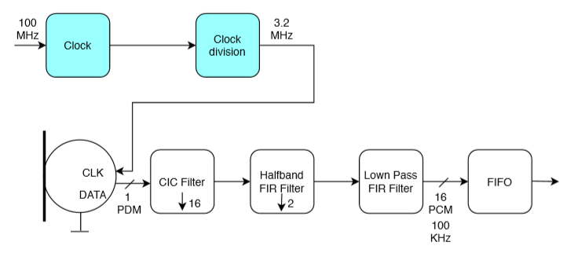
Clocking for Design
The PCM sampling rate in this design is 100 kHz and the PDM rate is 3.2 Mhz (100 Khz × 32) for each microphone.
Note, microphones require >3.072 MHz for ultrasonic operation.
Notes:
At first, we used 1.4112 Mhz as PDM sampling frequency to record human voice, considering the ultrasonic mode for the microphone is activated for PDM clock frequency greater than 3.072 Mhz as per microphone datasheet, we changed it to 3.2 Mhz and tested it by dog whistler. The corresponding parameters of filters are also changed.

Slide 23
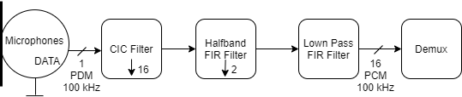
PDM to PCM Conversion
The conversion from PDM to PCM using one cascaded integrator-comb decimating filter(CIC filter), one half-band FIR filter, one low-pass FIR filter and one high-pass.
Filter coefficients are derived manually in MATLAB using the FilterDesigner tool and using filter-response parameters as inputs.
Notes:
CIC Filter IP block is used to decimate the PDM input by a factor of 16, halfband FIR Filter IP block decreases the sample rate of CIC output by 2 and compensates for the passband of CIC ﬁlter which is not ﬂat [6]. Low-pass FIR ﬁlter IP block passes the low frequency signal components and removes the high frequency noise and high-pass ﬁlter is the ﬁnal stage to remove any DC component

Slide 24
Mux and Demux
Mux:
Mux block is used to select one of 4 microphone input signals and forward the selected input to the output at the rising edge of the clock cycle.
Demux:
After the PDM data is successfully converted to PCM, we separate the data from the one channel form by using a demux.
The interleaved data is separated at the rising edge of the clock cycle again.

Slide 25
Delay Implementation
In this design, we beamform using statically defined look-directions (30°-150°).
The PDM signals from the microphones are buffered in a fixed-length, addressable shift-register, and clocked (propagated) at the PDM frequency, fc.
Delay values can thus be selected by addressing the shift-register with a certain index.
Delayed Data Out
Data In
Addr
0
1
k
N-1
Clk @ fc Hz
Notes:
In this design, we use 120 angles totally from 30 degree to 150 degree to calculate the clock cycles of delay values based on the following formula.
The PDM signals from the microphone are buffered in a fixed-length addressable shift-register, and they are propagated at the PDM frequency.
Since nothing needs to be dynamically computed, all delay values can be pre-computed (using MATLAB) and initialized into ROM on the FPGA at compile-time.

Slide 26
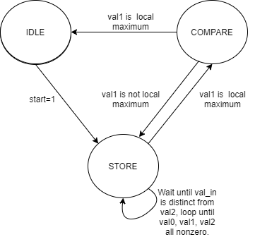
Energy Computation
In this design, the energy calculation is written with sum and multiplication together, which adds the output of delayed signal from shift register and squares the signal to get the energy.
In order to extract the energy of the sound wave, we attempt to find the maxima of the squared wave. This is done by a simple algorithm to find local maxima. Points val0, val1, and val2, occurring successively, are compared. If val1 has the largest squared amplitude, it is a local maximum and is output through FIFO. Ten such values are extracted for each angle for the purpose of improving statistics.
Notes:
In the design, the energy calculation is written with sum and multiplication together, which adds the output of delayed signal from shift register and squares the signal to get the energy(according to the expression mentioned before )

Slide 27
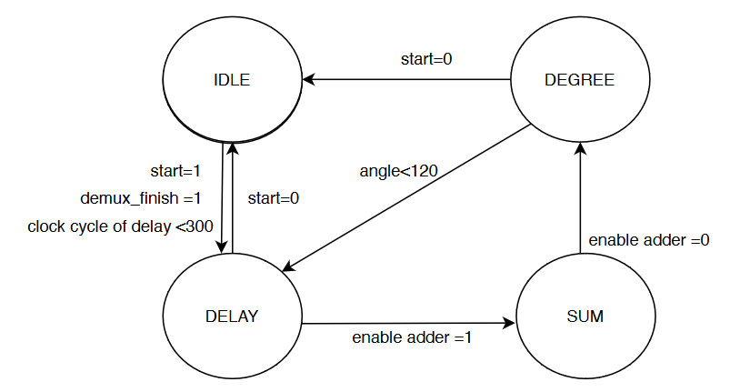
Scanning Range of Angles
To scan a range of angles, an FSM (finite state machine) was implemented to “sweep” through the precomputed delay values.
In our system design, there are actually 120 sets of number of delay clock cycle corresponding to a scan between 30 degree to 150 degree. Thus, the counter needs to increment 119 times to ﬁnish the entire scan for the angles in a system
angle++
Notes:
The IDLE state is to wait for the switch on the FPGA turns on and all the data is ﬁnished to demux. The delay state is used for all the four microphones propagated out of the shift registers at each degree and the sum state is to add the amplitude together. Every time the system changes to the next four address of next angle, the number of delay clock cycle is already saved in ROMs, it will return to delay value to assert a counter and read the new delay from ROMs.
We use a ﬂag signal of scan_ﬁnish to indicate that all dalay values are implemented for four microphones and another ﬂag signal of adder_enable to control the energy calculation block.

Slide 28
Results

Slide 29
Experimental Data
The following slides show data obtained by the system, in comparison with theoretically expected values.
Energy values were written directly to memory, in order of increasing angle.
All experiments use 4 microphones and a source frequency of 25 kHz.

Slide 30
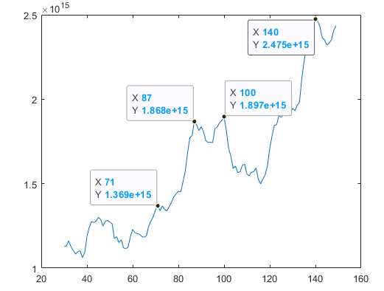
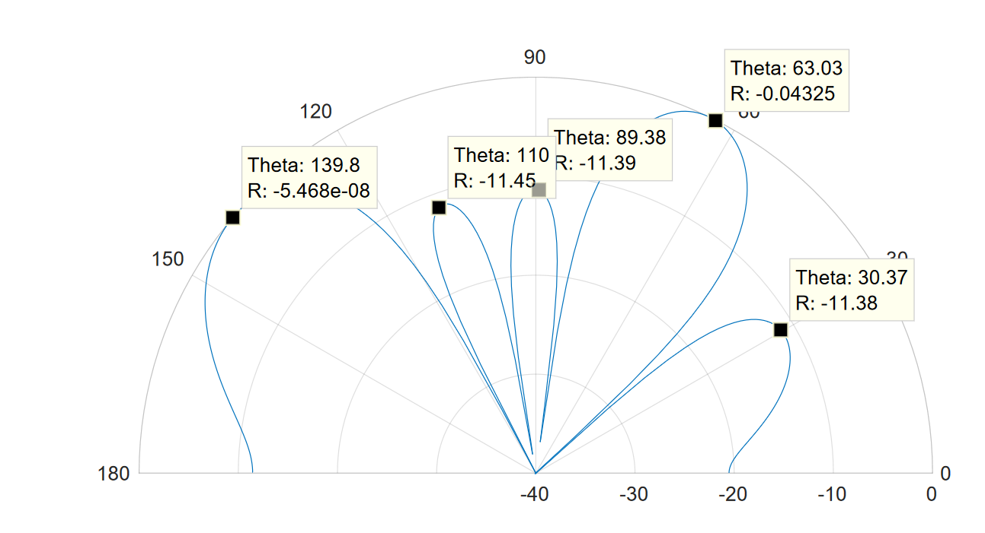
Comparison of energy data obtained (left) and theoretical beamforming calculation (right) at 140 degrees.
Notes:
From the energy data in Matlab we can get the max energy is around at 140 degree, it is same as the direction of the sound source. There are also several small peaks in the figure, their directions are also similar as the the direction of grating lobes because of the spatial aliasing.
in matlab script, swapbytes first and take the signal to sum (10 values from energy per angle) and plot

Slide 31
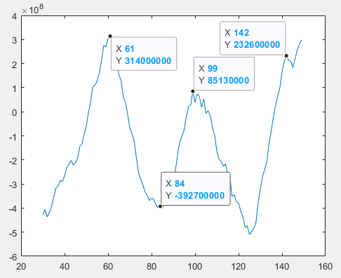
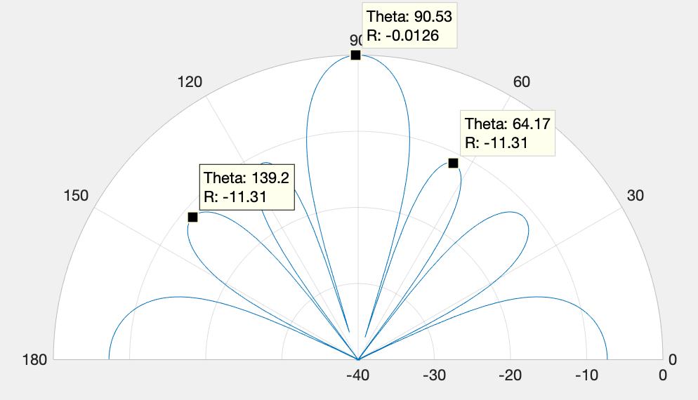
Comparison of energy data obtained (left) and theoretical beamforming calculation (right) at 90 degree.

Slide 32
Conclusions

Slide 33
Summary
Beamforming results align fairly well with expected values, but suffer from unsolved issues, such as negative values..
Not all design specifications were met
  Lack of precision in results (>2°)
  Real-time presentation of data.
Notes:
In summary, the beamforming result aligns relatively closely to the theoretical, expected results, But suffers from several unsolved issues, such as:
negative energy values.
Furthermore, not all the design specifications were met:
the results lack the required precision
and there is currently no real-time representation of data

Slide 34
Negative Values in Result
The system occasionally produces negative energy values, strongly implying wrapping due to insufficient data-widths.
This can probably be solved by tracing data through the design and sizing data-widths after each computation such that overflow cannot occur.
An alternative might be to use Integrated Logic Analyzer (ILA) to directly observe energy values and empirically determine the cause.
Notes:
The negative values after computing energy values strongly imply wrapping behaviour, due to insufficient data-widths.
This may be solved by sizing data-widths at each stage in the design so that no overflow can possibly occur.
An alternative might be to use the Xilinx Integrated Logic Analyzer to directly observe the energy values in operation and determine the cause impirically.

Slide 35
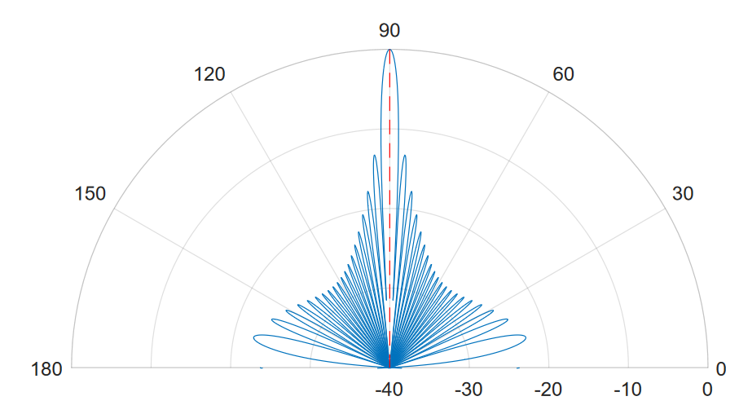
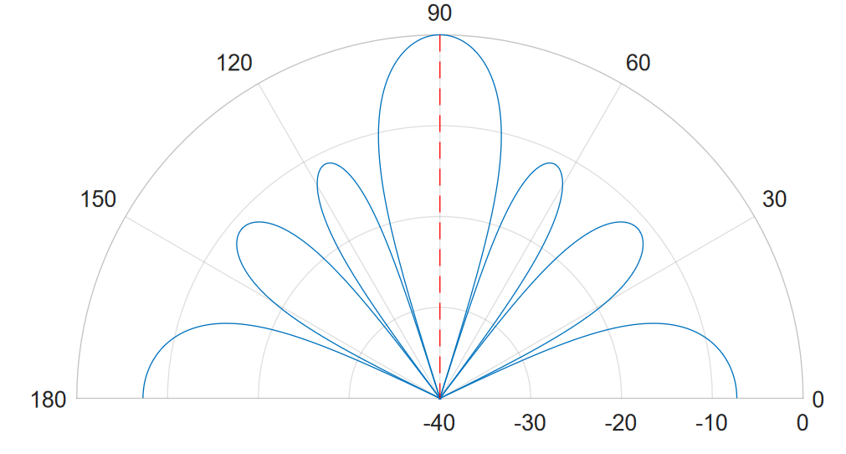
Unmet Specifications
Lack of precision in results.
Real-time presentation of data.
In order to increase beamforming precision, more sensors can be added to the system.
The effect on precision is clearly illustrated by the figures below, using 24 and 4 sensors, respectively.
Notes:
Of the unmet specifiations:
the lack of precision is most easily remedied by simply increasing the number of sensors used.
As illustrated in the theoretical models below, the range of sensitivity decreases with an increase in the number of sensors.

Slide 36
Unmet Specifications
Lack of precision in results.
Real-time presentation of data.
Real-time presentation of data is challenging due to the GRMON interface.
In its current state, an operator must manually use GRMON to read memory contents.
As a partial solution, a script could be written using GRMON to periodically read incrementing blocks of data from the memory.
Notes:
Real-time presentation of data is challenging due to GRMON primarily being a debugging tool.
A partial solution may be to use a script on the remote machine to periodically read incrementing blocks of data via GRMON, and display them in a program such as MATLAB.

Slide 37
Future Work
Notes:
We will now discuss what future work could be carried out to improve the design and meet the target specifications.

Slide 38
Future Work
Extending the system to use 24 sensors.
Correcting internal data-widths so that overflow cannot occur.
Using two sensor arrays to implement 2-dimensional beamforming.
Implementation of continuous data transfer to PC when scanning, to enable real-time presentation of beamformer data.
Notes:
Primarily , the system should be extended to use 24 microphones, in order to increase precision and get less ambiguous results.
Internal data-widths should be carefully dimensioned so that overflow cannot occur.
Two sensor arrays should be interfaced in order to be able to scan in two dimensions.
Some sort of continuous data transfer should be implemented, so that data can be presented in real time.

Slide 39
Ending Notes

Slide 40
Unfortunate Circumstances
The ongoing pandemic* prompted the Swedish government to recommend social distancing and mandate remote education from LP4 onwards.
Since this project was a team effort, with shared physical hardware, the working methodology was adversely affected during the latter half of the project.
*https://en.wikipedia.org/wiki/COVID-19_pandemic

Slide 41
Thank you for listening!

